Slide 1
VAPING: HISTORY, HEALTH, AND HEIGL

Slide 3
You’re not harming anyone around you and you’re not harming yourself.

Slide 4
Are you harming anyone around you and harming yourself?

Slide 5
It’s a battery...and then this is the filter. This has liquid nicotine in it...that it heats up.

Slide 6
INSIDE AN E-CIG
Image adapted from Utah Public Radio.

Slide 7
MANY KINDS OF E-CIGS
Image adapted from Grana et al., Circulation, 2014.

Slide 8
They have cigar-flavored ones.

Slide 9
KID-FRIENDLY FLAVORS
Coffee
Candy
Cola
Fruit
Belgian waffle
Notes:
Flavors include normal tobacco and menthol
Flavored tobacco products used disproportionately by youth and initiators (Grana 2014)
U.S. bans regular cigarettes with flavors other than menthol (Grana 2014)

Slide 10
SAFE TO EAT, SAFE TO INHALE?
FDA regulates food additives based on:
Historical use
Carcinogenicity
Oral toxicity in animals
Worst Case: microwave popcorn butter flavoring diacetyl
Safe to eat, dangerous to lungs
Notes:
Diacetyl is GRAS.
Mechanism – may alter how ions are transported across cells in lungs.

Slide 11
How long have they been on the market?

Slide 12
A QUICK HISTORY OF E-CIGS
FDA proposes expanding its authority to e-cigs
Patented in China
Heigl interview
Early 2000’s 2003 2005 2008 2010 2011 2012 2013 2014
Exported to U.S.
King County BOH passes e-cig regulations
Invented by Chinese pharmacist Hon Lik

Slide 13
A QUICK HISTORY OF E-CIGS
215 calls/month to Poison Control
1 call/month to Poison Control
Early 2000’s 2003 2005 2008 2010 2011 2012 2013 2014
First e-cig adverse event reported to FDA
Tried by 3.3% youth
Tried by 6.8% youth

Slide 14
You’re going to get me in trouble!

Slide 15
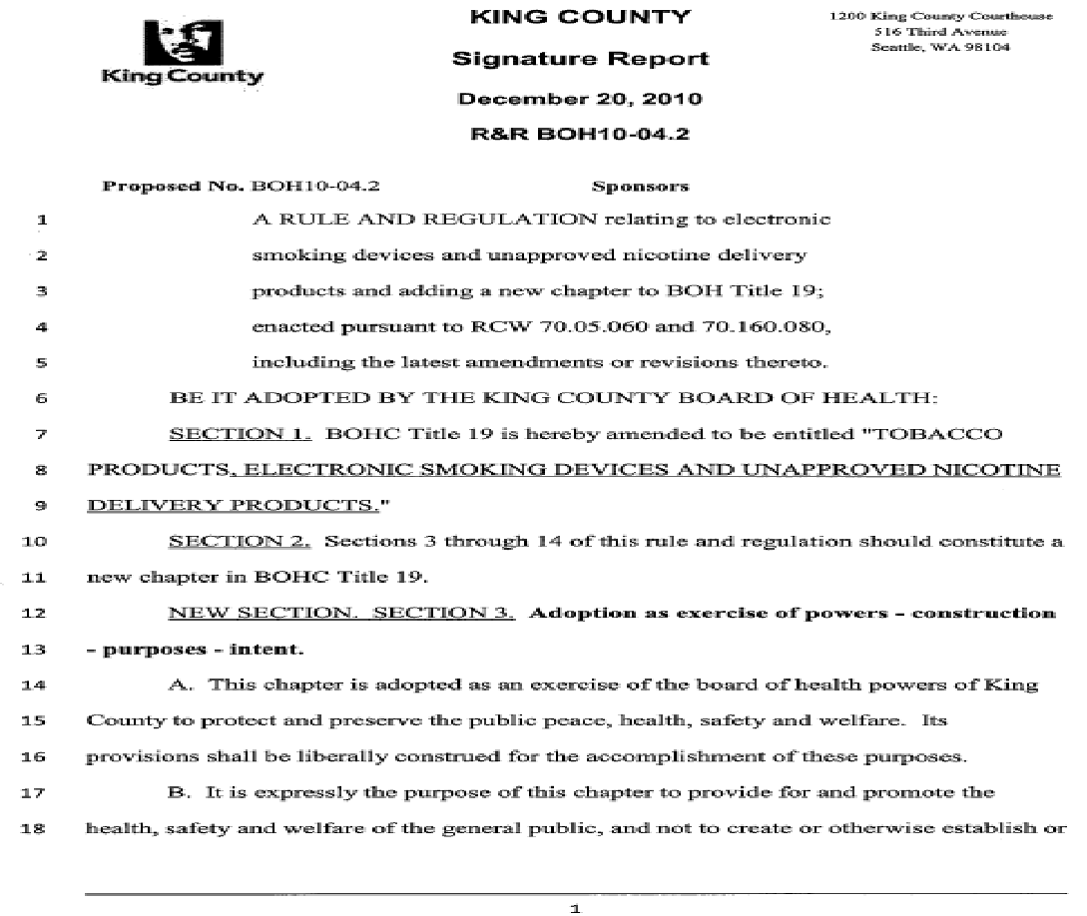
CURRENT LAWS
Prohibits selling e-cigs to minors (same as WA law RCW 26.28.080)
Prohibits offering free/nominal-cost e-cigs
Prohibits e-cig use in same areas where smoking prohibited by law
Image adapted from King County Board of Health Regulation #10-04.
Notes:
King County Board of Health Regulation #10-04

Slide 16
Will it make you dizzy when you take a hit of nicotine?

Slide 17
WHEN YOU TAKE A HIT, YOU MIGHT EXPERIENCE...
Throat & mouth irritation
Cough
Airway constriction
Nausea
Notes:
Throat and mouth irritation, cough, constriction – from propylene glycol, glycerol; nonspecific response to aerosol and PM
Nausea – nicotine
People with asthma or other lung problems especially vulnerable

Slide 18
KIDS WITH ASTHMA ARE MORE VULNERABLE
Asthma more common among:
Kids
Boys
Adult women
African-Americans
American Indians
People with low income
Graph from Centers for Disease Control – Asthma Surveillance Data.

Slide 19
It’s water vapor.

Slide 20
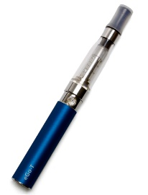
IT’S NOT JUST WATER VAPOR
Notes:
1- to 2-fold less toxicants.
10x less nicotine than smoking.

Slide 21
IT’S FULL OF PARTICULATE MATTER (PM)
E-cig PM contains:
Tin
Chromium
Nickel
...and more TBD
E-cig PM increases with:
Nicotine content
Longer puffs
Images from (left) How Stuff Works.
Notes:
Particle pollution – solid matter and liquid droplets suspended in air
PM2.5: ~20 equal diameter of one human hair
PM does not change depending on flavorings
PM – primary PM (directly from source), and secondary PM (primary reacting with other things) – most PM is secondary

Slide 22
PARTICULATE MATTER IS DANGEROUS TO LUNGS & HEARTS
About 9 – 18% of e-cig PM reaches alveoli and blood circulation
Exposure to PM associated with:
Breathing problems
Worsened asthma
Less lung growth in kids
Lung cancer
Coronary artery disease
Image from Alberni-Clayoquot Regional District – Particulate Matter.
Notes:
Secondhand PM comparable between vapers and smokers
Health effects: premature death in people with heart and lung disease; heart attacks; aggravated asthma; decreased lung function; lung irritation and respiratory symptoms

Slide 23
[Nicotine’s] about as bad for you as a cup of coffee.

Slide 24
NICOTINE IS A PESTICIDE
Nicotine from tobacco plants (Nicotiana tabacum, Nicotiana rustica)
Tobacco extracts used as insecticides since 1690
Poisons insect central nervous system
Limited modern use
Popular in U.S. from 1940s through 1990s
Ornamental greenhouse use only nowadays

Slide 25
NICOTINE IS A DRUG
Quickly enters the brain:
Stimulates nicotinic receptors (youth have more receptors)
Releases dopamine
Causes stimulation and pleasure
Reduces stress and anxiety
Changes the brain:
Receptors become less sensitive to nicotine
Leads to withdrawal if stopped
Reduces dopamine release
Reduces pleasure from normal life
Increases stress and anxiety
Increases hunger
Causes insomnia
Image from University of Arizona Dean Carter Binational Center – Toxicology Background.
Notes:
Anxiety from release of corticotropin-releasing factor, which stimulates other nicotinic receptors. CRF also released during withdrawal from alcohol, cocaine, etc. (Benowitz 2009)

Slide 26
NICOTINE IS TOXIC
Acute toxicity (poisoning): 30 – 60 mg for adults, 10 mg for kids
First Stage – Excitation: Nausea, rapid heart rate, sweating
Second Stage – Depression: Slowed heart rate, low blood pressure, confusion, lethargy, coma, death from respiratory paralysis
Chronic toxicity (smoking, vaping, snuff, etc.):
Constricts blood vessels – poor wound healing
Reduces insulin sensitivity – may aggravate diabetes
May promote tumor growth and spread
May damage fetal brains
May cause pre-eclampsia in pregnant women
Notes:
Releases catecholamines

Slide 27
You have no excuse now to smoke a real cigarette.

Slide 28
MOST VAPING KIDS DON’T NEED AN EXCUSE
Middle School
High School
61% dual-use
80% dual-use

Slide 29
VAPING DOESN’T HELP QUITTING
Vapers do smoke less, but:
Cardiovascular disease risk increases with even 1 cigarette/day
Lung cancer risk associated with duration, not intensity, of smoking
Vapers do not quit more
Less likely to quit smoking than non-vapers after 7 months
Same odds for quitting as smokers after 12 months
Image from Vape Sensation.

Slide 30
Are you harming anyone around you and harming yourself?

Slide 31
ARE YOU HARMING YOURSELF AND OTHERS?
You
Everyone Else
Breathing in toxic nicotine
Having breathing problems
Still smoking
Still at risk for lung cancer and heart disease
At risk for being poisoned by e-liquids
Breathing in toxic particulate matter

Slide 32
REFERENCES & RESOURCES
Food additives:
FDA. Food Additives & Ingredients. Last updated March 27, 2013. <http://www.fda.gov/Food/IngredientsPackagingLabeling/FoodAdditivesIngredients/default.htm>
Grana R, Benowitz N, Glantz S. E-Cigarettes: A Scientific Review. Circulation. 2014;129(19):1972-1986.
CDC. Flavorings-Related Lung Disease. Last updated August 11, 2011. <http://www.cdc.gov/niosh/topics/flavorings/>
History of e-cigarettes:
FDA. Electronic Cigarettes. Last updated April 24, 2014. <http://www.fda.gov/NewsEvents/PublicHealthFocus/ucm172906.htm>
King County Board of Health. Regulation #10-04, relating to electronic smoking devices. December 20, 2014. <http://www.kingcounty.gov/healthservices/health/BOH/regulations/2010.aspx>
Grana R, Benowitz N, Glantz S. E-Cigarettes: A Scientific Review. Circulation. 2014;129(19):1972-1986.
CDC. New CDC study finds dramatic increase in e-cigarette-related calls to poison centers. April 3, 2014. <http://www.cdc.gov/media/releases/2014/p0403-e-cigarette-poison.html>
NPR. E-Cigarettes: The New Frontier in War on Smoking. August 5, 2009. <http://www.npr.org/templates/story/story.php?storyId=111578997>

Slide 33
REFERENCES & RESOURCES
E-cigarette laws and regulations:
King County Board of Health. Regulation #10-04, relating to electronic smoking devices. December 20, 2014. <http://www.kingcounty.gov/healthservices/health/BOH/regulations/2010.aspx>
FDA. Electronic Cigarettes. Last updated April 24, 2014. <http://www.fda.gov/NewsEvents/PublicHealthFocus/ucm172906.htm>
Washington State Department of Health. Electronic Cigarettes. <http://www.doh.wa.gov/YouandYourFamily/Tobacco/OtherTobaccoProducts/ECigarettes.aspx>
E-cigarettes, breathing problems, and asthma:
Durmowicz E. The impact of electronic cigarettes on the paediatric population. Tob Control. 2014;23:ii41-ii56.
Grana R, Benowitz N, Glantz S. E-Cigarettes: A Scientific Review. Circulation. 2014;129(19):1972-1986.
CDC. Asthma Surveillance Data. Last updated March 11, 2014. <http://www.cdc.gov/asthma/asthmadata.htm>
CDC. Asthma’s Impact on the Nation. <http://www.cdc.gov/asthma/impacts_nation/asthmafactsheet.pdf>

Slide 34
REFERENCES & RESOURCES
E-cigarette secondhand vapor and particulate matter:
Grana R, Benowitz N, Glantz S. E-Cigarettes: A Scientific Review. Circulation. 2014;129(19):1972-1986.
Goniewicz M, Knysak J, Gawron M, et al. Levels of selected carcinogens and toxicants in vapour from electronic cigarettes. Tob Control. 2014;23:133-139.
Czogala J, Goniewicz M, Fidelus B, et al. Secondhand exposure to vapors from electronic cigarettes. Nicotine Tob Res. 2014;6:655-662.
Schober W, Szendrei K, Matzen W, et al. Use of electronic cigarettes (e-cigarettes) impairs indoor air quality and increases FeNO levels of e-cigarette consumers. Int J Hygiene Env Health. 2013.
CDC. Particle Pollution. Last updated April 1, 2014. <http://www.cdc.gov/air/particulate_matter.html>
EPA. Particulate Matter: Basic Information. Last updated March 18, 2013. <http://www.epa.gov/oar/particlepollution/basic.html>

Slide 35
REFERENCES & RESOURCES
Nicotine:
Grana R, Benowitz N, Glantz S. E-Cigarettes: A Scientific Review. Circulation. 2014;129(19):1972-1986.
Durmowicz E. The impact of electronic cigarettes on the paediatric population. Tob Control. 2014;23:ii41-ii56.
Callahan-Lyon P. Electronic cigarettes: human health effects. Tob Control. 2014;23:ii36-ii40.
Placzek A, Zhang T, Dani J. Age dependent nicotinic influences over dopamine neuron synaptic plasticity. Biochem Pharmacol. 2009;78:686-692.
Torres O, Tejeda H, Nativad L, O’Dell L. Enhanced vulnerability to the rewarding effects of nicotine during the adolescent period of development. Pharmacol Biochem Behav. 2008;90:659-663.
Benowitz N. Pharmacology of nicotine: addiction, smoking-induced disease, and therapeutics. Annu Rev Pharmacol Toxicol. 2009;49:57-71.
Toxic Effects of Pesticides. In Casarett & Doull’s Toxicology.
EPA. Reregistration eligibility decision for nicotine. March 2008. <http://www.epa.gov/oppsrrd1/REDs/nicotine_red.pdf>

Slide 36
REFERENCES & RESOURCES
Vaping and smoking cessation:
Grana R, Benowitz N, Glantz S. E-Cigarettes: A Scientific Review. Circulation. 2014;129(19):1972-1986.
Flanders W, Lally C, Zhu B, et al. Lung cancer mortality in relation to age, duration of smoking, and daily cigarette consumption: results from Cancer Prevention Study II. Cancer Res. 2003;63:6556-6562.

