Slide 1
National Trends, Marketing Campaigns, and Peers
MARKETING EXECUTIVE?
Created By:
Marie Leake, M.A.T.

Slide 2
Notes:
https://www.youtube.com/watch?v=OV-sWkKANwY&t=2s
Vape Rap

Slide 3
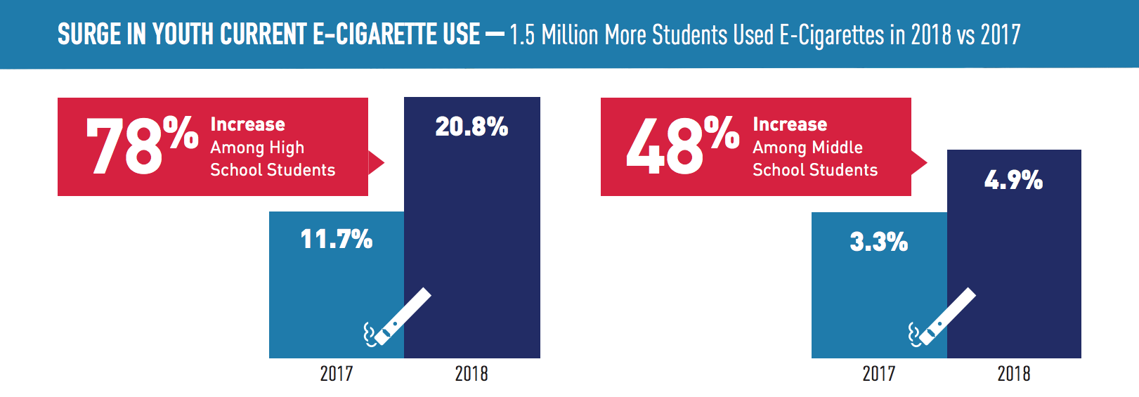
In just one year, high school student e-cigarette usage increased by 78%. This is a nationwide epidemic.
Youth Tobacco Use: Results from the National Youth Tobacco Survey. (2018, November). Retrieved March 13, 2019, from https://www.fda.gov/TobaccoProducts/PublicHealthEducation/ProtectingKidsfromTobacco/ucm405173.htm#2018data

Slide 4
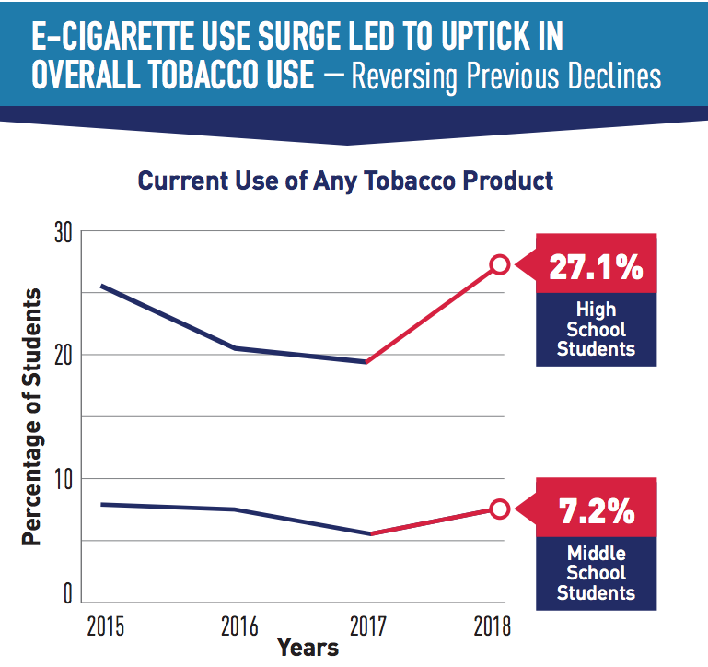
Increase of Overall Tobacco Use of the Youth
High School:
2018: 27.1%
2017: 19.5%
Middle School:
2018: 7.2%
2017: 5.7%
Youth Tobacco Use: Results from the National Youth Tobacco Survey. (2018, November). Retrieved March 13, 2019, from https://www.fda.gov/TobaccoProducts/PublicHealthEducation/ProtectingKidsfromTobacco/ucm405173.htm#2018data

Slide 5
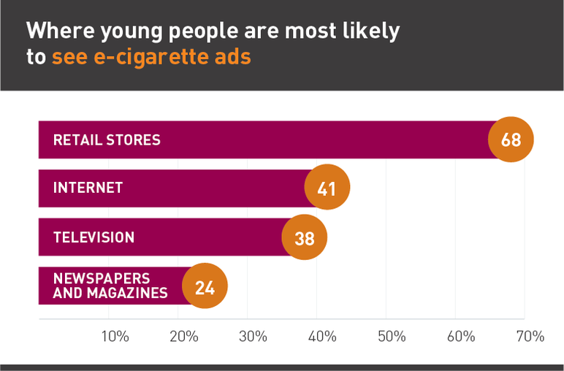
The Media
There are very few marketing restrictions for e-cigarettes, .
Unlike traditional cigarettes, e-cigarettes can be advertised on television and radio. All other tobacco products cannot.
Truth Initiative. (2018, July 19). E-cigarettes: Facts, stats and regulations. Retrieved March 13, 2019, from https://truthinitiative.org/news/e-cigarettes-facts-stats-and-regulations

Slide 6
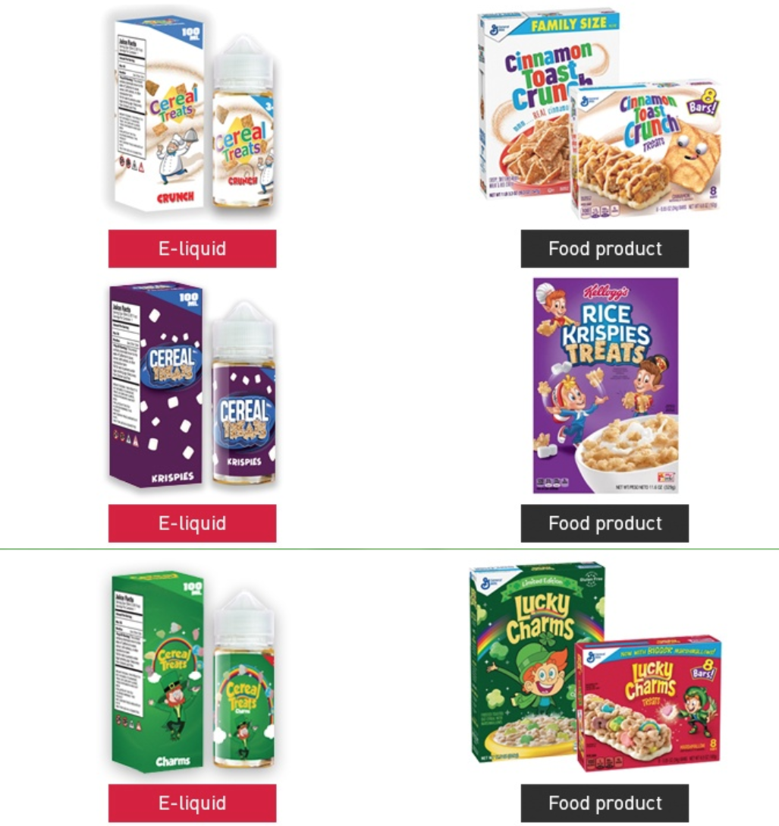
The Packaging
In 2018, the FDA made it illegal for companies to label nicotine products to look like kid-friendly food products.

Slide 7
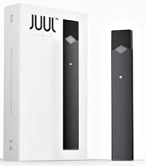
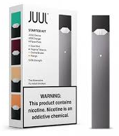
New Packaging Requirements
Before:
All tobacco products are now required to have a nicotine warning label, including e-cigarettes.
The warning label must comprise at least 30% of the two largest display panels and be in a big, legible font.
After:
Truth Initiative. (2018, July 19). E-cigarettes: Facts, stats and regulations. Retrieved March 13, 2019, from https://truthinitiative.org/news/e-cigarettes-facts-stats-and-regulations

Slide 8
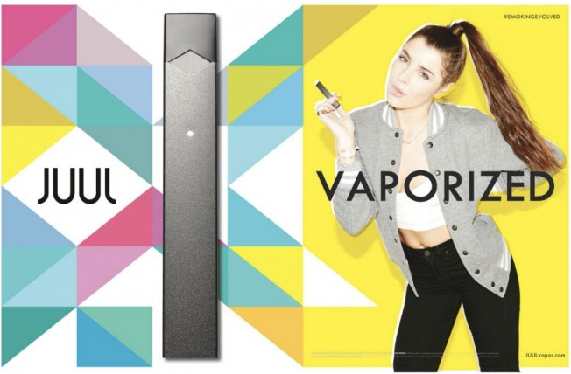
Social Media Campaigns
Most recently, e-cigarette brands, like JUUL, have used social media to market and promote their products.
For its launch in 2015, JUUL spent more than $1 million to market the product on the internet.
Truth Initiative. (2018, July 19). E-cigarettes: Facts, stats and regulations. Retrieved March 13, 2019, from https://truthinitiative.org/news/e-cigarettes-facts-stats-and-regulations

Slide 9
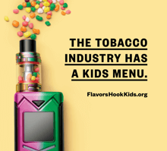
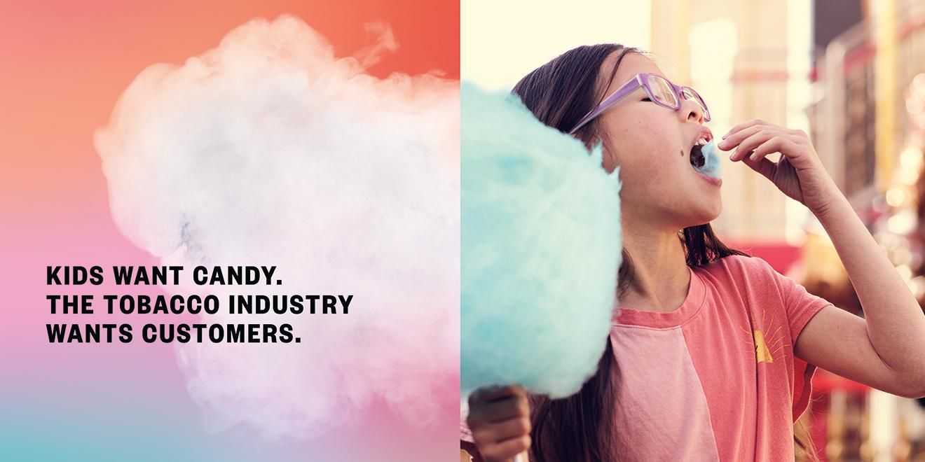

Slide 10
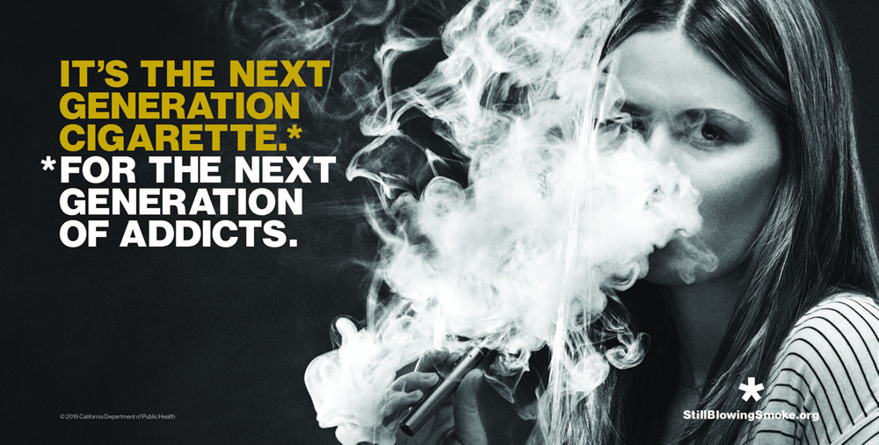
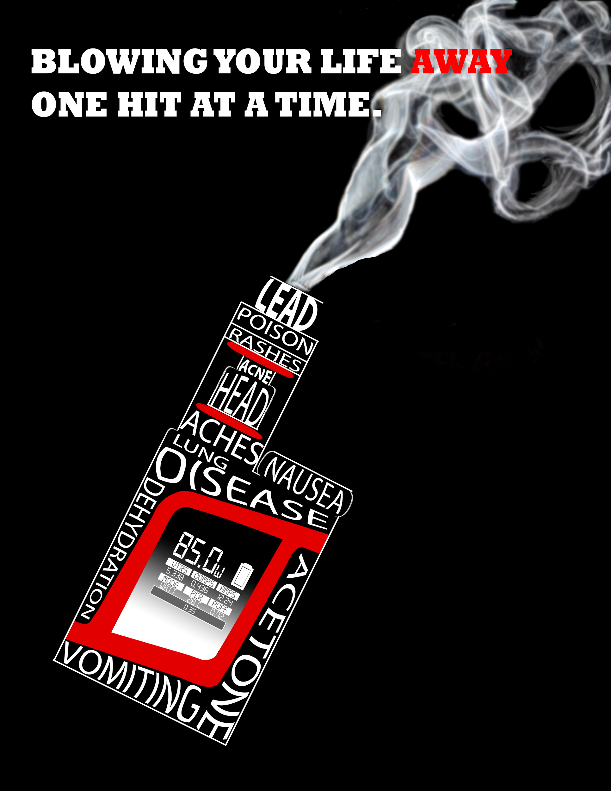

Slide 12
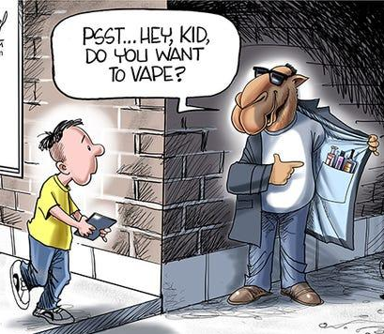
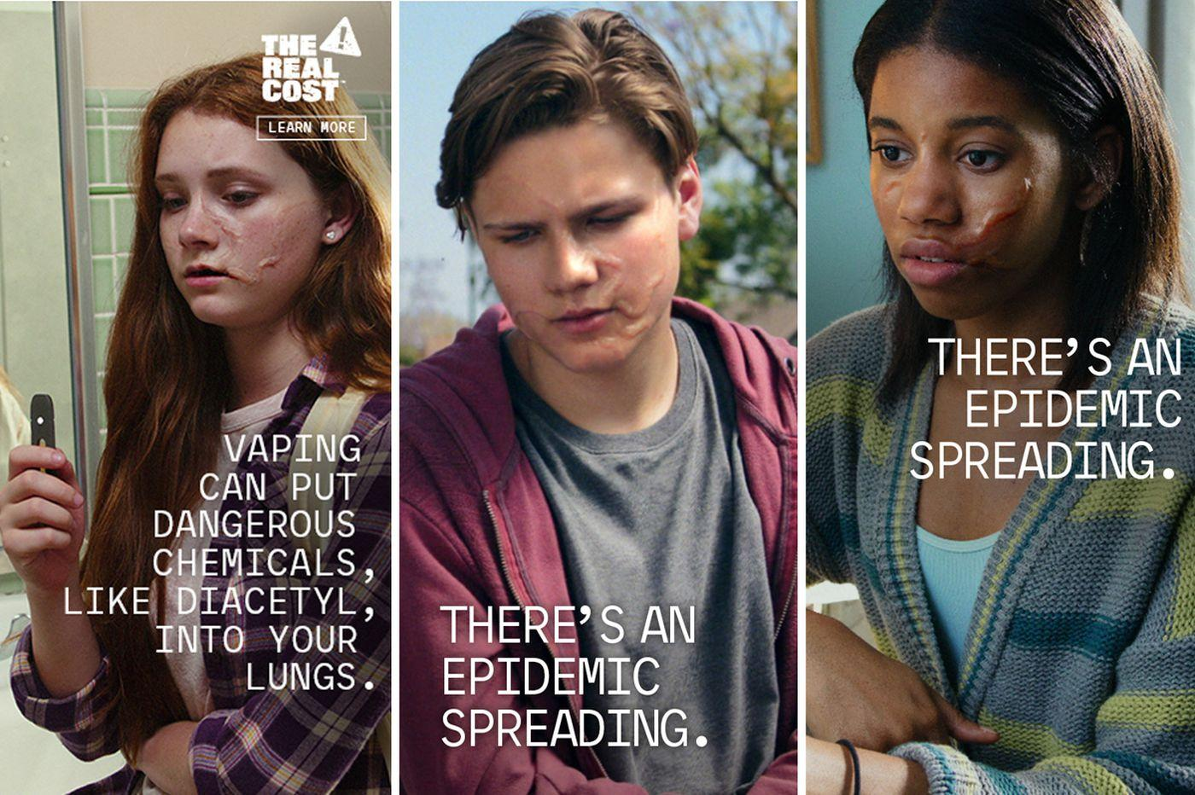

Slide 13
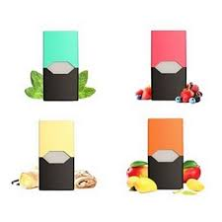
Top Three Reasons
Teens Use E-Cigarettes:
Because a friend or family member used them (39%)
The availability of flavors, such as mint, candy, fruit or chocolate (31%)
The false belief that e-cigarettes are less harmful than other forms of tobacco, such as cigarettes (17.1%)

Slide 14
MARKETING EXECUTIVE?
Created By:
Marie Leake, M.A.T.

