Slide 1
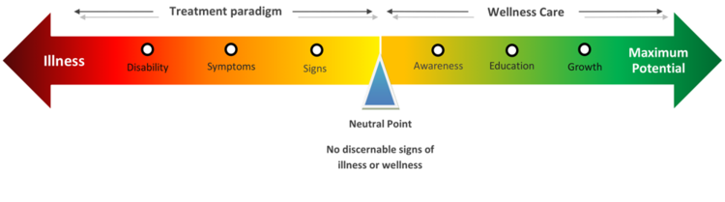
My Health Continuum
Applying the health Continuum to my life's choices.

Slide 2
Directions
Copy the template slide below and make it your own by placing your name as the title. (Use your favorite font and colors)
Insert your favorite picture of you.
Discuss risk factors with your parents (particularly hereditary risk factors).
Possible guiding questions; What are your hobbies? What sports do you play? What types of music do you listen to? What movies do you like? Which TV shows do you love to watch? what excites you?

Slide 3
Paste your favorite picture here.
My Health Continuum
Potentially Fatal - Unhealthy - Healthy - Very Healthy
heredity
environmental
behavioral
Risk Factors

Slide 4





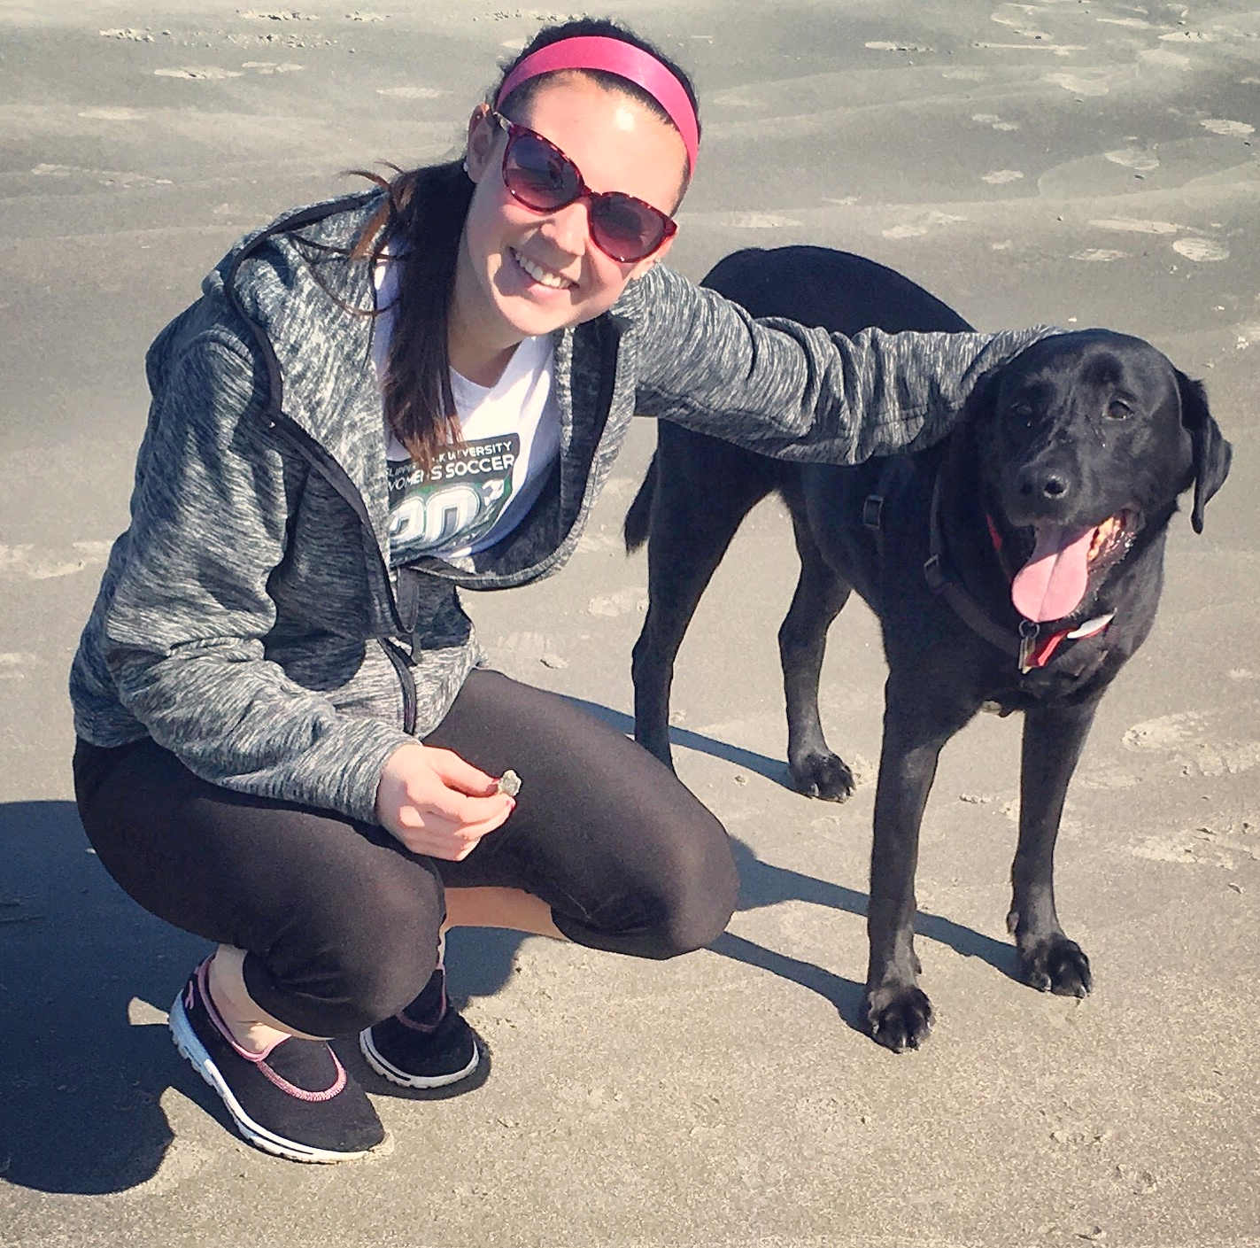


My Health Continuum
Potentially Fatal - Unhealthy - Healthy - Very Healthy
Lack of Stress management,
leading to over thinking
causing me to be mind full instead of mindful
prompting chocolate overload
Wellness through family, friends, and exercise.
Soccer, SUP, Kayaking, walking my dog, and more!
Heredity: Type 2 Diabetes
Environmental: Allergies (Plant Pollens, Mold, dust mites..)
Behavioral: Stress, Over thinking, chocolate
Risk Factors

Slide 5
