Slide 1

Top Chef for a Day
BY:

Slide 2
Menu
Protein-Fresh pink salmon sautéed at 275 degrees Fahrenheit.
  Grain- 1 serving of whole grain dipping chips and whole grain pasta boiled until soft
  Vegetables- 4 ripe avocados, half tomato and onion cut up in small pieces, quarter of a jalapeño pepper cut up, cilantro, and a tablespoon of salt
  Fruit- 1 cup of fresh blueberries, strawberries, and blackberries cut up and mixed
Dairy- 1 glass of skim milk

Slide 3
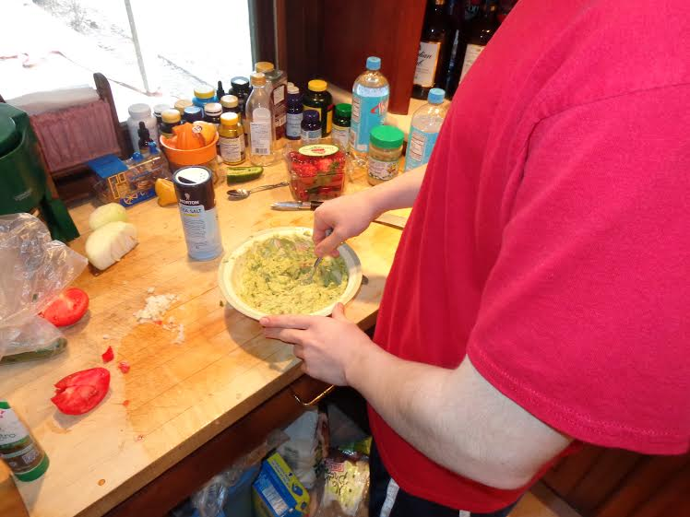
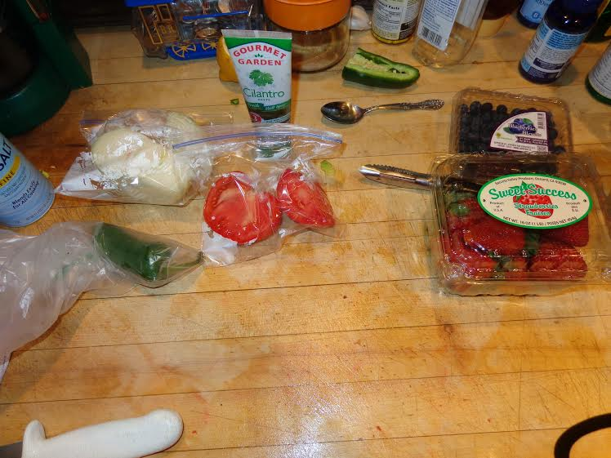
Ingredients and Cooking in Action

Slide 4
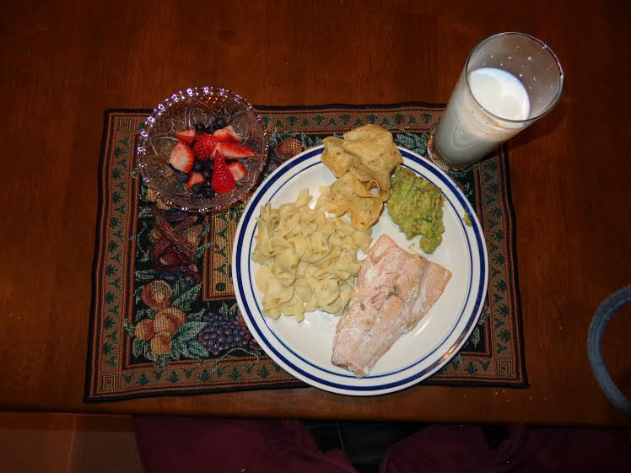
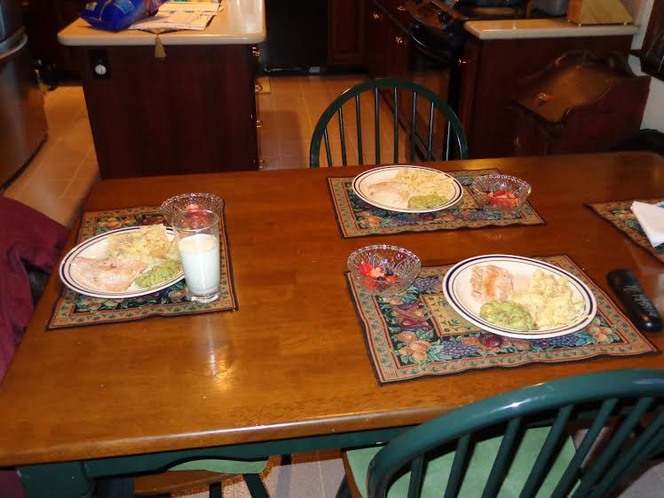
Finished and Served to Family

Slide 5
Reflection
      My meal had many successes along with struggles. Some of the successes included making the guacamole, mixed berries, and pouring a glass of milk. I’m very careful when it comes to cutting things up because I hate cutting my hands. One of my struggles I had was making the salmon. The first time I made it, it turned out black, which nobody was going to eat. The next time I did it I was afraid I was going to leave it on to long so it came out raw. But third time’s a charm. It came out perfect. After making it all and serving it to my family, they all liked it. The only thing that they weren’t a big fan of was the skim milk which I’m not a big fan of either. All of the salmon, pasta, guacamole, and berries were gone by the end of the meal. Although I don’t see myself as being a chef, I do see myself cooking this meal for my family again sometime. Now that the first time making it is over, I think it will be easier to be done the next time I do it because I know everything that I need to do to make it taste good. Making this meal helped me learn how to make healthy food for my family and eventually when I need to cook healthy for myself, I will be able to use the experience that I have and will gain to do so.

