Slide 1

Heroes
Who is your hero?

Slide 2
Heroes
What are some traits of a hero?
Notes:
After Ss brainstorm some traits of a hero, give them a copy of

Slide 3
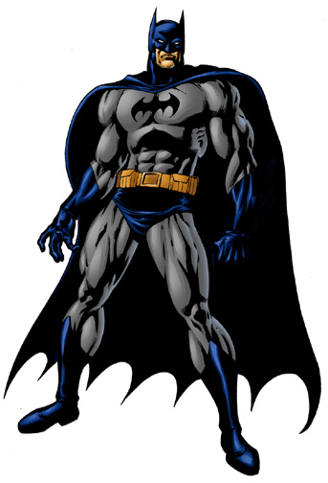
Heroes
Notes:
Superheroes as heroes

Slide 4
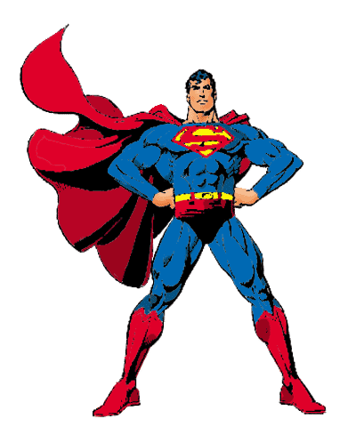
Heroes
Notes:
Superheroes as heroes

Slide 5
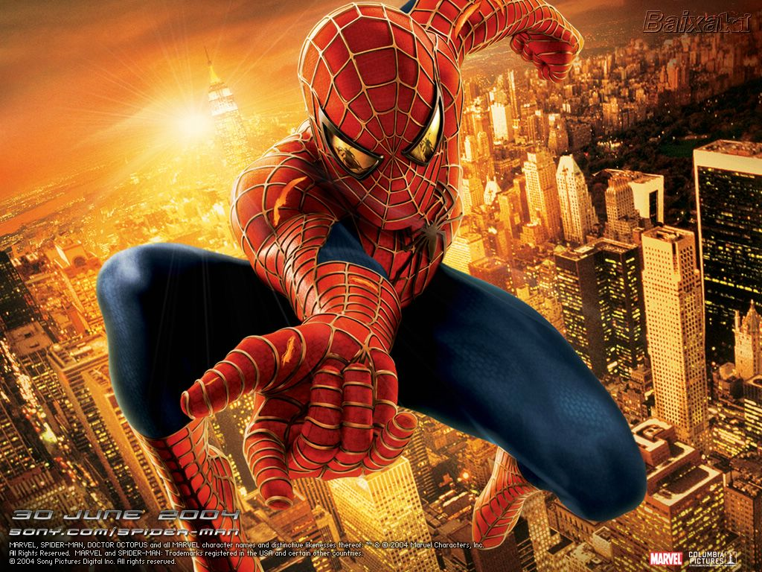
Heroes
Notes:
Superheroes as heroes

Slide 6
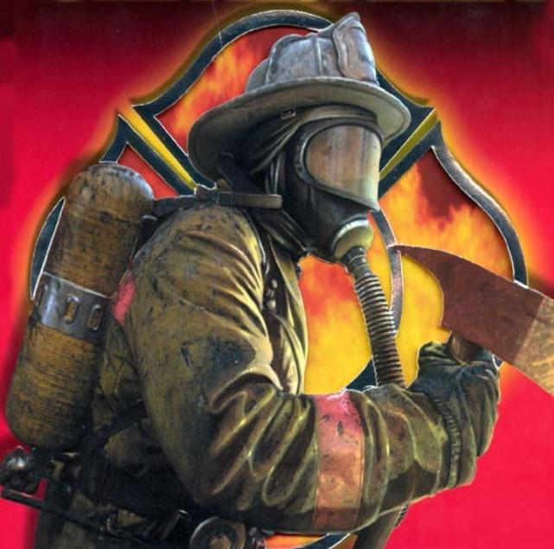
Heroes
Notes:
Public safety workers as heroes?

Slide 7
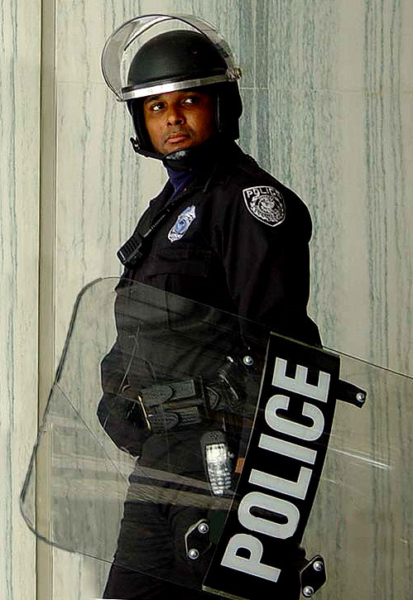
Heroes
Notes:
Public safety workers as heroes?

Slide 8
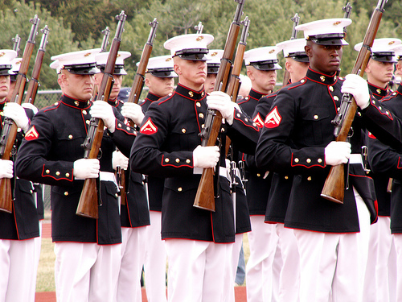
Heroes
Notes:
Military as heroes?

Slide 9
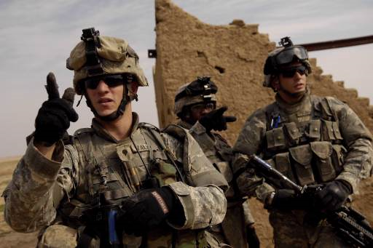
Heroes
Notes:
Military as heroes?

Slide 10
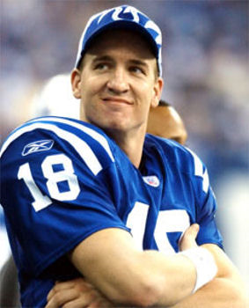
Heroes
Notes:
Athletes as heroes?

Slide 11
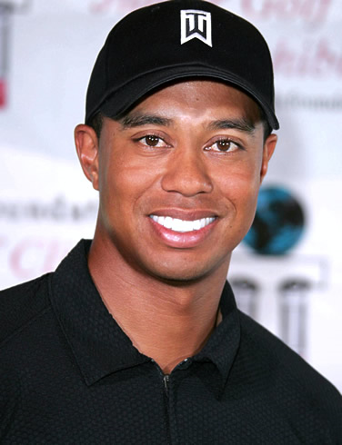
Heroes
Notes:
What happens when the hero falls from grace?

Slide 12
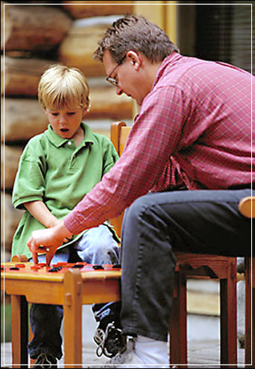
Heroes
Notes:
Parents as heroes?

Slide 13
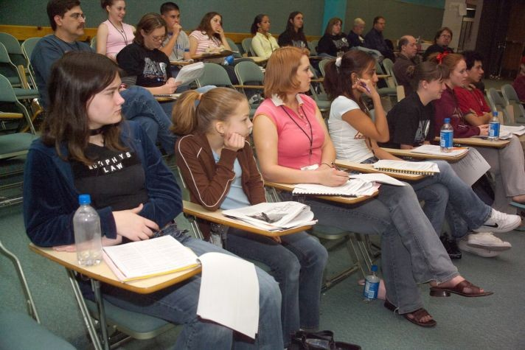
Heroes
Notes:
Students as heroes?

Slide 14
Heroes
Hero (noun)
a : a mythological or legendary figure often of divine descent endowed with great strength or ability b : an illustrious warrior c : a man admired for his achievements and noble qualities d : one that shows great courage

Slide 15
Heroes
Heroes come in all shapes and sizes
If you look in the mirror, heroes look a lot like you
What makes you a hero?

Slide 16

Heroes – One Question to Ask Yourself

