Slide 1
Healthy Day: the teenage Way

Slide 2
Directions for the Lesson

Slide 3
How did this happen?

Slide 4
King Curtis & His Bacon Meltdown:

Slide 5
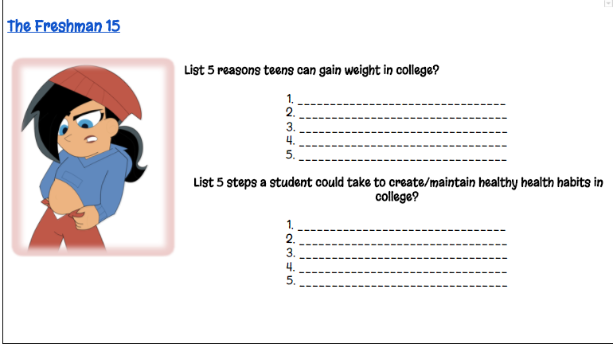
Freshman 15

Slide 6
Coming to America: Eddy’s Story

Slide 7
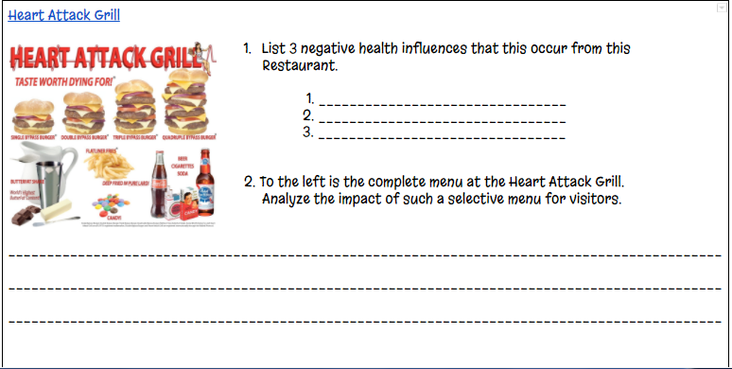
Heart Attack Grill

Slide 9
