Slide 1
Sleep & Teens
“Without sleep there is low energy and disease
and with sleep there is energy and health”
Matthew Walker, Sleep Expert

Slide 2
Bell Ringer - Answer these questions as you come in
How many hours of sleep did you get last night?
How many hours of sleep do you typically get on a school night? Weekend night?
What do you typically do the 30-60 minutes before going to bed? (aka: your bedtime routine)
Do you consume caffeine? (coffee, tea, soda, chocolate, energy drinks, etc.) If so, what time during the day and how much?
Do you find that you find that when your head hits the pillow your mind often starts “worrying” about things?
What is ONE thing you can do tonight to get more sleep or improve the quality of your sleep?

Slide 3
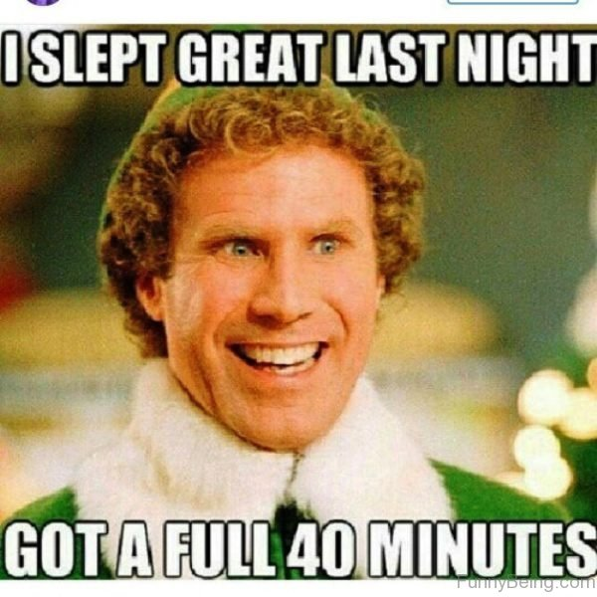

Slide 4
Without talking, please stand in order based on how many hours of
sleep you got last night
Least Most
Round to the nearest hour

Slide 5
Raise your hand if this is a typical night for you during the week?

Slide 6
How do you physically feel when you don’t get enough sleep?

Slide 7
How do you mentally or emotionally feel when you don’t get enough sleep?

Slide 8
For those of you under 7 hours, tell us some reasons why?

Slide 9
For those of you 8 hours or over, tell us how you do it?

Slide 10
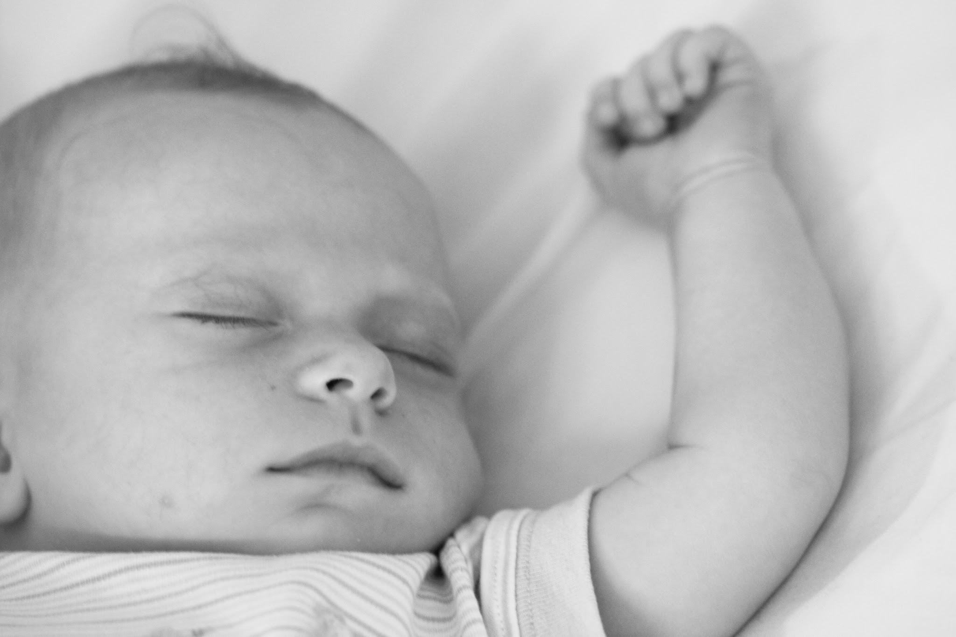
Sleep for infants is non-negotiable,
so why is it not for teens?

Slide 11
What percent of students in the state of Virginia do you think get less than 8 hours of sleep?

Slide 12
72%

Slide 13
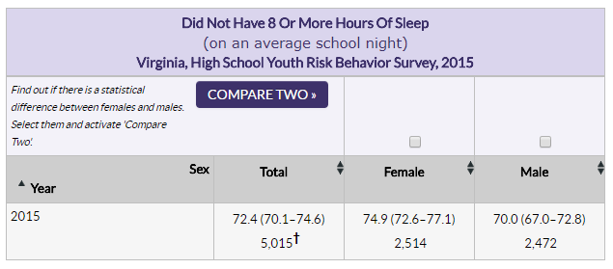
Virginia YRBS Data 2015

Slide 14
Sleep
Myth or Fact

Slide 15
It is ok if teens only get 7 hours of sleep each night.

Slide 16
MYTH

Slide 17
Your genetic code determines whether you are a morning person or a night owl

Slide 18
FACT

Slide 19
The shorter you sleep, the shorter your life
Notes:
Lack of sleep is a major predictor of “all cause mortality” including cancer, alzheimers, heart disease, stroke, diabetes, depression, and suicide.

Slide 20
FACT

Slide 21
Less sleep equals more productivity

Slide 22
MYTH

Slide 23
Deep REM sleep is proven to enhance my problem-solving ability

Slide 24
FACT

Slide 25
If you are tired, consuming caffeine after lunch time likely will not interfere with one’s sleep at night

Slide 26
MYTH

Slide 27
It is recommended to not do homework in bed

Slide 28
FACT
Notes:
Your brain should only associate your bed for sleeping, nothing else.

Slide 29
If I am tired, taking a nap is always beneficial for me.

Slide 30
MYTH

Slide 31
It is a good idea to pull an “all-nighter” if you are not ready for your test the next day

Slide 32
MYTH

Slide 33

The “All-Nighter”
A Good Idea?
No!
Impacts hippocampus
40% reduction in memory
The difference between
An “A” and an “F”

Slide 34
It is a good idea to sleep in later on the weekends to catch up for lost sleep during the week.

Slide 35
MYTH

Slide 36
“Sleep Bulimia”
Binge sleep on the weekends (sleep a lot)
And purge on the weekdays (sleep less)

Slide 37

There is no banking or credit system for sleep
You cannot
bank sleep
Or sleep off
a debt

Slide 38
After 16 plus hours of being awake, my body responds similarly to being “legally drunk”

Slide 39
FACT

Slide 40
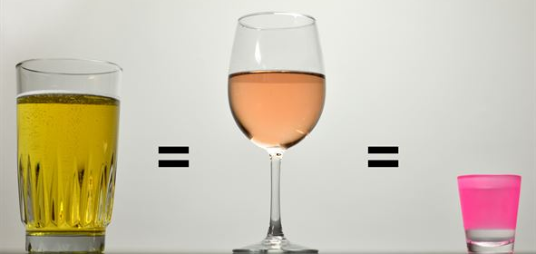
Being awake 16-20 hours is
similar to being intoxicated (.08 BAC)

Slide 41
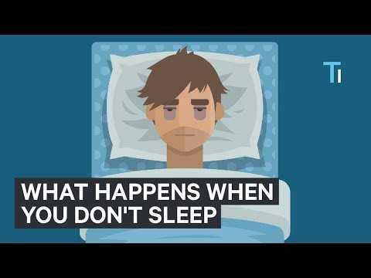
What Happens to Your Body & Brain if You Don’t Get Sleep

Slide 42
Why do we need Deep Sleep?
Clears out waste - Sewage network clears out beta amyloid, then refreshed
Learning & Memory - prevents you from forgetting, cleans out short-term memory
Emotions get reset
Regulates pre-frontal cortex...not enough sleep, you are more emotional and less rational
Notes:
This applies to Deep Non-REM sleep

Slide 43
Why do we need Deep Sleep?
Best form of blood pressure medication
Regulates metabolic levels (i.e. blood glucose)...those who got one week of 5-6 hours of sleep show pre-diabetic state
Crucial for reproductive health
Stimulates Human-Growth Hormone
Regulates appetite and weight...food consumption (imbalance in lecithin and ghrelin “Hunger Hormones”
Immune system - clear link to cancer...200-300% more likely to get a cold than people who get 8 hours
Notes:
This applies to Deep Non-REM sleep

Slide 44
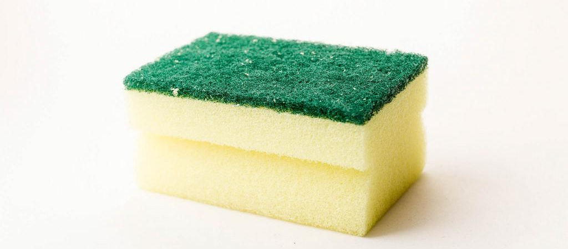
Learning and Memory - Why should you care?
When you get enough sleep your brain is like a dry sponge ready to soak up new information
Sleep is critical to be ready to learn BEFORE learning

Slide 45

Learning and Memory - Why should you care?
Sleep is critical AFTER learning
It’s like “hitting the save button” - creates connections
Replays info learned while sleeping (10-20x faster)
Strengthens neural circuits
Imprints the memory (transfers to Cortex of brain)

Slide 46

Learning and Memory - Why should you care?
Sleep interconnects NEW and OLD memories
Information collides
Updates your neural network
Key to PROBLEM-SOLVING
Notes:
This is specific to Deep REM sleep

Slide 47
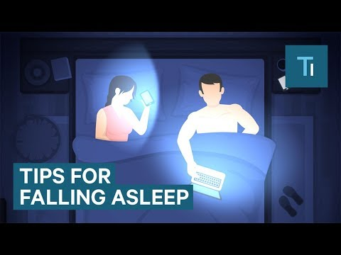
5 Tips for Falling Asleep Quicker

Slide 48
Strategies for Better Sleeping
Must carve out 8 Hours. Period. This is Non-Negotiable
2. Regularity - Go to bed and wake up at the same time
3. Keep it cool - body needs to drop about 2 degrees before it sleeps. 68 degrees is pretty ideal. Hot baths help
4. Darkness - Must have to release melatonin. Think about lights in room and lights from screen.
5. Do not stay in bed if awake for more than 20 mins
6. No caffeine in the afternoon. Avoid alcohol in evening. Depth of sleep is significantly affected
Notes:
This applies to Deep Non-REM sleep

Slide 49
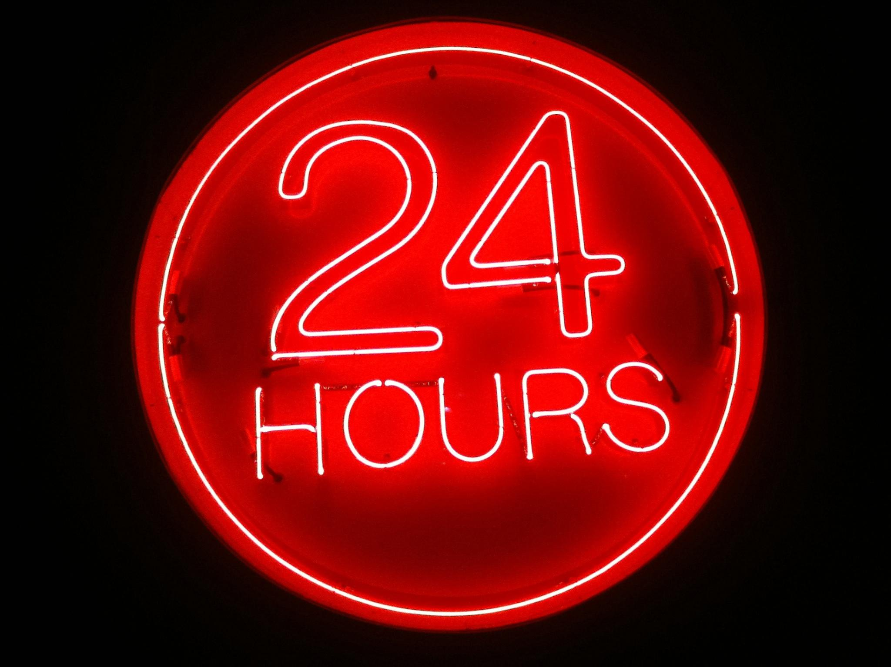
How can you make
8 hours of sleep non-
negotiable?

Slide 50


Slide 51
Could finish with a Sleep Goal, Sleep Advocacy Poster or Sleep Decision Making scenario (consider the consequences)

