Slide 1


Goal Setting
Notes:
1

Slide 2
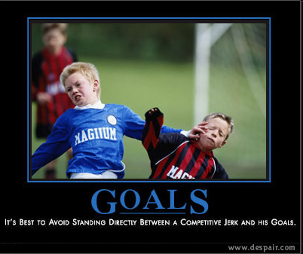
Notes:
2

Slide 3
Why do we need to set goals?
Notes:
3

Slide 4
Failing to Plan is Planning to Fail
Think of your goal as your final destination.
If you don’t know what your final destination is, there is no way to plan how to get there.
NO PLANNING = FAILING
Notes:
Subdivisions rush
4

Slide 5
Why do we not pursue our goals?
Notes:
5
Bush come down

Slide 6


Of

Slide 7
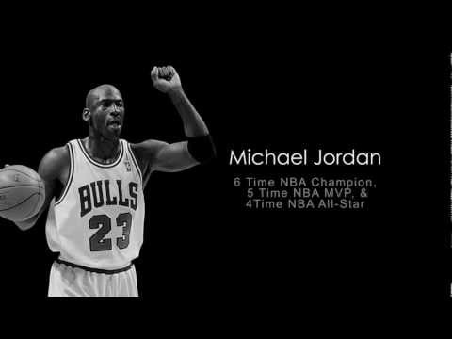
What if they would have quit?
Notes:
https://www.youtube.com/watch?v=zLYECIjmnQs&t=18s

Slide 8

Keep Your goals Away from Trolls
Notes:
8

Slide 9

Set Goals That Are S.M.A.R.T.
Specific
Measurable
Achievable
Realistic
Timely
Notes:
9

Slide 10
Example of a Bad Goal
“I want to get faster.”
Is this goal set up as a goal that is measurable? Is there a time frame to this?
Why is this considered a “bad goal”?

Slide 11
Example of a Good Goal
“I currently run the 40 yard dash in 5.0 seconds and by December 1, I want to be able to run the 40 yard dash in 4.9 seconds.”
Is this goal SMART?
  (specific, measurable, achievable, realistic, timely)

Slide 12
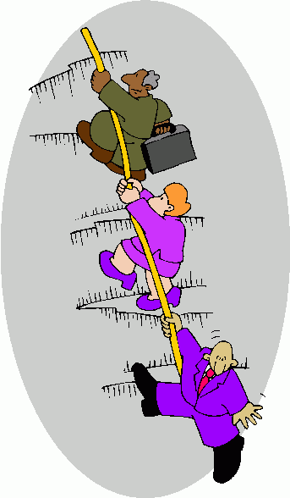
Steps to Goal Setting
Notes:
12

Slide 13

STEP 1:
State your Goal
Notes:
13

Slide 14

STEP 2:
Determine a Deadline
Notes:
14

Slide 15

STEP 3:
Identify the Obstacles
Notes:
15

Slide 16

STEP 4:
Develop
an
Action
Plan
Notes:
16

Slide 17

STEP 5:
Work Towards The Goal
Notes:
17

Slide 18

STEP 6:
Accomplish
The GOAL!
Notes:
18

Slide 19

Celebration???????
19
Notes:
19

Slide 20
Set Goals That Are S.M.A.R.T.
Specific
Measurable
Achievable
Realistic
Timely
Notes:
20

Slide 21

30 Days
Yes, it is a gift. So, take a moment to think ‘Who do I want to be in 5 years?’
What kind of habits would you like to have?
You better start now if you want your new habits to influence your lifestyle and consequently your life!
Notes:
21

Slide 22

30 Days
It is been said that it takes about 30 days to form a habit.
The ones that are good for you require cultivation and determination. The starting phase is the hardest, especially if you want to change an old habit into a new one.
This is why giving yourself a challenge for a minimum of 30 days is a great way to improve all facets of your life.

Slide 23
Goals vs. Dreams
Dreams are your ultimate destination
  Represent what you want and why
Goals are intermediate stops along the way
  Represent your plan to get to your dream

Slide 24

Creating specific goals
A specific goal has a much greater chance of being accomplished than a general goal.
A general goal would be, "Get in shape.“ But a specific goal would say, "Join the YMCA and work out 3 days a week."

