Slide 1
Don’t Halt Your Heart By Using an Alt(o)
Risks associated with E-Cigarette use.
Created By:
Marie Leake, M.A.T.

Slide 2
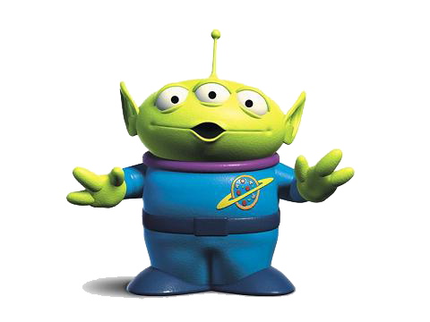
*alien voice from Toy Story* The Brainnnnnnnn
The area of the brain responsible for emotions and controlling our impulses is known as the Prefrontal Cortex.
It’s very vulnerable to nicotine’s effects. This is especially true for young people. The reason: This part of the brain doesn’t finish developing until about age 25.
The brains of teens who smoke or vape may create more receptors to handle the flood of nicotine they have come to expect. As the number of receptors increases, teens will need more nicotine to get the same feeling. That makes nicotine users seek hit after hit, resulting in addiction.
Feldhausen, T. S. (2016, July 29). Explainer: The nico-teen brain. Retrieved March 13, 2019, from https://www.sciencenewsforstudents.org/article/explainer-nico-teen-brain

Slide 3


The Brain and Nicotine
The increase of nicotine receptors in the brain can result in teens having a more difficult time focusing.
It can also result in anxiety and depression.
Feldhausen, T. S. (2016, July 29). Explainer: The nico-teen brain. Retrieved March 13, 2019, from https://www.sciencenewsforstudents.org/article/explainer-nico-teen-brain

Slide 4
E-Cigarettes and the Heart
Daily use of e-cigarettes doubles your risk to having a heart attack.
Daily use of tobacco products and e-cigarettes makes you 5 times as likely to have a heart attack.
First evidence of long-term health damage from ecigs. (2018, February 24). Retrieved March 13, 2019, from https://tobacco.ucsf.edu/first-evidence-long-term-health-damage-ecigs-smoking-e-cigarettes-daily-doubles-risk-heart-attacks

Slide 5
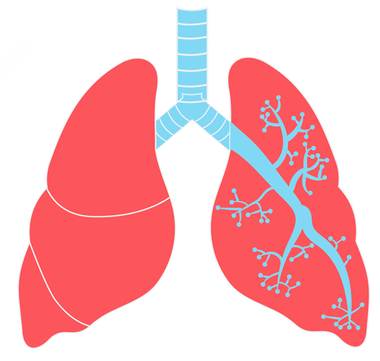
E-Cigarettes and your Lungs
Even though we know that Diacetyl causes Popcorn Lung, this chemical is found in many e-cigarette flavors. It is added to "e-juice" liquid by some e-cigarette companies to complement flavorings such as vanilla, maple, coconut and more.
When inhaled, diacetyl causes bronchiolitis obliterans (a.k.a. Popcorn Lung) a scarring of the tiny air sacs in the lungs resulting in the thickening and narrowing of the airways. It's a serious lung disease that causes coughing, wheezing and shortness of breath.
E-cigarettes produce a number of toxic chemicals such as acetaldehyde, acrolein, acrolein, and formaldehyde. These chemicals have been found to cause lung disease, asthma, and lung cancer.
Health Risks of E-Cigarettes and Vaping. (n.d.). Retrieved March 13, 2019, from https://www.lung.org/stop-smoking/smoking-facts/impact-of-e-cigarettes-on-lung.html
Popcorn Lung: A Dangerous Risk of Flavored E-Cigarettes. (2016, July 07). Retrieved March 13, 2019, from https://www.lung.org/about-us/blog/2016/07/popcorn-lung-risk-ecigs.html

Slide 6

Next Class:
Why have high school users of e-cigarettes increased by 78% in the last year?

