Slide 1

All About Me
Emotional Health
Let’s Learn About Health!
1st Grade

Slide 2



Emotions

Slide 3


Happiness
What makes you happy?
What does happiness look like?
What does happiness feel like?

Slide 4

Unhappy
What makes you unhappy?
What does unhappiness look like?
What does unhappiness feel like?

Slide 5
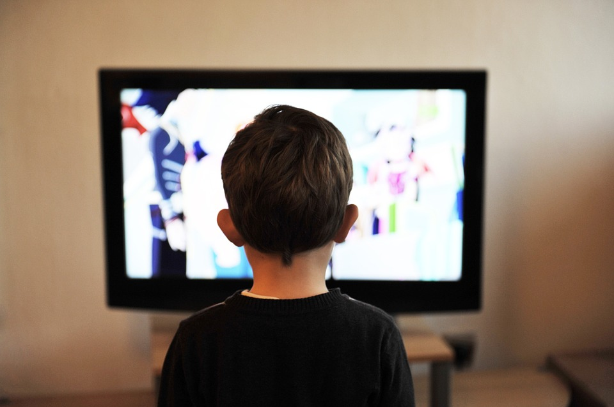
What Should I do?
At school today, Tommy said that nobody liked me. School is over for the day and I still feel sad. Instead of playing outside with my neighbors, I’m going to sit on the couch and watch television.
What should I do about these feelings?
Who can I talk to?
What would I say?

Slide 6
Let’s Practice Expressing Unhappiness
I feel….(tell the person how you feel)
When… (tell the person why you feel that way)
I would like… (tell the person what you want to happen instead)

Slide 7
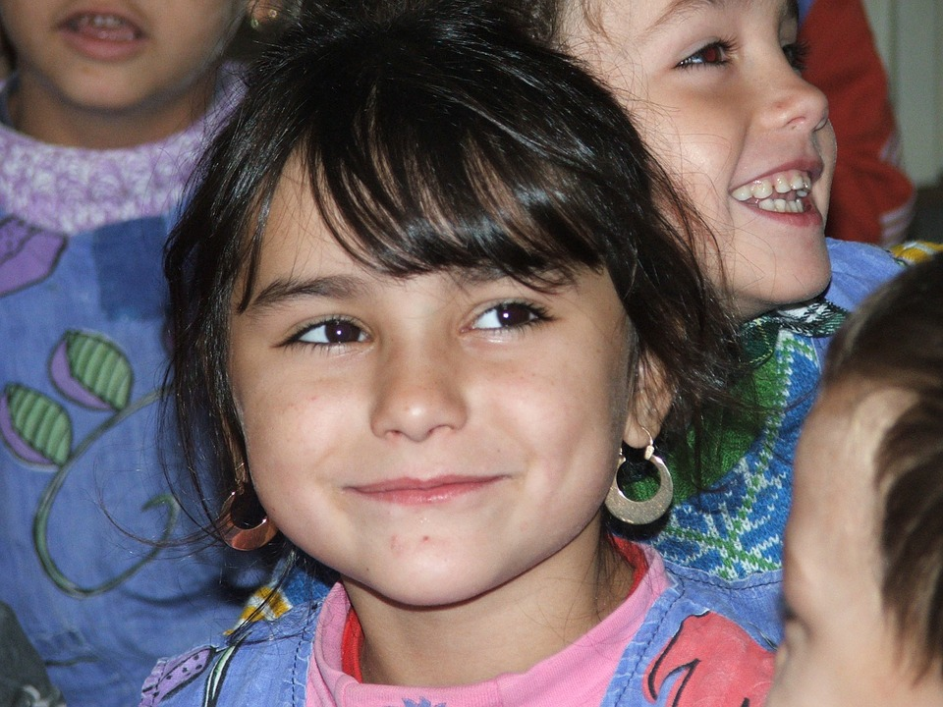
What Should I do?
I just finished my reading test, and I’m at the highest level in the class. I’m so excited and proud of myself. I can’t wait to tell Sarah, my best friend in the class. Actually, I’d love to tell the entire class how smart I am. I’m so happy. As I walk closer to her, I see that she looks sad. Sarah tells me that she is on the lowest level in the class and everyone thinks she is dumb.
What should I do with these feelings of happiness inside of me?

Slide 8

Let’s Practice Expressing Happiness...
Imagine You….
Scored a goal in soccer
Passed a math test in class
Just got home from school and your family surprised you with a puppy
Received a present from a friend

Slide 9


Let’s Review
Expressing Positive Emotions
Expressing Negative Emotions
Positive self-talk
Give a hug
High Five
Talk to a friend, parent/guardian or trusted adult
Other ways?
Talk to a friend, parent, guardian or trusted adult
Talk to the person who make you upset
Take deep breaths
Positive self-talk
Other ways?

Slide 10

Ready to Practice...

Slide 11
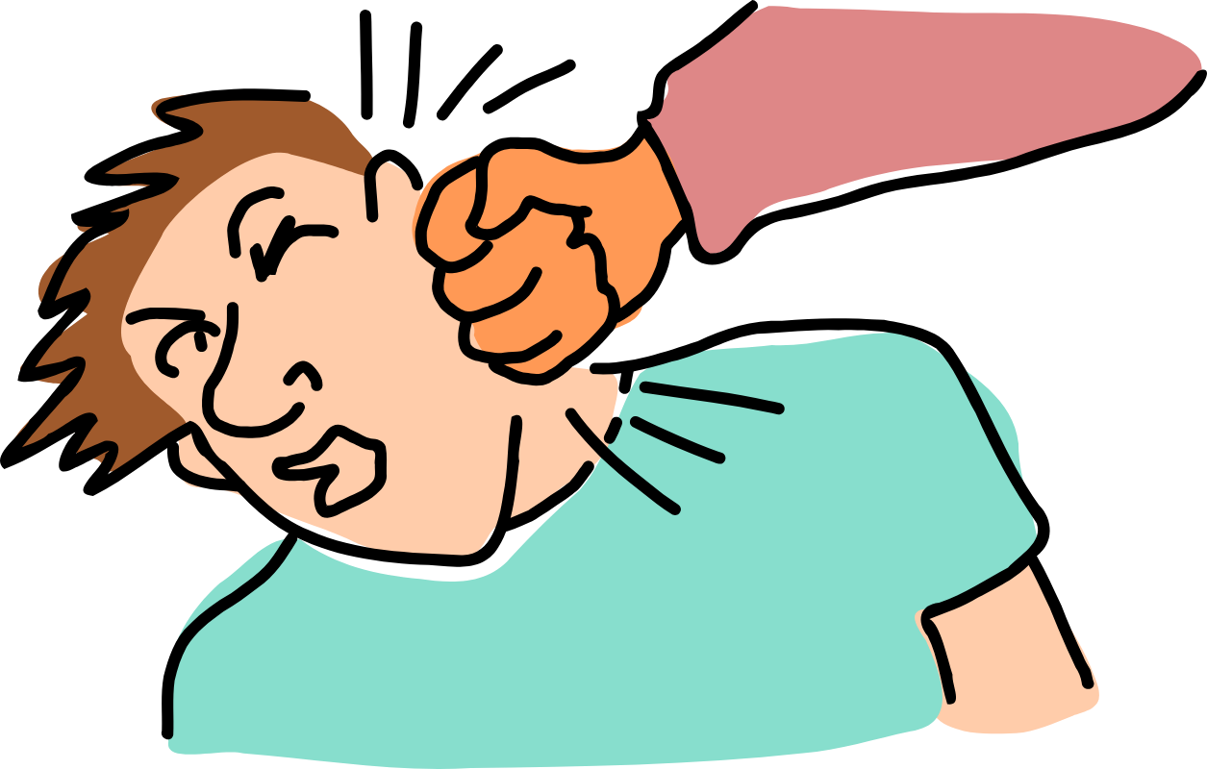

Imagine You Feel Angry….
You want to…
But instead you decide to…

Slide 12
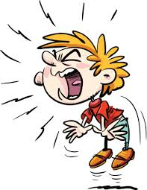
Imagine You Feel Stressed….
You want to…
But instead you decide to…

Slide 13
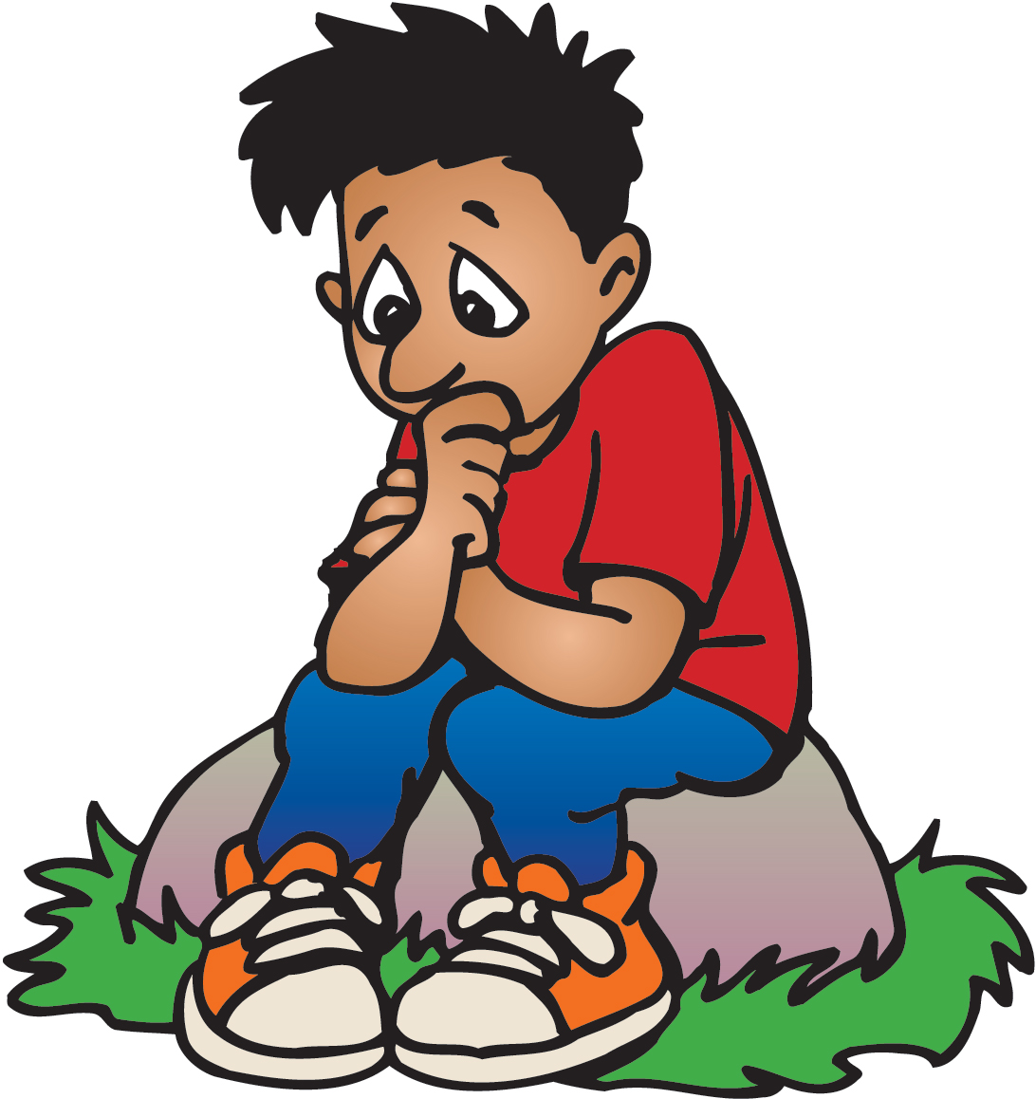
Imagine You Feel Alone….
You want to…
But instead you decide to…

Slide 14
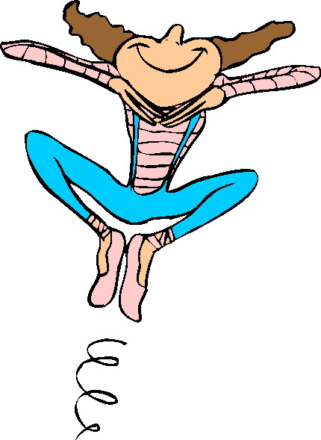
Imagine You Feel Happy….
You want dance on your desk...
But instead you decide to…

Slide 15
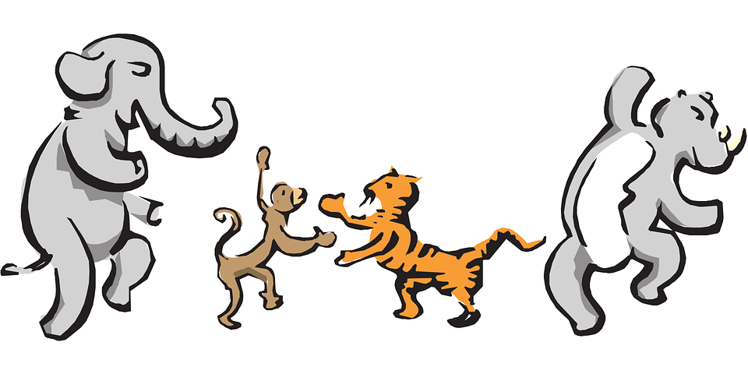
Let’s Move!
https://www.youtube.com/watch?v=QfzRP6V5rE4

Slide 16

The End
Take Care of Yourself & Others

