Slide 1
Dental Care
How do I take care of my teeth?

Slide 2
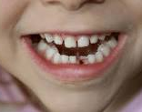
Why is it important to take care of my teeth?
Strong, heathy teeth help me:
Chew my food
Speak clearly
Look my best

Slide 3
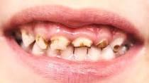
What Happens if we don’t clean our teeth very well?
Plaque builds up on our teeth
Plaque is a bacteria that can cause cavities and gum disease
Too much plaque build up can eventually lead to tooth decay
A unhealthy mouth leads to an unhealthy body. Gum disease increases risk of heart disease, stroke and diabetes

Slide 4

Tips for Taking Care of Your Teeth
Brush your teeth at least twice a day
Brush for 2 minutes using a soft bristle toothbrush
Make sure to brush all your teeth, front, back, tops and sides
Floss everyday
Visit the dentist twice a year
Eat healthy! Limit sugary food/drinks

