Slide 1

All About Me
Healthy Environment: Reduce, Recycle, & Reuse
Let’s Learn About Health!
1st Grade

Slide 2
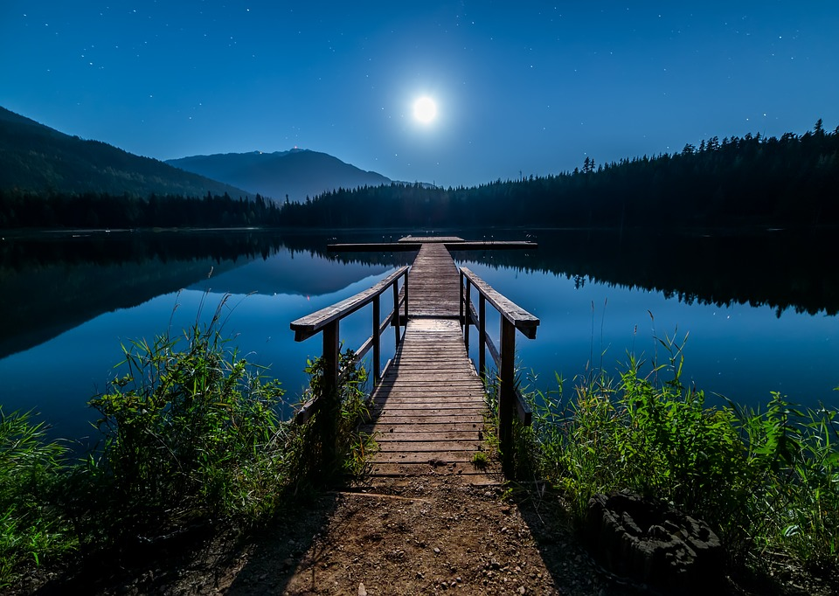
Save Our Earth

Slide 3

Reduce

Slide 4

Can you help me?
I pack my lunch everyday for school. Mom uses baggies to keep my food safe and organized. While eating lunch, the student beside me told me that I was being wasteful by using baggies.
What does that mean?
Can you help me be less wasteful?

Slide 5

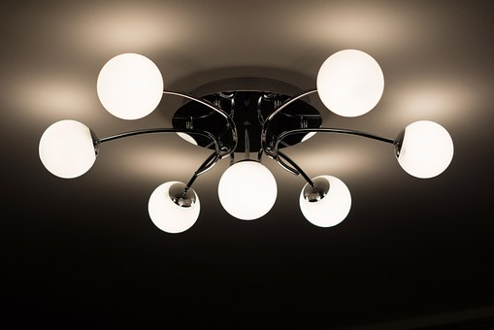

Reduce
How can you REDUCE waste in your home?
Use less water
Use cloth towels instead of napkins
Turn off lights when not in the room
How else can you reduce waste in your home?

Slide 6

Recycle

Slide 7





Can you help me?
I’m in charge of helping with recycling at my school. I’ve gathered several items, but I’m not sure which ones I can recycle. Can you help me?

Slide 8





Recycle
What are some items that you can recycle?
What other items can you recycle?

Slide 9

Reuse

Slide 10

What Should I Do?
I’m growing bigger every day. I wear clothes for a couple of months and outgrown them. What should I do with the clothes that I outgrow to help protect our environment?

Slide 11




Reuse
What can you reuse to help protect the environment?
What other items can be reused to help reduce waste?

Slide 12

Protect Our Earth
Reduce pollution
Reduce landfill space
Save energy
Conserve natural resources
Save money

Slide 13

Let’s keep thinking...

Slide 14

Can I reduce, recycle, or reuse this?

Slide 15

Start a compost pile
Fruit and veggie scraps
Egg shells
Coffee grounds
Grass clippings
Tea bags
And so much more….

Slide 16

How can your school be greener?

Slide 17
It’s Your Turn...
Think about your day at school and at home. What can you do to reduce, recycle, and reuse? Create a personal pledge to recycle, reduce, and reuse. A pledge is a promise. Include at least 5 ways to help your environment in your pledge. See the next slide for an example of a pledge.

Slide 18
Go Green Pledge
I pledge to:
1. Turn off the lights when I leave the room.
2.
3.
4.
5.
_________ (write your name)____________
Add color and pictures

