Slide 1
My Body

Slide 2
Let’s review some of the body parts and body structures we have talked about this week.

Slide 3
The Respiratory System

Slide 4
Lungs
You breath in air through your nose and mouth.
The air goes into your lungs as oxygen.
The oxygen goes into your blood and carbon dioxide is take out.
The lungs are protected by your rib cage.

Slide 5
The Digestive System

Slide 6
The Stomach
Food is broken down into tiny pieces in a bag like organ called “The Stomach”.
The stomach makes liquids that help kill bacteria in foods so you don’t get sick.
The stomach prepares the food to go into the small intestine so nutrients can go into your body.

Slide 7
Circulatory System

Slide 8
The Heart
The heart pumps blood through our bodies.
The heart is divided into 4 parts.
The heart pumps between 70 and 100 times a minute.
Your heart is a muscle.

Slide 9
The Brain
The brain is the command center of the body
Different parts of your brain control different parts of your body.
The brain sends out signals that tell our body how to think, feel, and move.

Slide 10
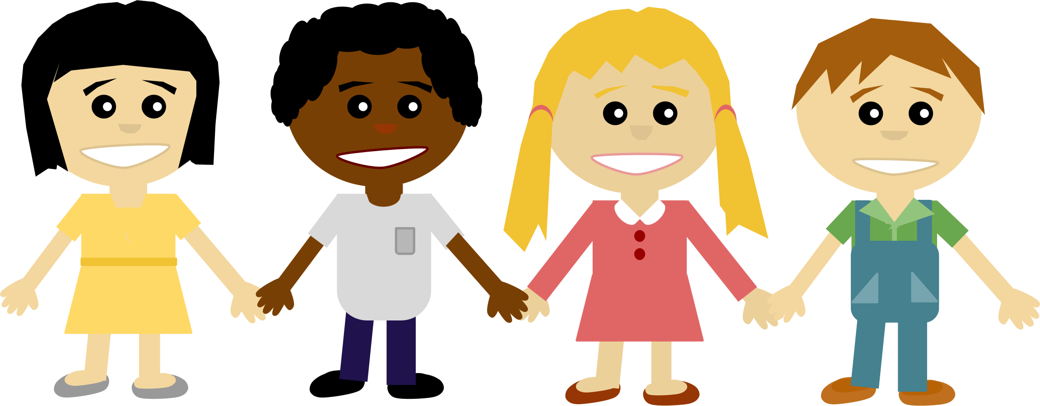
You only have one body. That is why it is so important to keep that body healthy by eating healthy foods, exercising, getting plenty of sleep and staying away from drugs and cigarettes!
Be the BEST that you can be!

