Slide 1
All About Me
Body Structures, Organs & Body Systems
Let’s Learn About Health!
1st Grade

Slide 2
Let’s Review the Major Body Parts
Where in my body are my important organs?

Slide 3
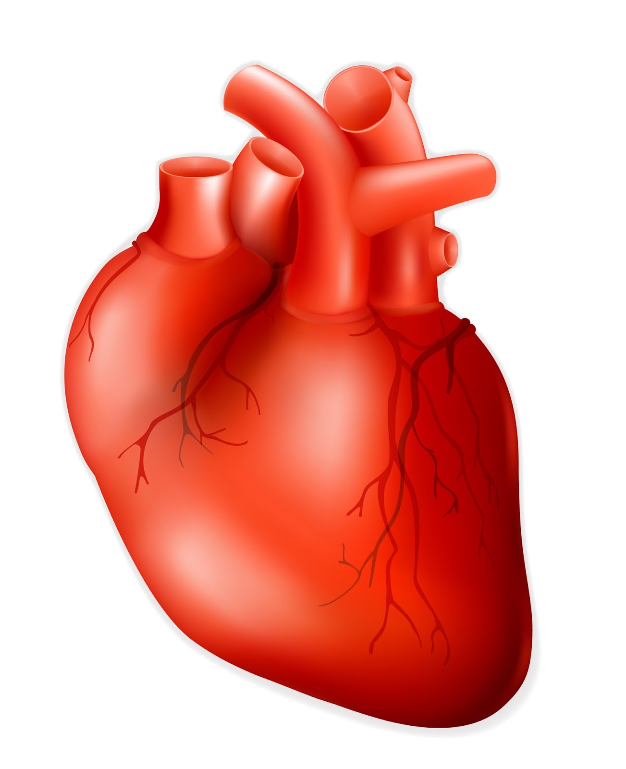
What Do You See?
What is it? What does this picture mean?
What is it? What does this picture do?

Slide 4
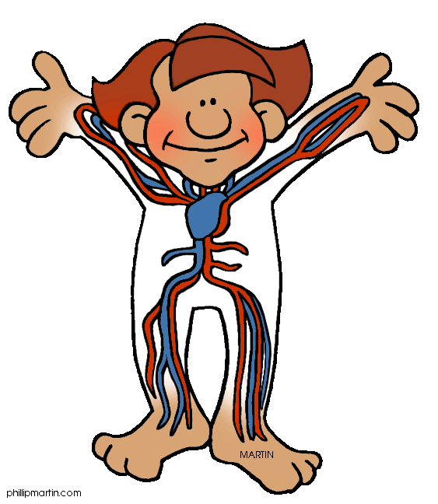
How Your Heart Works
Circulatory System
Watch the following video to learn how your heart works:
https://www.youtube.com/watch?v=_eVG45_iF9U
(How Your Heart Works: Kidshealth.org)

Slide 5
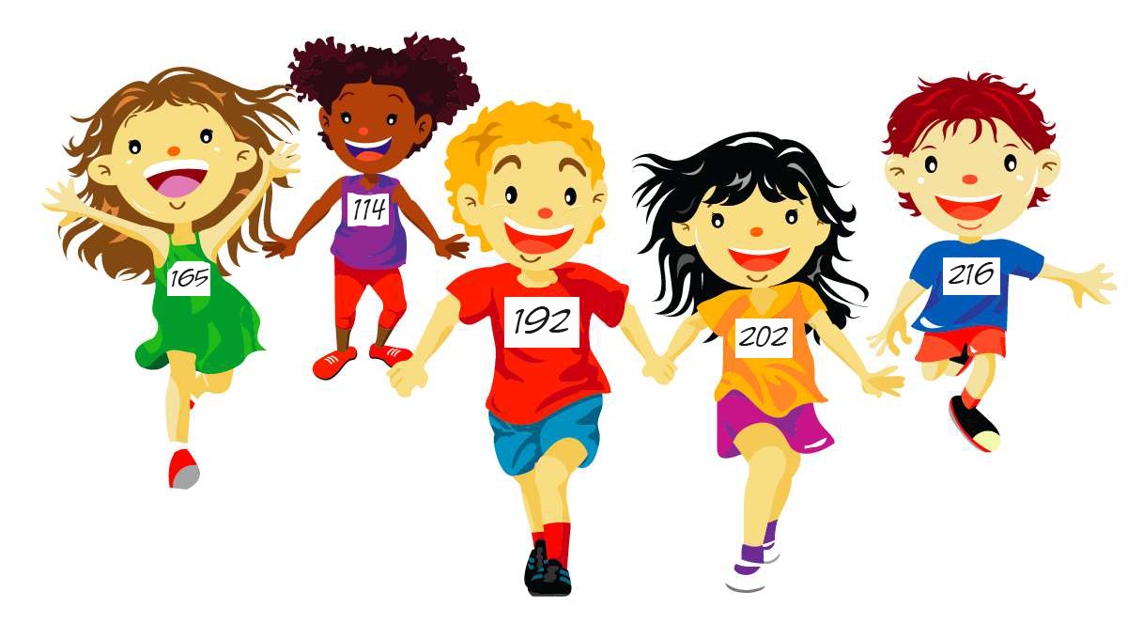
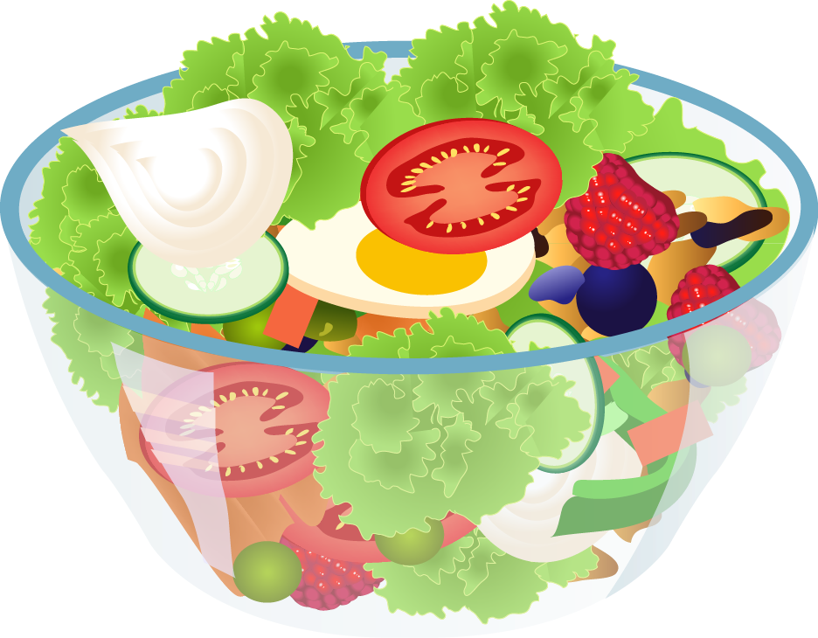
Keep Your Heart Healthy
Don’t smoke
Why is it important to keep your heart healthy?
Stay Active
Eat Healthy

Slide 6
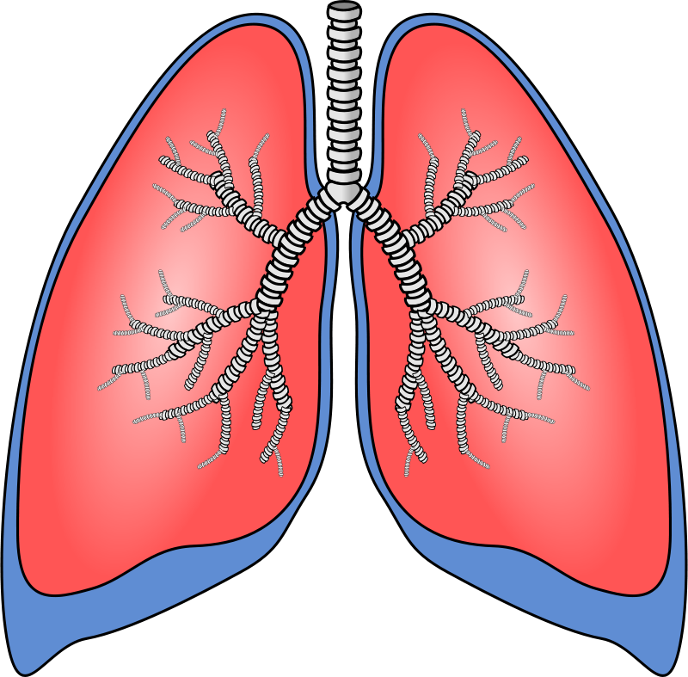
What Do You See?
What is it? What does it do?

Slide 7
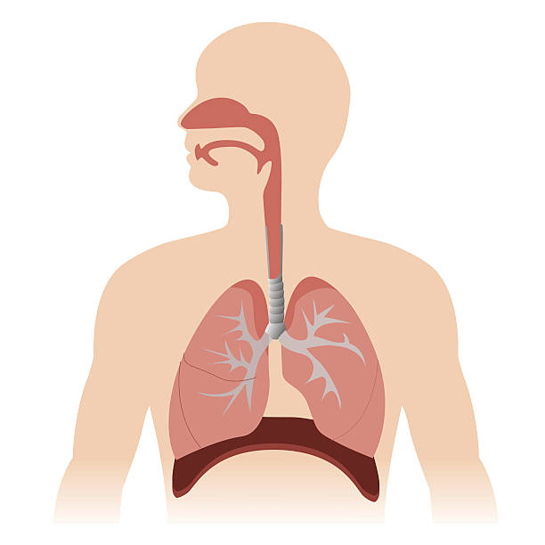
How Your Lungs Works
Respiratory System
Watch the following video to learn how your lungs works:
https://www.youtube.com/watch?v=0giiDDBJVQU
(How Your Lungs Works: Kidshealth.org)

Slide 8
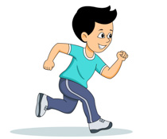
Keep Your Lungs Healthy
Why is it important to keep your lungs healthy?
Stay Active
Don’t smoke

Slide 9
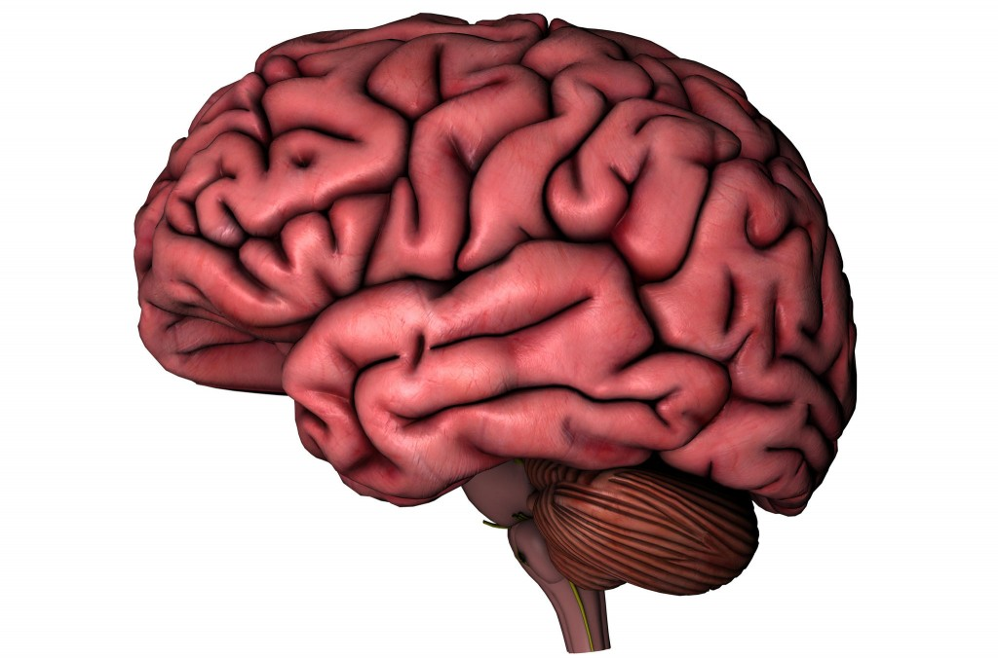
What Do You See?
What is it? What does it do?

Slide 10
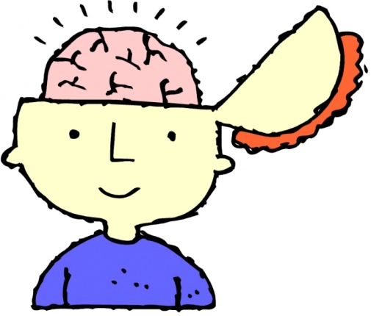
How Your Brain Works
Nervous System
Watch the following video to learn how your brain works:
https://www.youtube.com/watch?v=-nH4MRvO-10
(How Your Brain Works: Kidshealth.org)

Slide 11
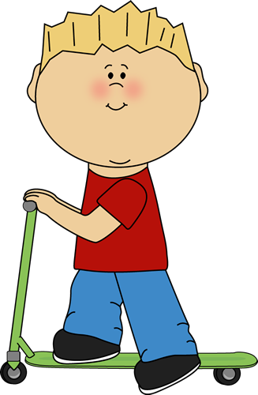
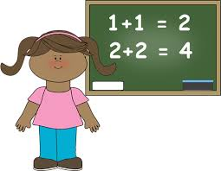
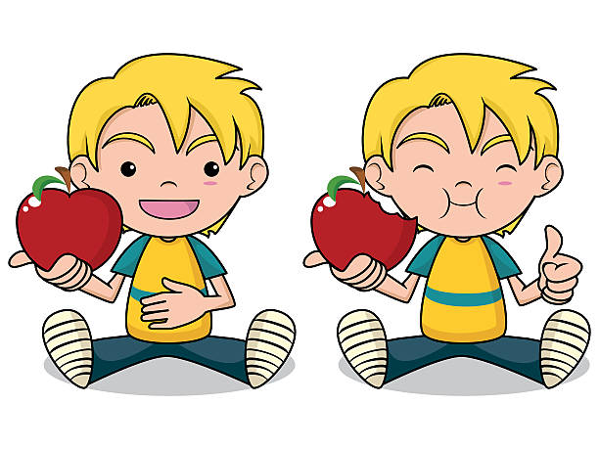
Keep Your Brain Healthy
Don’t smoke
Why is it important to keep your brain healthy?
Learn something new
Stay Active
Eat healthy

Slide 12
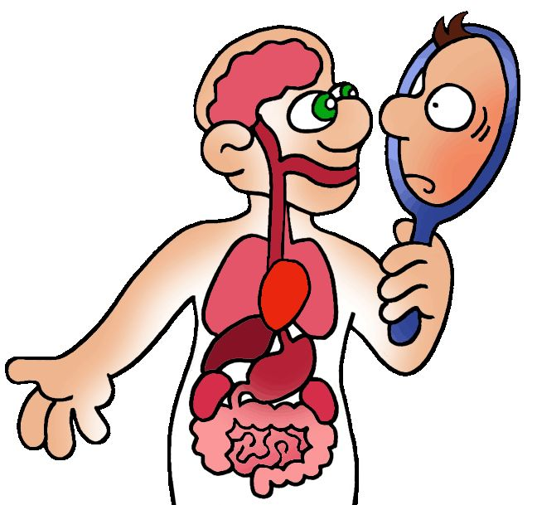
Interested in Learning More About the Body Systems?
If not, go to slide 18 to practice drawing the heart, lungs, and brain.

Slide 13
The Digestive System
Digestive System
Watch the following video to learn how your digestive system works:
https://www.youtube.com/watch?v=VwrsL-lCZYo
(How Your Digestive System Works: KidsHealth.org)

Slide 14
The Immune System
Immune System
Watch the following video to learn how your immune system works:
https://www.youtube.com/watch?v=24IYt5Z3eC4
(How Your Immune System Works: KidsHealth.org)

Slide 15
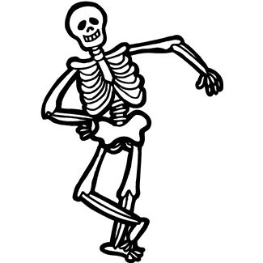
The Skeletal System
Skeletal System
Watch the following video to learn how your skeletal system works:
https://www.youtube.com/watch?v=i42FSNA9bAY
(How Your Bones and Skeleton Works: KidsHealth.org)

Slide 16
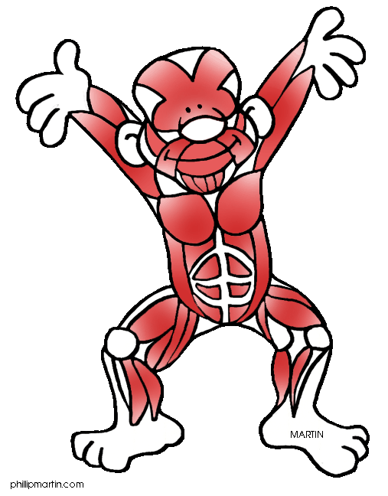
The Muscular System
Muscular System
Watch the following video to learn how your muscular system works:
https://www.youtube.com/watch?v=f_F5UwtdPOc
(How Your Muscles Works: KidsHealth.org)

Slide 17
Let’s Practice Drawing the Organs

Slide 18
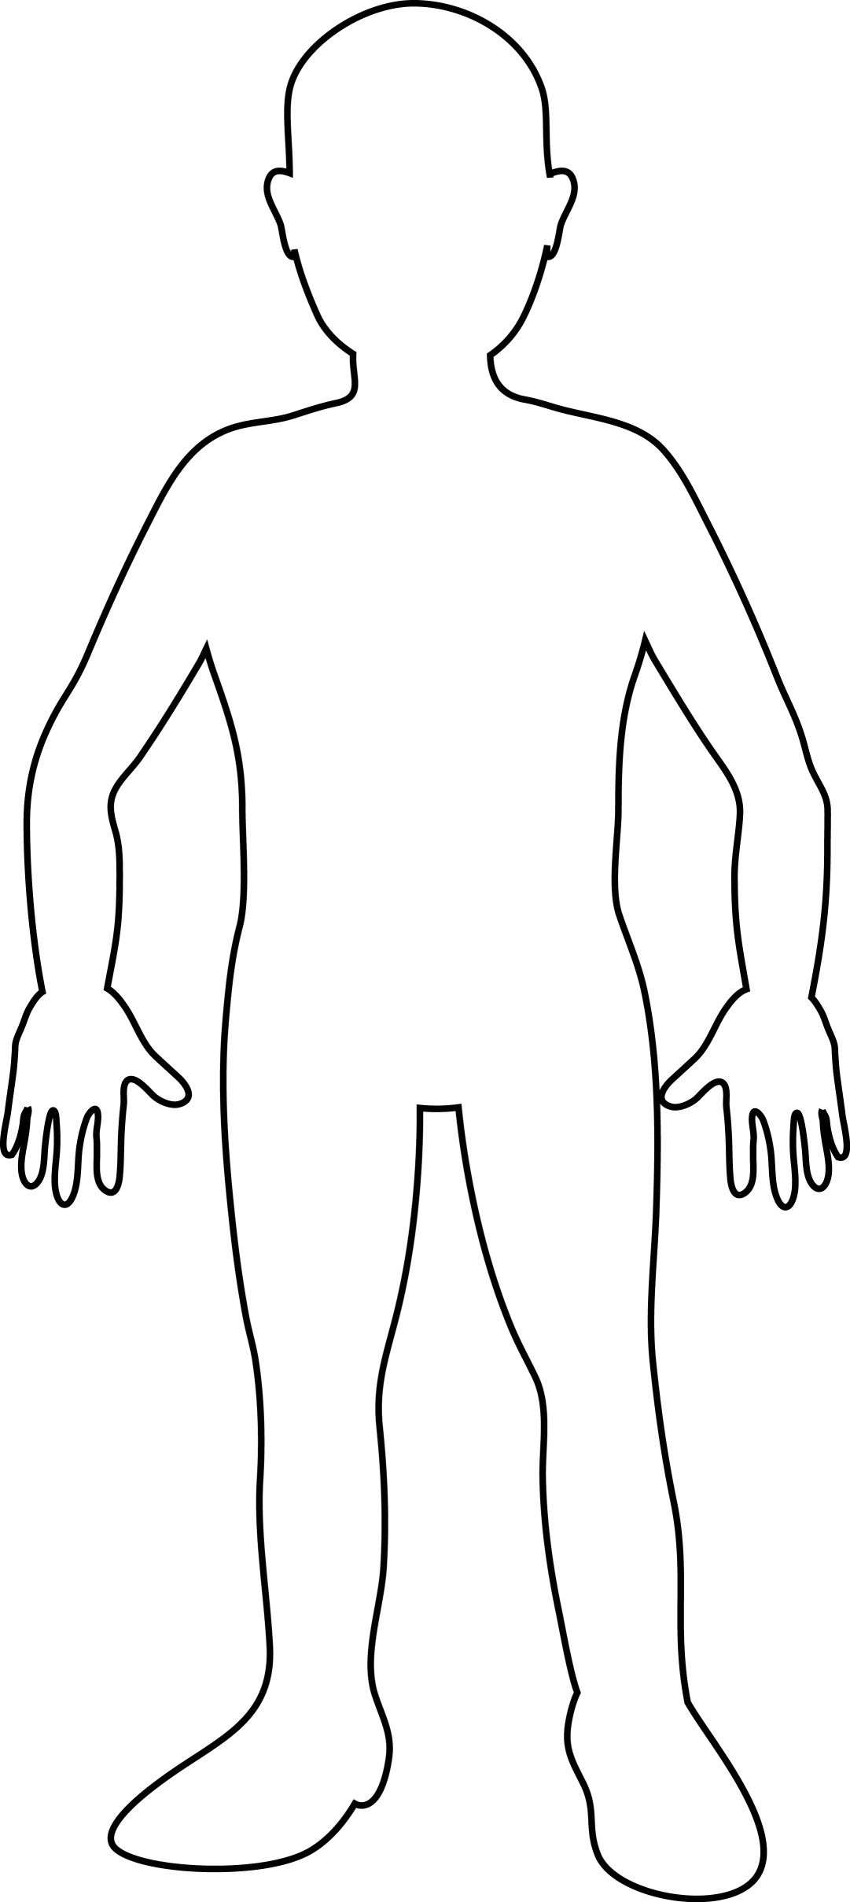
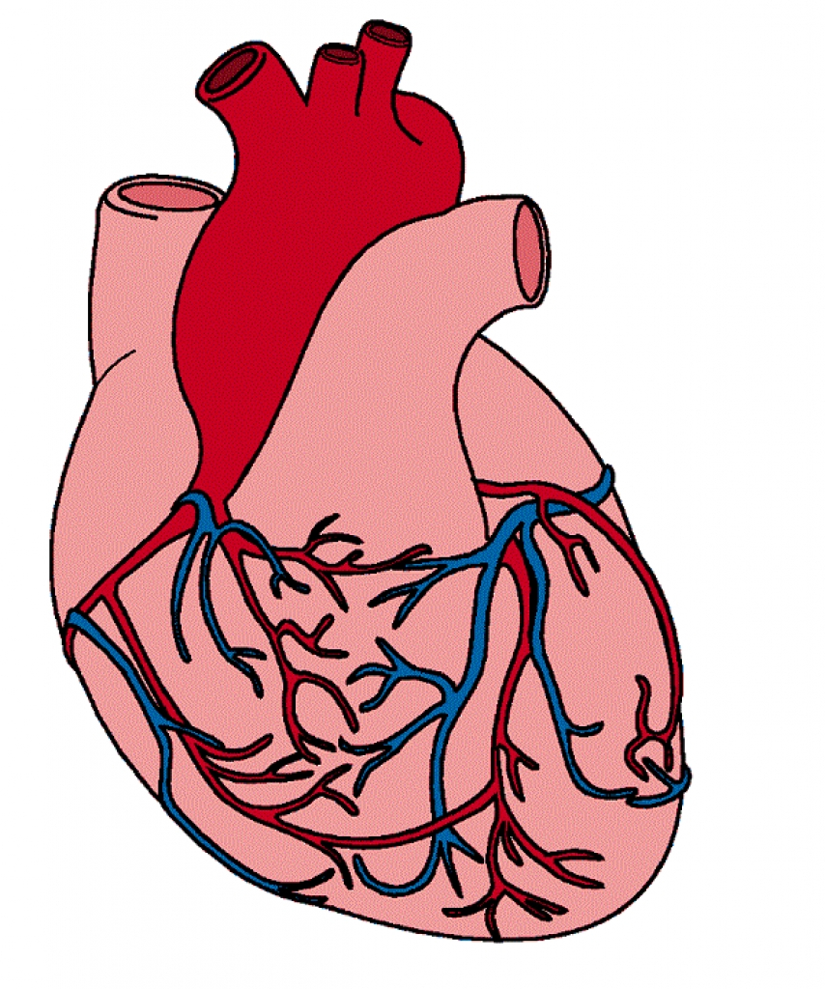
Draw the Heart
Don’t forget to leave space for my lungs

Slide 19
Draw the Lungs
Look at the pictures beside me to see how the heart and lungs fit together

Slide 20
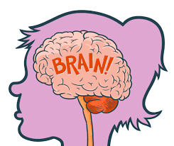
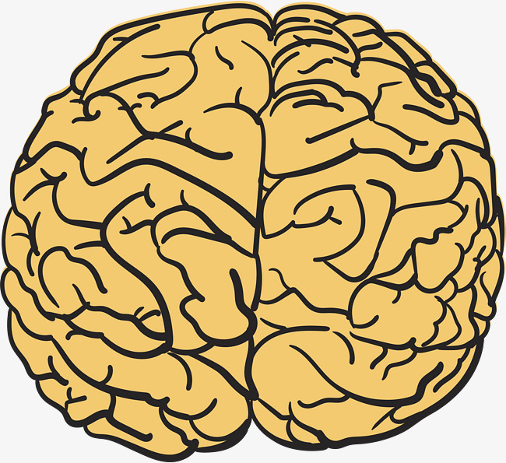
Draw the Brain
Now add my eyes, nose, mouth, and hair. I’m a little chilly so dress me in pants.

Slide 21
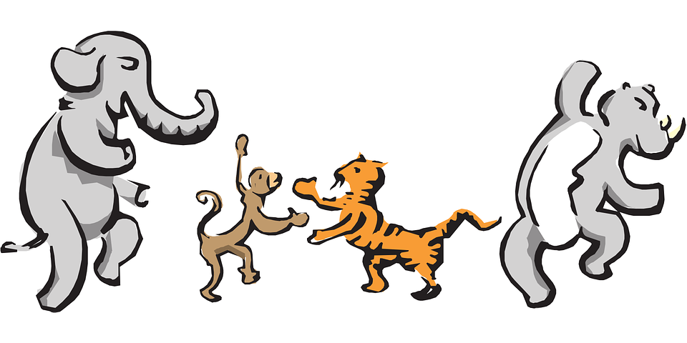
Let’s Move!
https://www.youtube.com/watch?v=QfzRP6V5rE4

Slide 22
The End
Take Care of Yourself & Others

