Slide 1
TOBACCO & NICOTINE
KNOW THE FACTS

Slide 2
There are many different types of tobacco products and all of them contain nicotine:
Cigarettes
Vaping & E-Cigs
Hookah
Cigars
Smokeless Tobacco
Notes:
Nicotine delivery systems come in many different forms in addition to cigarettes.
These include Cigarettes, Vaping and E-Cigarettes, Hookah, Cigars and Smokeless Tobacco.

Slide 3
Cigarettes
Notes:
First, we will talk about cigarettes.

Slide 4
The tobacco in cigarettes contains nicotine – the addictive ingredient in all tobacco related products.
Nicotine addiction symptoms can occur in just weeks after smoking begins.
1/3 of youth that try smoking become daily users.
Notes:
The tobacco in cigarettes contains nicotine. Nicotine is the active ingredient in all tobacco related products.
Symptoms of nicotine addiction can occur in just a few weeks after someone starts smoking.
One third of youth that simply try smoking become addicted, daily users.

Slide 5
Short Term Effects of Smoking Cigarettes
Stained teeth & periodontal disease
Chronic coughing
Increased phlegm
Shortness of breath
Hearing loss
Vision problems
Headaches
Faster resting heartrate
Notes:
There are many adverse effects from smoking Cigarettes.
The short-term effects include staining of teeth as well as gum disease; developing a chronic cough and an increase in phlegm production; shortness of breath due to lower oxygen levels; hearing and vision problems; headaches and a faster resting heartrate.

Slide 6
Long-term Effects of Smoking Cigarettes
Includes all the short-term effects as well as increased chances of:
Heart disease
Chronic lung disease
Lung and other cancers
Stress
Notes:
The long term effects are even more harmful. They include all the short term effects we discussed as well as:
Heart disease, chronic lung disease including emphysema and COPD, lung and other cancers and stress on the overall biological systems.

Slide 7
Electronic Cigarettes

Slide 8
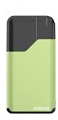
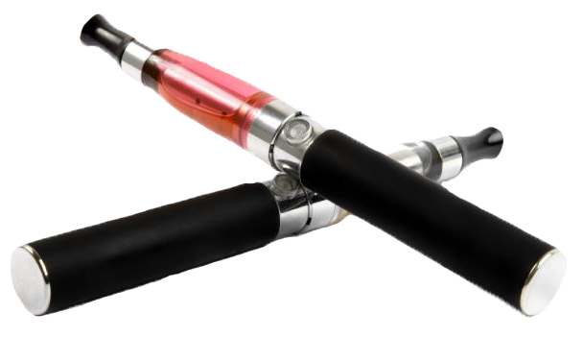

E-cigs do not contain tobacco, but they do use nicotine from tobacco. Nicotine is the addictive ingredient that comes from tobacco.
Notes:
Another alternative tobacco product is called the electronic cigarette (e-cig or e-cigarette).
E-cigs are one of the latest devices that the tobacco industry has introduced to the public.
Electronic cigarettes do not contain tobacco, but they do use nicotine from tobacco plants.
As you already learned, nicotine is the addictive ingredient derived from tobacco.

Slide 9

E-cigs do not produce a harmless “vapor” – it is an aerosol that contains nicotine and a number of chemicals.
Notes:
E-cigs do not produce cigarette smoke or vapor but rather an aerosol that contains nicotine and a number of chemicals.
They have a heating element that atomizes a liquid solution known as e-liquid or e-juice. E-liquids are usually a mixture of propylene glycol, glycerin, nicotine, and flavorings. Propylene glycol is used by the chemical, food, and pharmaceutical industries. It is a solvent for food colors and flavors, and in the paint and plastics industries and as an ingredient in antifreeze. Propylene glycol also is used to create artificial smoke or fog used in fire-fighting training and in theatrical productions.
The Food and Drug Administration (the FDA) regulates electronic cigarettes.

Slide 10
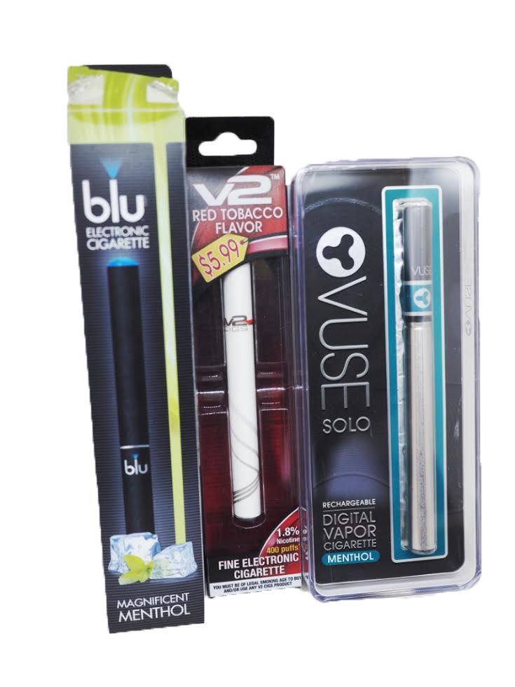
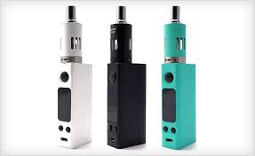
Nicotine levels have been found to be mislabeled on electronic cigarette packages.
Notes:
Electronic cigarette users say that a reason they like the product is because they can choose the level of nicotine they wish to inhale. However, there have been several cases of mislabeling the level of nicotine in a product. Therefore, they are not actually choosing AND in most cases do not know what they are even inhaling.
E-cigs still are addictive because they contain the ingredient nicotine. So, even if someone stops smoking cigarettes, they still may be addicted to nicotine contained in electronic cigarettes, which also is a toxic agent.

Slide 11
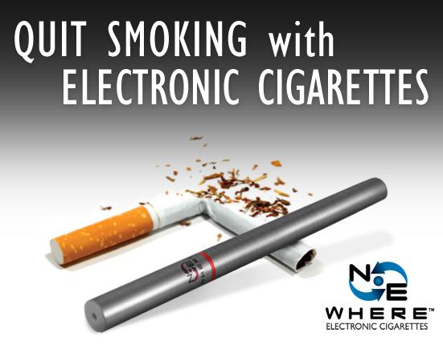
E-cigs have not been scientifically proven to help people quit using tobacco products.
Notes:
Although there are numerous discussions and claims that seem to say e-cigs help some people stop smoking, there is NO scientific proof to support this claim.

Slide 12
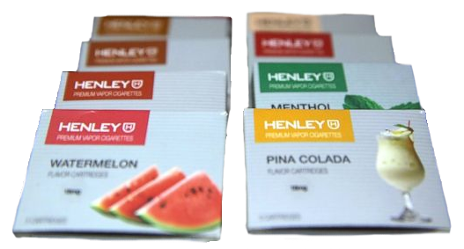
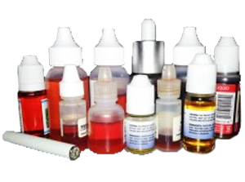
Advertised as
…BUT
REALLY…
Actual Products
Fruity flavors merely cover up the toxic danger of the tobacco product.
Notes:
To cover up or mask the toxic agents found in electronic cigarettes, tobacco companies encourage and promote the use of fruity flavors, which are particularly attractive to youth and young adults.
It is illegal to sell flavored cigarettes, however, there are no such restrictions for Other Tobacco Products. Although you cannot smell or taste the bitter and harsh tobacco, the toxic agents still can harm your health and lead to breathing complications, particularly with your sinuses, throat and lungs.
Researchers at Harvard found that 39 of 51 e-cigarette brands contained diacetyl, an additive used for different flavorings. Diacetyl has been shown to call “popcorn lung” – a serious and irreversible lung disease.

Slide 13
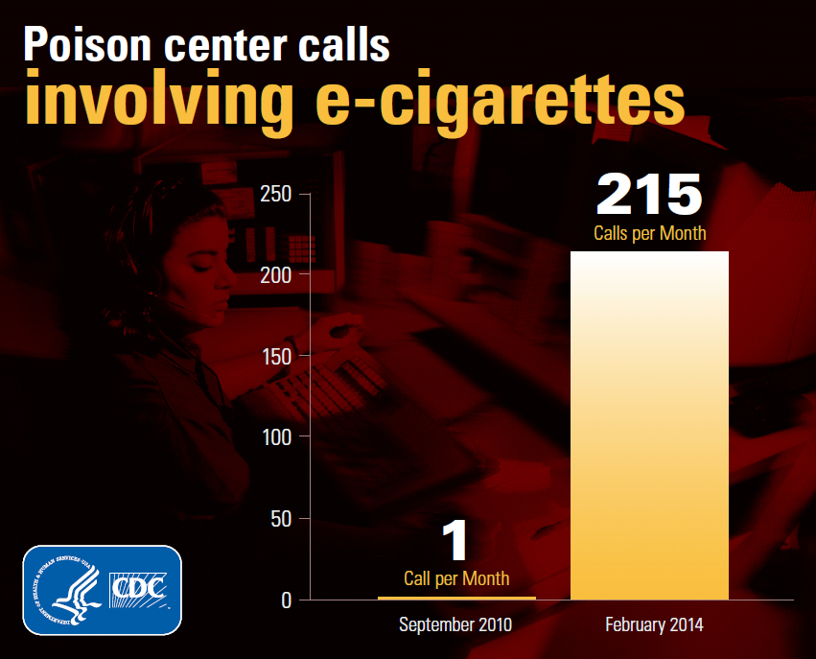

E-liquid Poisoning
Between 2012-2017, 8,269 e-liquid poisonings of children under 6 were reported to poison centers.
As well, second hand e-cigarette aerosol exposure is harmful.
Pets are also at risk for exposure to the accidental ingestion of e-liquids.
Notes:
Between 2012-2017, National Poison Data System data shows that more than 8,000 children were poisoned by the ingestion of e-liquids (also know as e-juice). Liquid nicotine exposure can result in heart attacks, seizures, coma and respiratory arrest in children. Calls continue to come into Poison Control centers every month.
As well, second hand aerosol exposure from e-cigarettes is also dangerous for children and others due to the higher concentration of nicotine in the e-liquid.
It is also being reported that pets are being poisoned by ingesting e-liquids.
>Figures from the American Academy of Pediatrics and Centers for Disease Control<

Slide 14

E-Cigs: JUUL
JUUL is a newer type of electronic nicotine delivery device.
It resembles a USB flash drive.
JUUL’s fruit & candy flavors attract younger users.
JUUL pods have a higher concentration of nicotine than many other e-cigs, posing additional health concerns.
Notes:
JUUL is the latest device introduced in the e-cig category. It is colorful, sleek and has a novel look and feel – often resembling a USB Flash Drive. The individual pods contain higher levels of nicotine than many other e-cigarette brands – posing additional health risks and concerns.
However, it is not safer or different than other e-cig nicotine delivery systems – its aerosolized mist contains nicotine and all the same chemicals as in other devices.

Slide 15
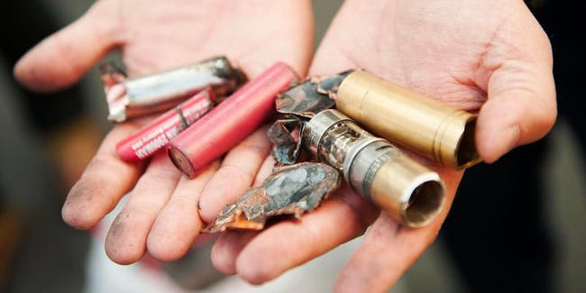
Vaping & Explosions
As of February 2018, 274 e-cig explosions have been reported. Of these, 182 resulted in injuries.
Explosions include a loud noise, light flashes, smoke, fire and projection of device parts. More than half the time, fires are started on nearby objects.
Newer vapes using lithium-ion batteries seem to explode more often than previous models.
A variety of injuries can occur from exploding vaping devices:
1st, 2nd, & 3rd Degree Burns
Broken Teeth
Eye injuries
Smoke Inhalation
Death
Notes:
Vaping and e-cigarettes carry the additional hazard of possible explosions.
Almost 300 explosions have been reported from vape equipment which produce loud noises, smoke, fire and projectile vape parts. 68% of those resulted in injuries, many severe. And more than half the time, surrounding objects catch fire as well. Newer, lithium-ion batteries seem to explode more often.
Reported injuries include 1st, 2nd, and 3rd degree burns, broken teeth, eye injuries, smoke inhalation and even death.
> Statistics from NIH/NIDA, 2018 and FDA, 2018 reports <

Slide 16
HOOKAH

Slide 17
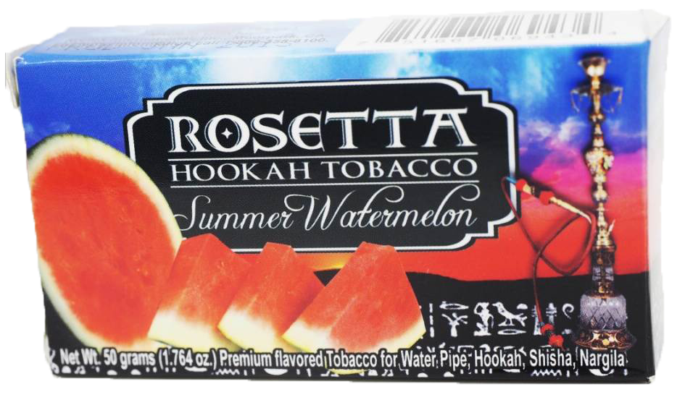
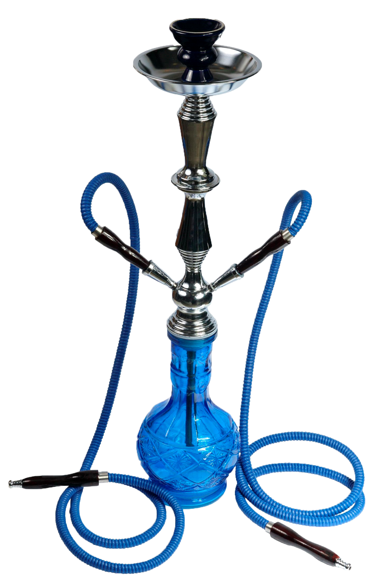
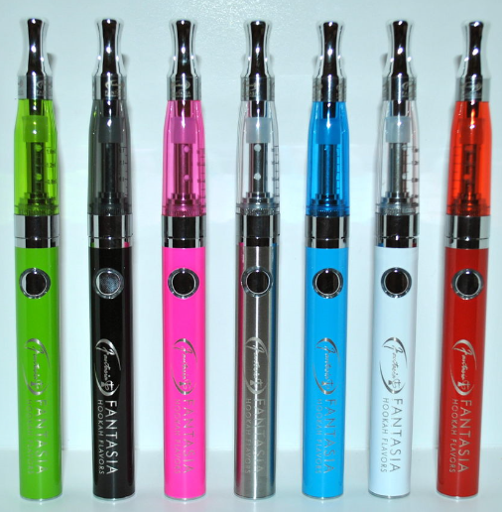
HOOKAH & HOOKAH PENS
Hookah use is equally damaging to your health as cigarettes.
Notes:
Hookah users are actually exposed to more smoke than cigarette smokers due to their longer smoking sessions, which can last up to an hour in many cases. In fact, hookah users consume nearly 200 times the smoke compared to just one cigarette.
The CDC has reported that hookah smokers are at risk for many of the same cancers and diseases as cigarette smokers. The heated tobacco used contains sixty-nine particular carcinogens that have been linked to tumor production as well as cancers of the lungs, stomach, and kidneys.
The tobacco used in hookah (as with all tobacco products) contains nicotine. Nicotine is the addictive ingredient in tobacco.

Slide 18
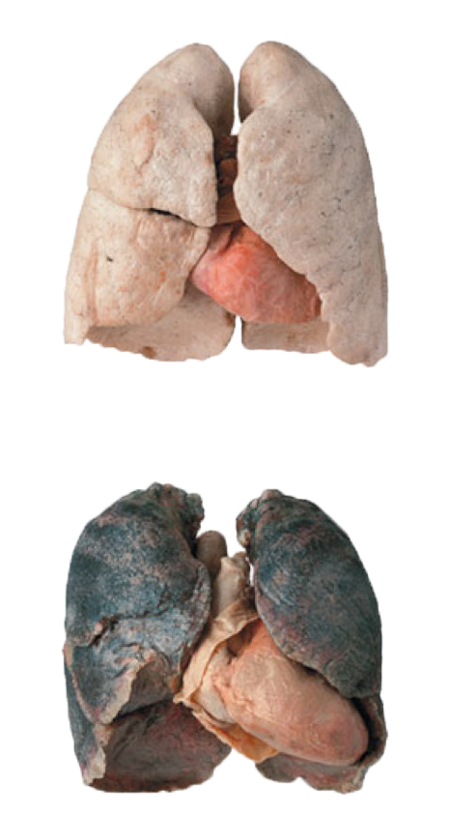
Smoke from the heated tobacco in hookahs clogs the pores in your respiratory system.
Hookah users are exposed to more smoke than cigarette users.
The water moving through the pipes does NOT “clean” the smoke inhaled.
Notes:
According to data collected by the Centers for Disease Control and Prevention, smoke from the heated tobacco in the hookah contains over 4,000 different chemicals, some of which cause cancer, have been repeatedly proven to clog the pores in one’s respiratory system.
The water moving through the pipes does not “clean” or purify the tobacco smoke inhaled. Again, there is no safe way to use hookah or tobacco.

Slide 19
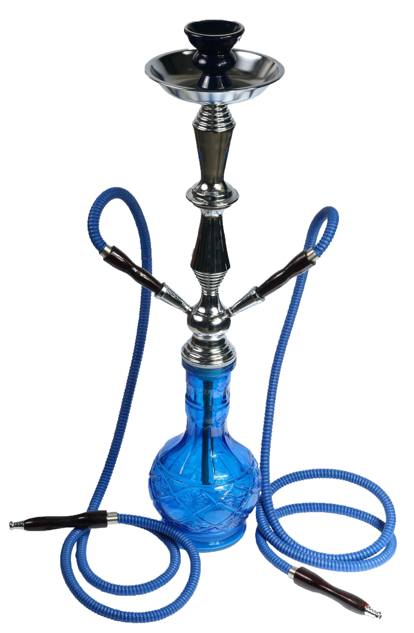
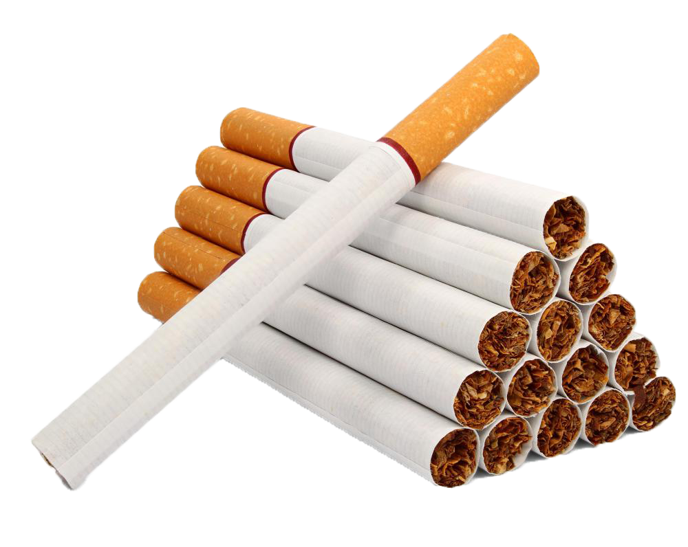
VS
One Hookah session = 100 or more cigarettes
Notes:
The World Health Organization (WHO) conducted a study on the health effects of hookah, in which they found supporting evidence that just one hookah session is equivalent to smoking over 100 cigarettes.
Researchers explained that the dramatic difference is caused by the excessive amounts of puffs that hookah users take during a given session.

Slide 20
CIGARS

Slide 21

There are 3 major types of cigars:
Little Cigar
Cigarillo
Cigar
Notes:
Now, let’s look at cigars, another alternative tobacco product.
The FDA uses three primary classifications of cigars based on their weight.
The smallest cigars are known as “little cigars”. They look very similar to a cigarette and many contain a filter on the end but these filters have not been scientifically shown to filter out the harmful agents of the cigar smoke.
The medium sized cigars are known as cigarillos. These come in various sizes and some come with plastic or wood tips.
The largest is the most common cigar. These are the one’s that are often associated with celebrations and celebrities.
Despite their size, they all are cigars. They all contain tobacco and nicotine. And they all are at least as dangerous and toxic as cigarettes and users are exposed to harmful toxicants.

Slide 22
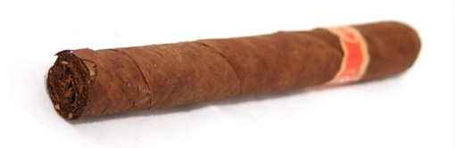
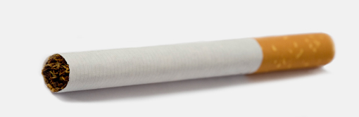
Cigars are perceived as healthier than cigarettes, BUT, the only difference between the two is what they are wrapped in.
  Cigars: Wrapped in tobacco
  Cigarettes: Wrapped in paper
Notes:
It is important to know that even though we may think cigars are a healthy alternative to cigarettes, they are equally as dangerous.
The only difference between cigars and cigarettes is the size and the wrapper. Cigars are wrapped in tobacco, and cigarettes are wrapped in paper that doesn’t contain tobacco.
Both cigars and cigarettes contain the addictive ingredient nicotine.

Slide 23
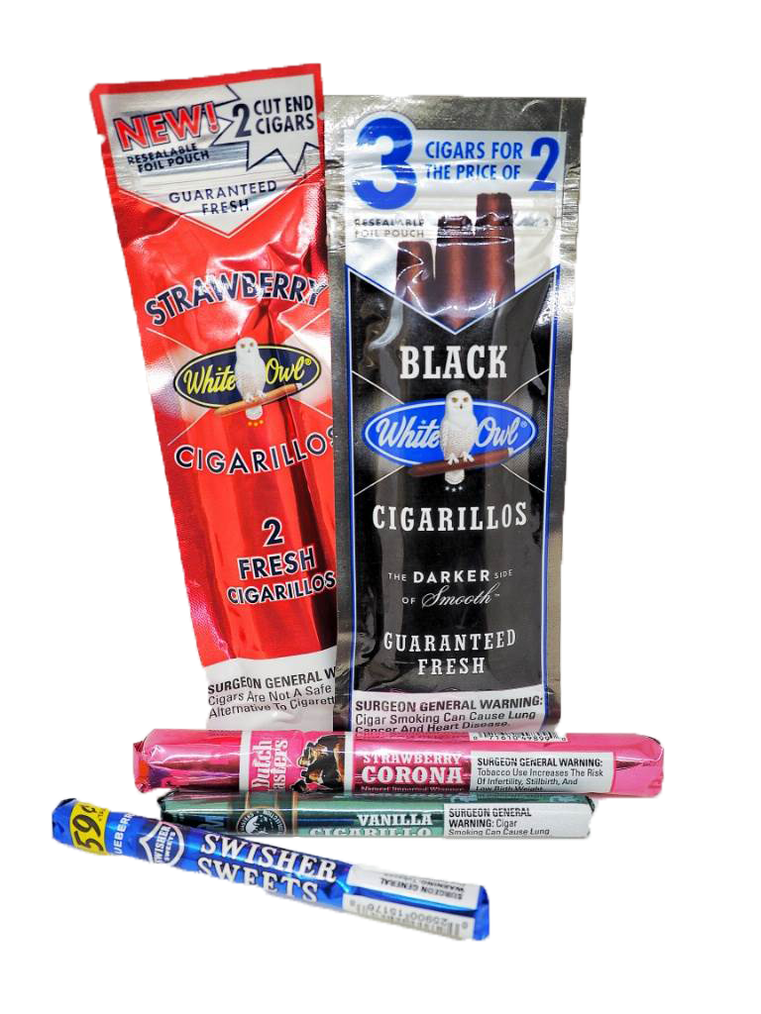
The tobacco industry packages their products to appear as candy or other sweets.
Notes:
Like other alternative tobacco products, the tobacco industry packages their products to appear similar to candy or other sweets.
The sweet flavors such as strawberry and vanilla do not make cigars safer. The flavors only mask the bitter and harsh smell and taste of the cigars – they do not mask the toxic, harmful effects.
It is illegal for companies to sell fruity and candy flavored cigarettes but it is NOT illegal for tobacco companies to add these flavors to cigars and other tobacco products.

Slide 24
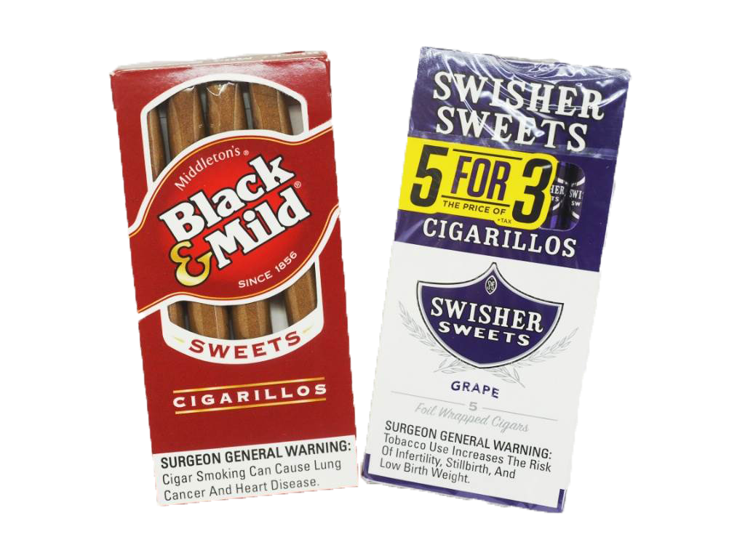
It is common for the tobacco industry to promote their products as affordable.
They are taxed differently and packaged differently to be less expensive.
Notes:
It also is common for the tobacco industry to promote their products less expensive. This is a tactic to try to persuade people to try these products with the hope that they will want to use them again and again. This tactic also preys on people who do not have a lot of extra money to spend.
The tobacco industry also has figured out how to exploit tax laws to sell more cigars. They package their products in unique ways to avoid tax laws in order to reduce the cost of their product and get more people to use them.

Slide 25
SMOKELESS TOBACCO

Slide 26
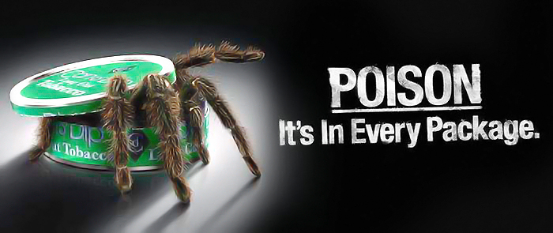
Smokeless tobacco products are equally as addictive as traditional tobacco products.
Notes:
Smokeless tobacco, which is more commonly known as chewing or spit tobacco, is another tobacco product. Although not smoked, it does carry its own dangerous and addictive risks.

Slide 27
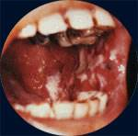
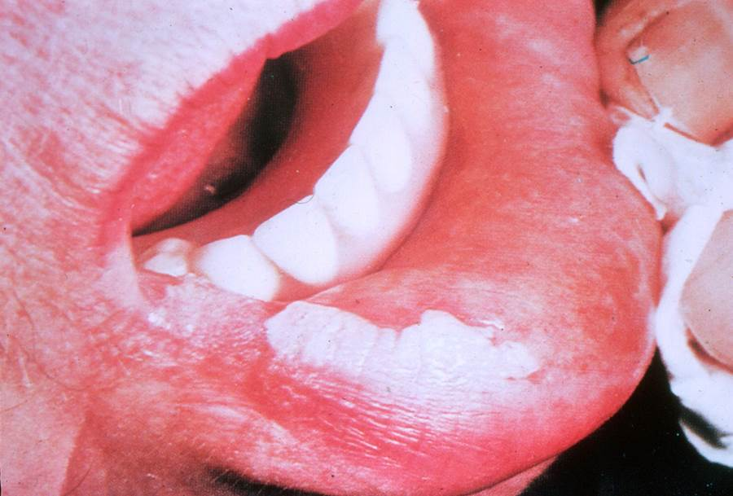
Smokeless tobacco products deliver more nicotine in a shorter time span.
Smokeless tobacco causes tooth decay.
Over 70% of smokeless tobacco users suffer from the disease Leukoplakia.
Chewing tobacco, dip, and snuff have been linked with esophageal, mouth, and pancreatic cancer.
Notes:
Smokeless tobacco products can deliver more nicotine than cigarettes.
One of the most common side effects experienced by smokeless tobacco users is excessive tooth decay. In addition to the tooth decay, the tobacco also causes gums to pull always from the teeth, resulting in permanent gum loss.
Although many of the common health effects of smokeless tobacco products attack the mouth, there are more severe risks associated with them as well. Medical professionals have linked many of the chemicals found in chewing tobacco, dip, and snuff with esophageal, mouth, and pancreatic cancer.

Slide 28
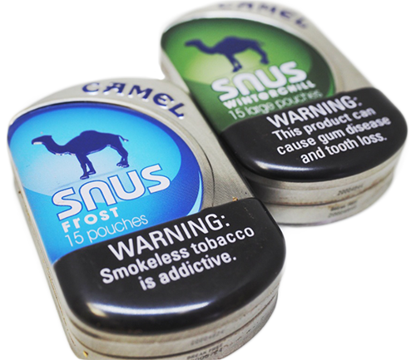
Some smokeless tobacco products are also spitless, making them more convenient to use. But they still contain the highly addictive ingredient, nicotine.
Notes:
Smokeless tobacco products come in a variety of forms to promote use among kids or those who normally would not try them.
Some smokeless tobacco products are spitless. Even though it may not smell or taste like tobacco, it still contains nicotine, is very addictive, harmful and can cause cancer.

Slide 29
SUMMARY
All tobacco related products contain nicotine.
The nicotine in cigarettes and other products is highly addictive.
E-cigs, hookah, cigars, and smokeless tobacco products contain toxic chemicals, including nicotine.
Vaping mist contains harmful chemicals.
E-cigs can also cause injuries through battery explosions.
Tobacco companies product packaging makes them appear healthy and safe.
Candy flavors only mask the bitter taste and harmful effects of tobacco products.
There is NO safe way to use the tobacco products reviewed in this presentation.
Notes:
So let’s summarize what we have learned today.
Hookah products, e-cigarettes, cigars, and smokeless tobacco products contain toxic chemicals, including nicotine.
E-cigarette batteries can explode and cause serious injury.
Tobacco companies package products to make them appear healthy and safe.
Candy flavors only mask the bitter taste and harmful effects of tobacco products.
There is NO safe way to use the tobacco products reviewed in this presentation.

Slide 30
Resources
https://www.cdc.gov/tobacco/
https://www.cdc.gov/tobacco/basic_information/e-cigarettes/Quick-Facts-on-the-Risks-of-E-cigarettes-for-Kids-Teens-and-Young-Adults.html
https://www.fda.gov/tobacco-products/ctp-newsroom/how-are-non-combusted-cigarettes-sometimes-called-heat-not-burn-products-different-e-cigarettes-and
https://teens.drugabuse.gov/drug-facts/tobacco-nicotine-e-cigarettes
www.vfhy.org

Slide 31
Standards of Learning: Grade 6
Healthy Decisions
6.2 The student will describe the influence of family, peers, and media on personal health decisions.
d. Identify the benefits of a tobacco-free environment.

Slide 32
Standards of Learning: Grade 7
Essential Health Concepts
7.1 The student will identify and explain essential health concepts to understand personal health.
Explain the link between addiction to alcohol, tobacco, and other drugs, chronic disease, and engaging in risky behaviors.
m. Recognize harmful and risky behaviors.
Healthy Decisions
7.2 The student will use decision-making skills to promote health and personal wellness.
l. Identify consequences of engaging in risky behaviors, to include alcohol, tobacco, and drug use, gang involvement, and imitating gang-related behaviors.
m. Identify strategies for avoiding alcohol, tobacco, inhalants, and other harmful substances.

Slide 33
Standards of Learning: Grade 8
Essential Health Concepts
8.1 The student will identify and explain essential health concepts to demonstrate an understanding of personal health.
i. Describe the short- and long-term health issues related to alcohol, tobacco, and other drug use, including inhalants, marijuana, cocaine, stimulants, methamphetamines, opiates, steroids, and performance-enhancing drugs.
j. Research the signs, symptoms, and causes of addiction.
k. Explain how drugs affect the brain.
l. Describe the relationship between healthy behaviors and cognitive performance.
Healthy Decisions
8.2 The student will apply health concepts and skills to the management of personal and family health.
i. Explain why most teenagers do not use alcohol, tobacco, or other drugs.

Slide 34
Standards of Learning: Grade 9
Healthy Decisions
9.2 The student will explain the impact of health risks and identify strategies and resources to limit risk. G.
d. Identify health-related decisions that contribute to heart disease, stroke, diabetes, and other chronic diseases and conditions.
g. Identify common types of cancer, risk factors, and prevention strategies.
i. Evaluate the effects of alcohol and other drug use on human body systems, brain function, and behavior, and describe health benefits associated with abstaining from the use of alcohol, tobacco, or other drugs.
j. Develop a set of personal standards to resist the use of alcohol, tobacco, and other harmful substances, and other harmful behaviors.

Slide 35
Standards of Learning: Grade 10
Essential Health Concepts
10.1
g. Research trends in teen use/abuse of alcohol, tobacco, and other drugs and their impact on the community.
h. Evaluate the causal relationship between tobacco, alcohol, inhalant, and other drug use and chronic disease.

