Slide 1



Stroke Education for Students

Slide 2
Objectives
Introduction to the nervous system
What is a stroke?
How can we prevent a stroke?
How we keep our blood vessels healthy
How to recognize a stroke
Act FAST
Play time

Slide 3
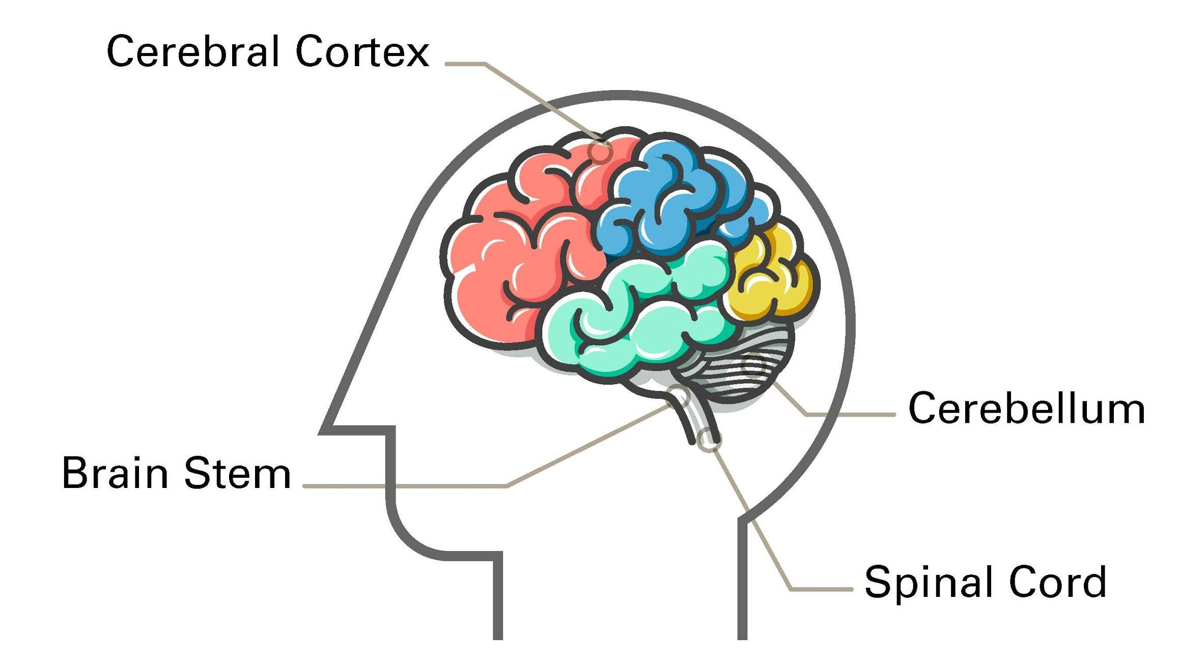
How Your Brain Works
Notes:
Handouts:
Give the students the flyer titled “How the Brain Works” for reference.
Slide overview:
This is the introduction to the nervous system. Ask the children if they want to see a brain or know how it works. Pull up this slide and point out the different components and explain what they do.
Content:
•The brain stem (at the bottom) is responsible for vital functions, like breathing, swallowing, and heart beating
•The brain is connected to the spinal cord through the brain stem. Nerves connect the brain stem and spinal cord to the muscles and receptors throughout the body.
•The cerebellum (striped region) gives you balance, helps you play piano and remembers how to ride a bike
•The cerebral cortex (in red) tells you who you are, what makes you happy or sad, lets you play sports and allows you to experience you world
Note:
If you wish, you also can discuss the other components of the nervous system.

Slide 4
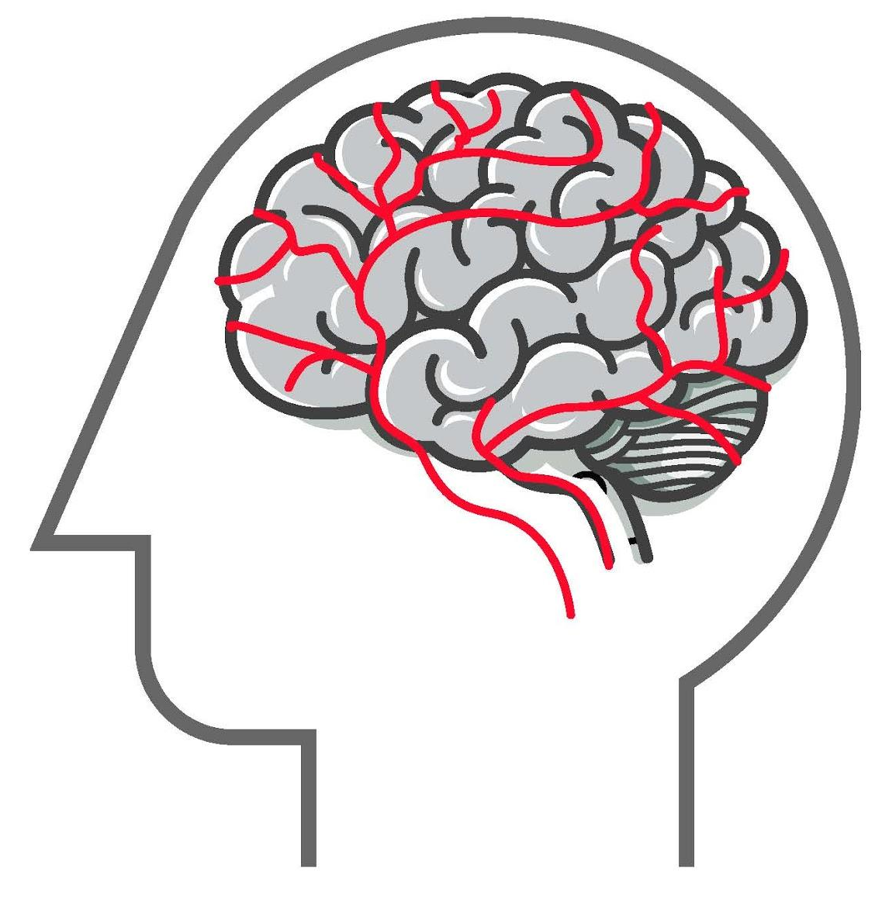
What is a stroke?
Notes:
Slide overview:
This slide introduces the concept of blood vessels and why they are important, and explains how blood nourishes the brain. Point out the blood vessels in the picture.
Content:
The brain controls all the functions of your body, including movement, thinking, talking, breathing, and heartbeat. Your brain receives a constant flow of blood from blood vessels in the neck and brain that is filled with oxygen and nutrients that keep the brain healthy. Blood vessels are important and must be healthy to bring blood to the brain (reference the web of healthy blood vessels in the picture). If one of these blood vessels are blocked, then that part of the brain will not work properly.

Slide 5
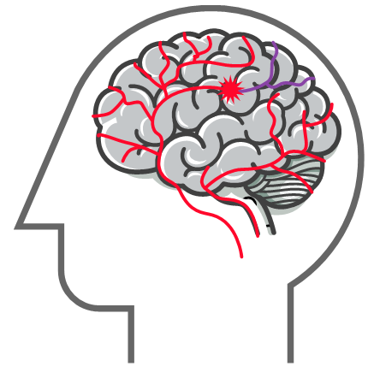
What is a stroke?
Notes:
Slide overview:
This slide introduces the concept of a stroke.
Content:
So, what is a stroke?
A stroke is a rapid loss of brain function caused by some type of disturbance in the blood supply to the brain, usually caused by a blood clot or bleeding in the brain. As a result, the part of the brain that does not receive blood starts to die (refer to the blood clot and purple blood vessels above the clot that are dying). There are a few different types of stroke, but the symptoms are similar, and there are ways that will help you remember how to recognize a stroke.
Note:
Be interactive! Before going to the next slide, ask the children if they have any ideas about how to keep their brains and blood vessels healthy. Invite different children to offer one way – you might be surprised at the answers you will get. Keep it fun!

Slide 6
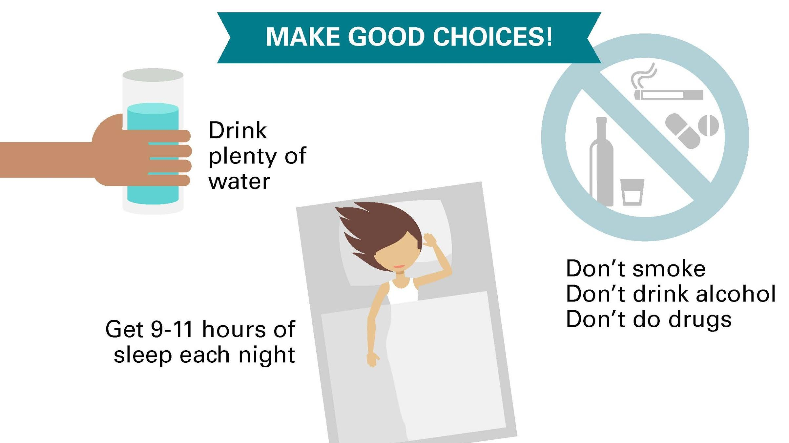
How do you keep your brain healthy?
Notes:
Slide overview:
These two slides are meant to educate kids about how to keep their brains healthy, how to live healthily, and how to prevent a stroke.
Content:
What do you need to keep your brain healthy?
•Blood
•Oxygen
•Glucose/sugar
•Healthy blood vessels
What habits are good?
•Eating healthy
•Exercise
•Keeping hydrated/drinking water
•Getting plenty of sleep
•
What habits are bad?
•Don’t smoke
•Don’t do drugs
•Do not drink alcohol

Slide 7
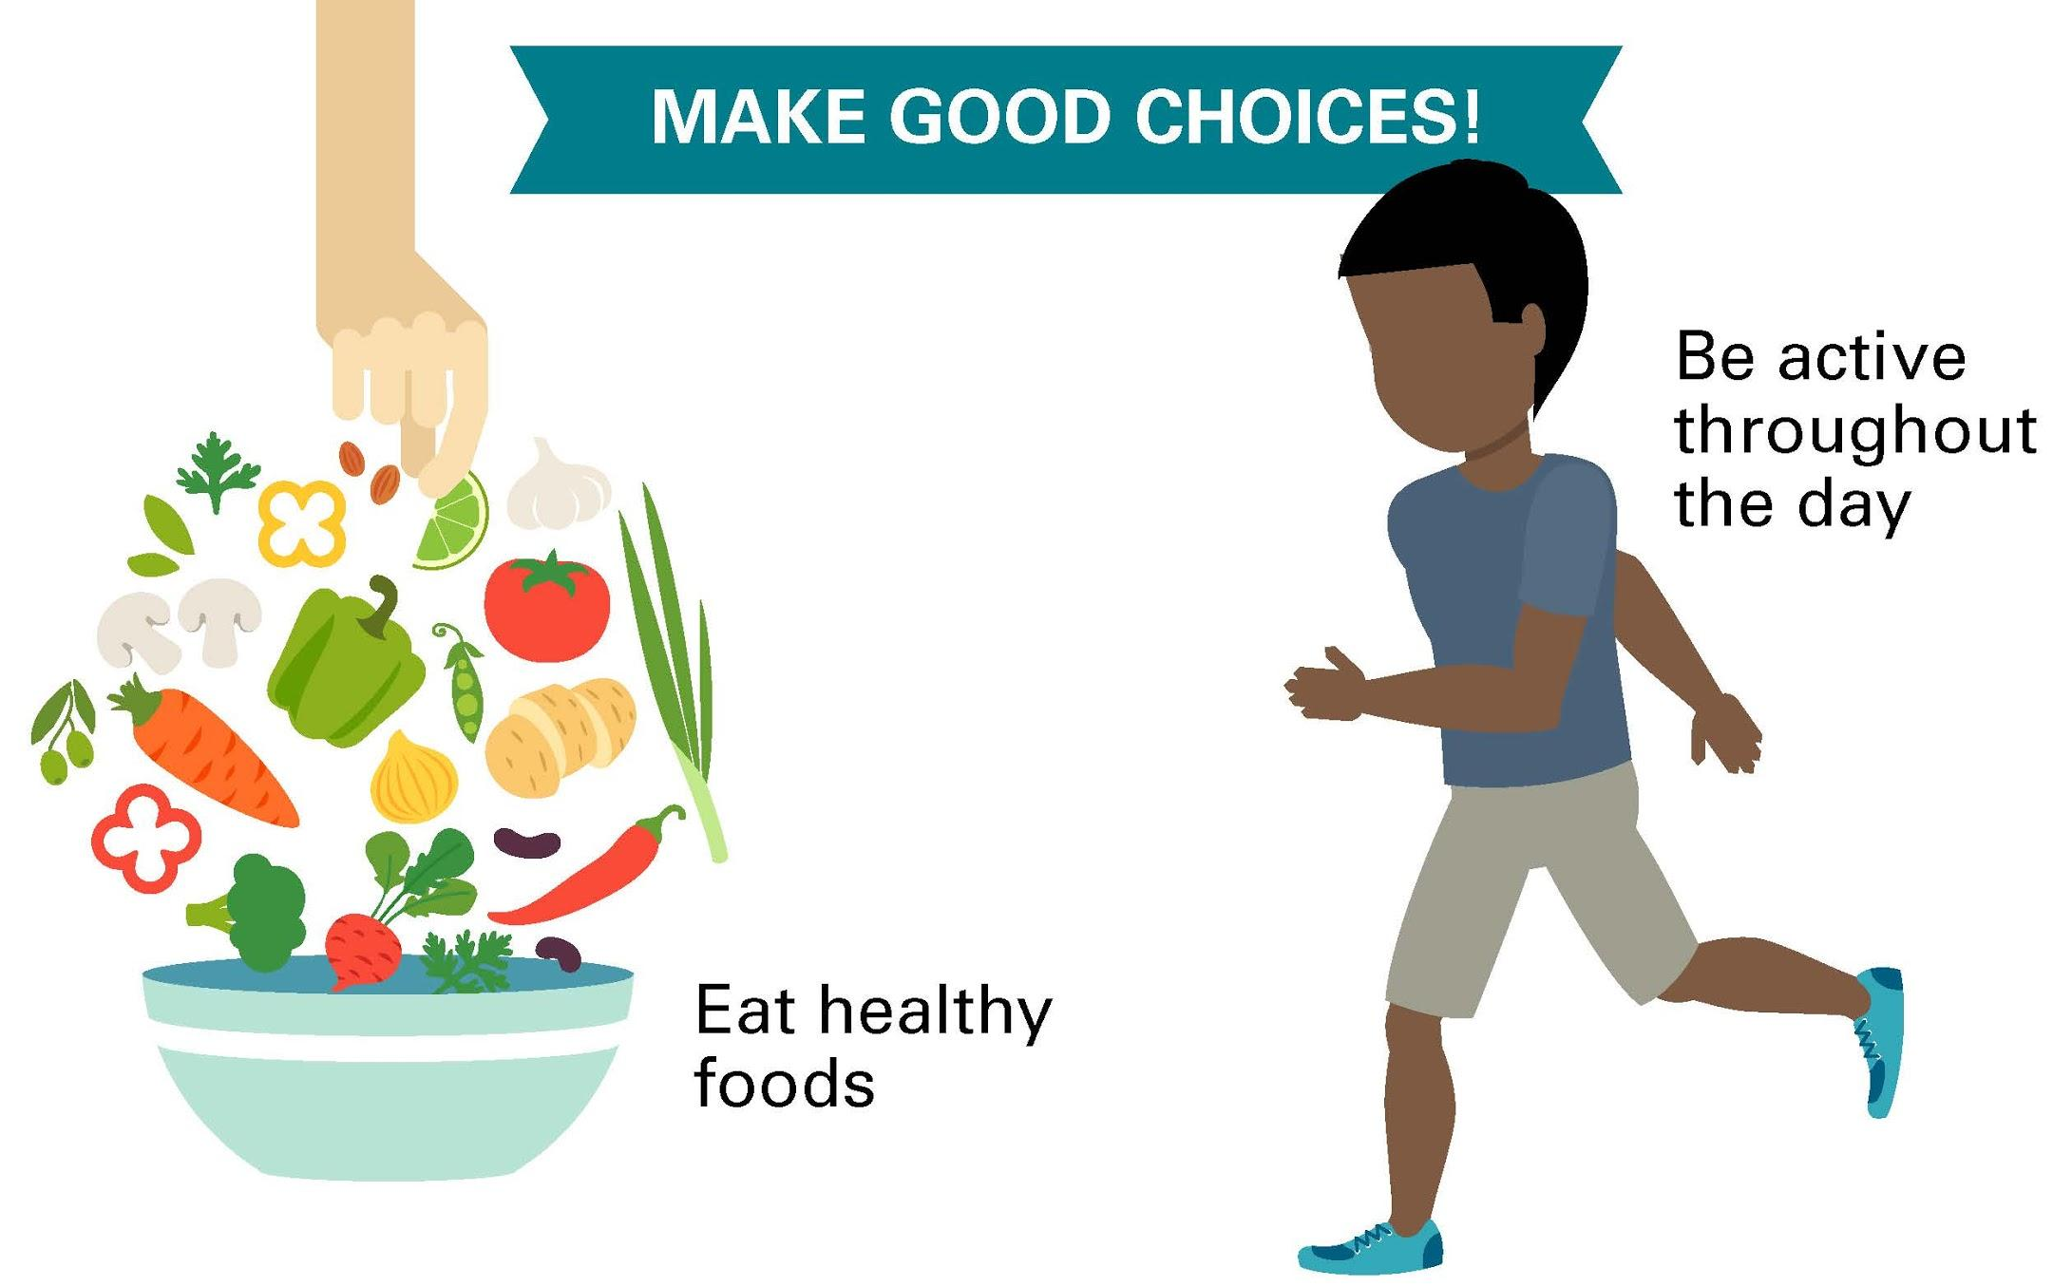
How do you keep your brain healthy?
Notes:
Slide overview:
These two slides are meant to educate kids about how to keep their brains healthy, how to live healthily, and how to prevent a stroke.
Content:
What do you need to keep your brain healthy?
•Blood
•Oxygen
•Glucose/sugar
•Healthy blood vessels
What habits are good?
•Eating healthy
•Exercise
•Keeping hydrated/drinking water
•Getting plenty of sleep
•
What habits are bad?
•Don’t smoke
•Don’t do drugs
•Do not drink alcohol

Slide 8
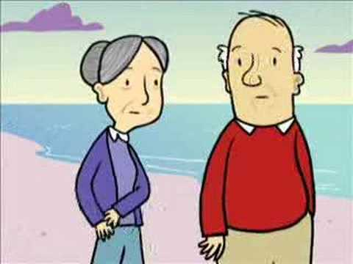
Stroke Heroes
Notes:
Slide overview:
This Act F.A.S.T. cartoon video will demonstrate to the children, in a fun way, how to recognize a stroke and provides a pneumonic to help them remember.
Handouts:
Give the students the handout titled “Symptoms of a Stroke” to reference on this slide.

Slide 9
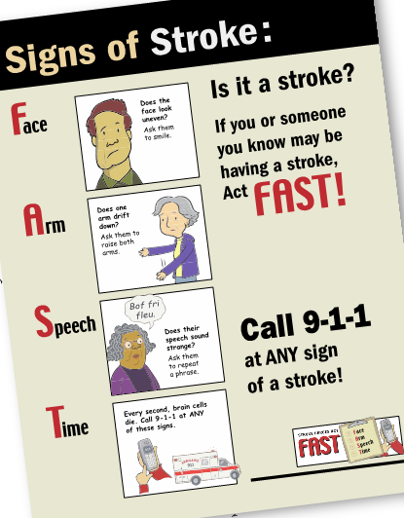
Let’s Practice! Act FAST
Who would
like to volunteer?
Notes:
Handouts:
Give the students the F.A.S.T. Flyer to reference on this slide.
Content:
Ask if any students have any thoughts or questions about the video, and answer them to the best of your ability. See if any students would like volunteer to perform the Act F.A.S.T exam on one of the presenters.
Note:
After this slide is complete, the PowerPoint portion of the lesson is complete – now, the fun can begin with role playing through skits!

Slide 10

Ready to act it out?
Notes:
Slide overview:
At this point, an area should be cleared for the stage, and the children seated to view the skit. Move media equipment aside as necessary. This transition process may take a few minutes, and one of the presenters can keep the children occupied by facilitating health related discussions. Review the demonstration skits in the video before acting it out for the students. Remember: You will be acting out the skits live, as opposed to playing the demonstration video for the children.
Note:
Skit #1: This skit is meant to emphasize that sometimes adults make the wrong decision when reacting to stroke; in this case, wishing to rest, instead of seeking immediate attention.
Skit #2: This skit also emphasizes how adults can make the wrong choices; in this case, deciding to postpone stroke treatment until after the baseball game instead of seeking immediate medical treatment. It is up to children in these circumstances to be persistent that they call 9-1-1.
Skit #3: This skit is meant to demonstrate a common mistake either a stroke victim or loved one can make when reacting to a stroke – calling the doctor instead of calling 9-1-1, delaying the opportunity for emergency treatment. Also emphasize not to eat or drink anything while having a stroke or while your loved one is having a stroke, even an aspirin.

Slide 11
Thank You
for participating today!
Any questions?
Please remember to fill out surveys!
Notes:
Slide overview:
You should be wrapping up at this point.
1. Review: What does Act F.A.S.T. stand for?
F: Stands for face. Does their face droop to one side, or do they have an uneven smile?
A: Stands for arm weakness. Is one arm weaker than the other or is numb?
S: Stands for speech. Are they having trouble talking, or is their speech slurred?
T: Stands for time. Call 9-1-1 immediately! Every moment counts!
Emphasize: Don’t eat or drink anything when having symptoms; Don’t drive; Call 9-1-1!
2. Post-test: Informal verbal test for 1st and 2nd graders, and distribute paper tests for 3rd graders and above.

