Slide 1
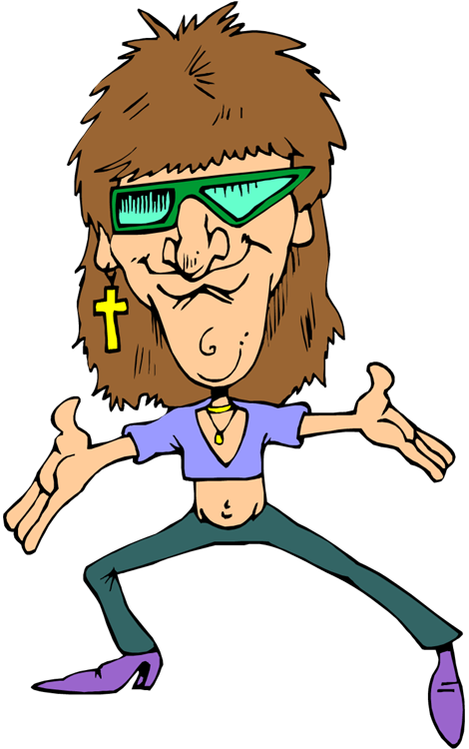
Celebrities

Slide 2
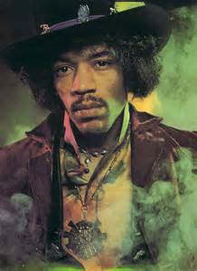
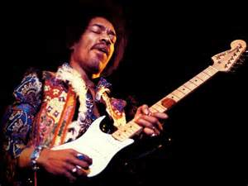
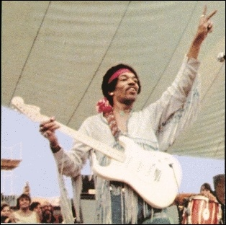
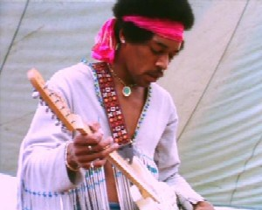
Jimi Hendrix

Slide 3
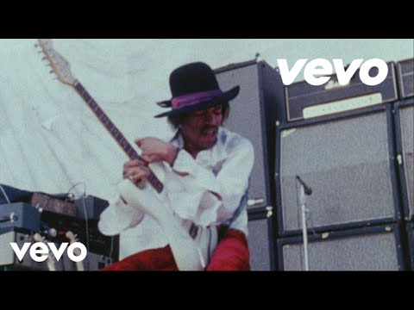
Jimi Hendrix

Slide 4
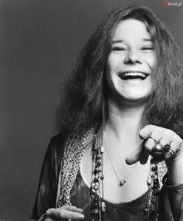
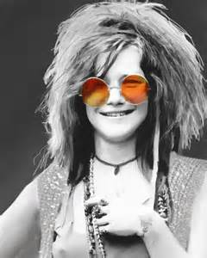
Janis Joplin

Slide 5
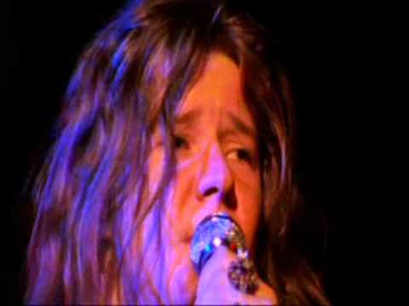
Janis Joplin

Slide 6
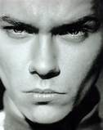
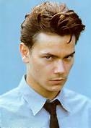
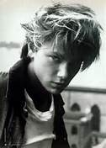
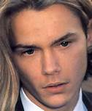
River Phoenix

Slide 7
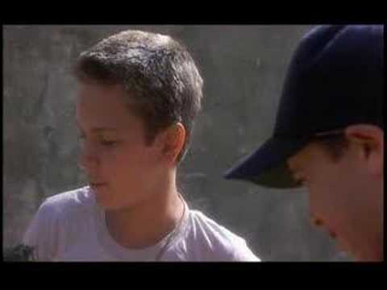
River Phoenix

Slide 8
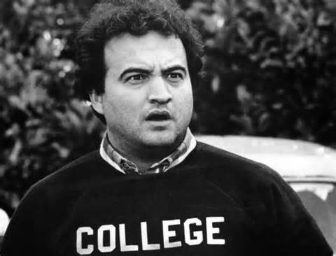
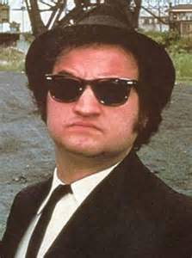
John Belushi

Slide 9
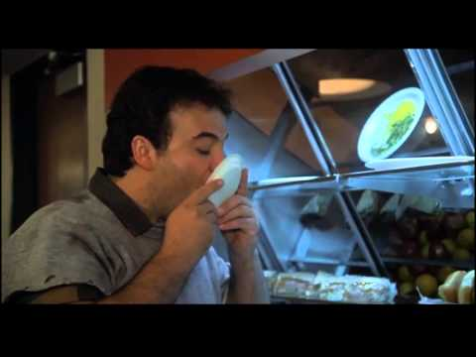
John Belushi

Slide 10
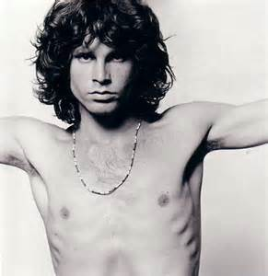
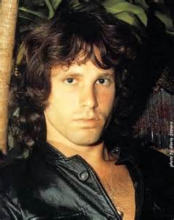
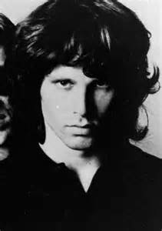
Jim Morrison

Slide 11
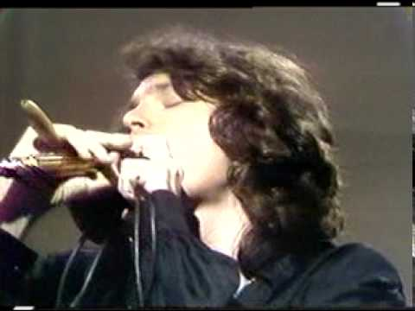
Jim Morrison

Slide 12
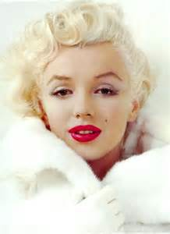
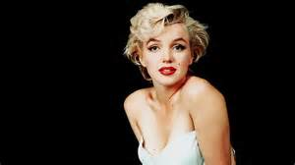
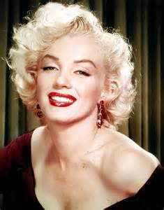
Marilyn Monroe

Slide 13
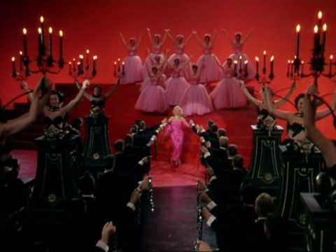
Marilyn Monroe
https://www.youtube.com/watch?v=Gs1ndTU7dbo

Slide 14
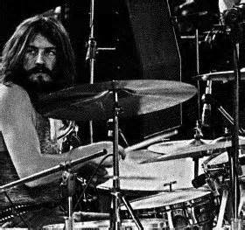
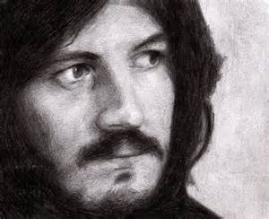
John Bonham

Slide 15
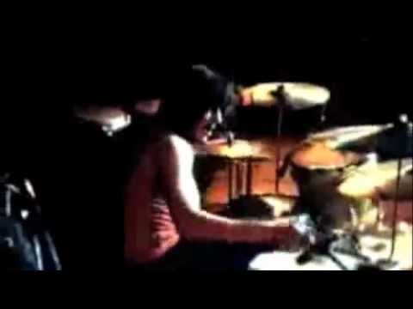
John Bonham

Slide 16
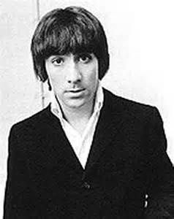
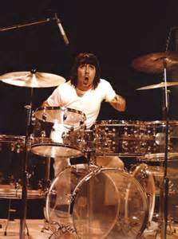
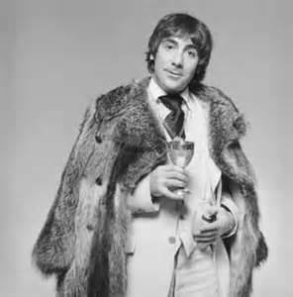
Keith Moon

Slide 17
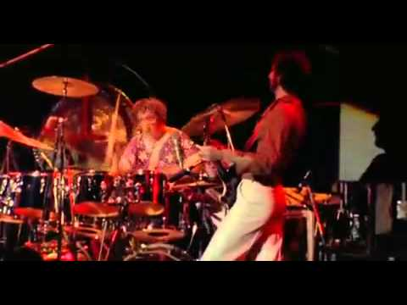
Keith Moon

Slide 18
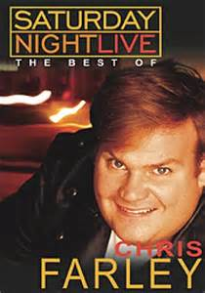
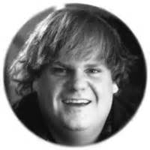
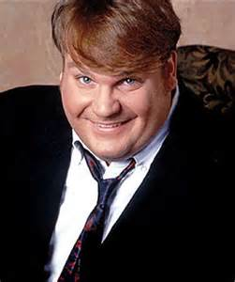
Chris Farley

Slide 19
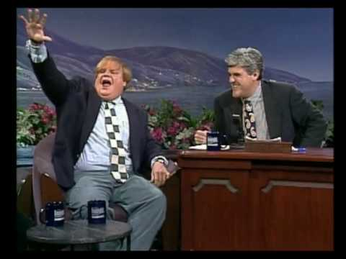
Chris Farley

Slide 20
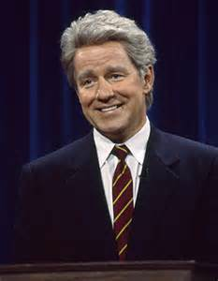
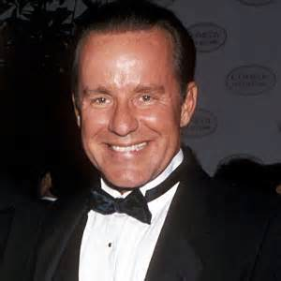
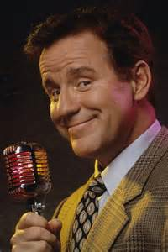
Phil Hartman

Slide 21
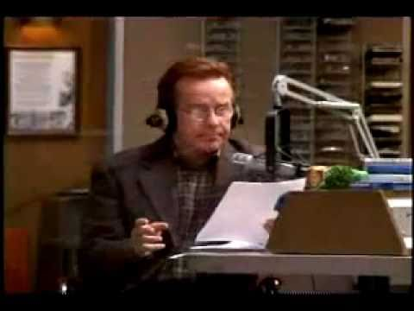
Phil Hartman

Slide 22
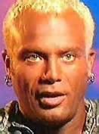
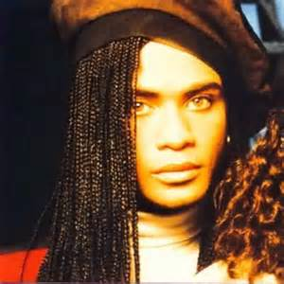
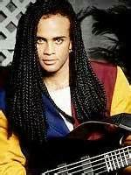
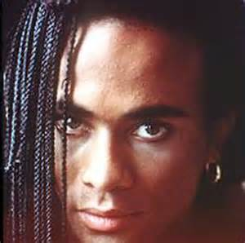
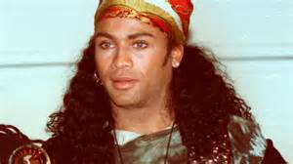
Rob Pilatus

Slide 23
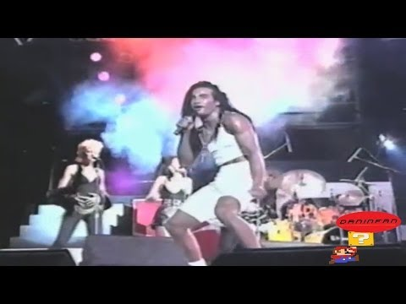
Rob Pilatus

Slide 24
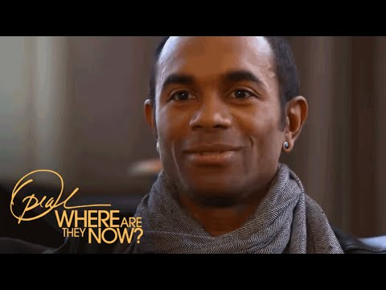
Rob Pilatus

Slide 25
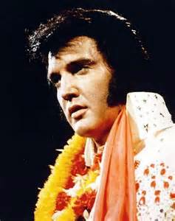
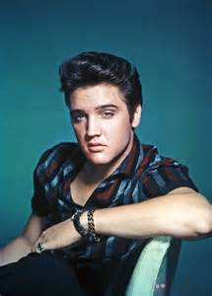
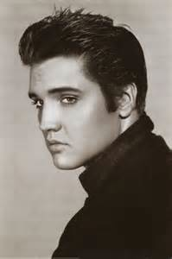
Elvis Presley

Slide 26

Elvis Presley

Slide 27



Chris Kelly

Slide 28

Chris Kelly

Slide 29



Bon Scott

Slide 30

Bon Scott

Slide 31



Hillel Slovak

Slide 32

Hillel Slovak

Slide 33




Judy Garland

Slide 34

Judy Garland

Slide 35



Kurt Donald Cobain

Slide 36

Kurt Donald Cobain

Slide 37



Anna Nicole Smith

Slide 38
Anna Nicole Smith

Slide 39




Heath Ledger
å

Slide 40

Heath Ledger

Slide 41




Michael Jackson

Slide 42

Michael Jackson

Slide 43

Gia
Carangi
)

Slide 44

Gia
Carangi
)

Slide 45



Amy Winehouse

Slide 46

Amy Winehouse

Slide 47




Princess Diana

Slide 48

Princess Diana

Slide 49



Whitney Houston

Slide 50

Whitney Houston

Slide 51



Corey Monteith

Slide 52

Corey Monteith

Slide 53

Phillip Seymour Hoffman

Slide 54

Phillip Seymour Hoffman

Slide 55



Prince

Slide 56

Prince

Slide 57


Slide 58



Slide 59



Slide 60



Slide 61



Slide 62


Slide 63


Slide 64


