Slide 1
Lead the Scene
Presenter Name/Organization
Notes:
Welcome to today’s program, “My Generation Rx: Lead the Scene”. You may be asking yourself, “What is My Generation Rx?”
“My Generation Rx” encourages teens to incorporate the Generation Rx messages into their individual, everyday lives. These messages focus on preventing prescription drug misuse by talking with teens about how to safely use medications and how to turn down invitations to misuse, as well as identifying positive alternatives for coping with the demands of life.
Today, we’ll conduct a skit-based activity that discusses these messages. First, we’ll watch three separate scenarios from a theatrical performance presented by InterACT, a theatrical group at Ohio State University. After each scenario, we’ll have a brief discussion. Following the last scenario, we’ll conduct a skit-based activity to apply what we’ve learned.
Note for facilitator: we encourage you to access the video of the theatrical performance that accompanies this activity before you begin. This video is titled “Lead the Scene”, and posted with this activity on GenerationRx.org. Once you’ve accessed the video, minimize it on your computer until the activity prompts you to play it (prompts included in the talking points in slide 4, 8, 11).

Slide 2


Medications can help us when used as directed by a healthcare professional
Notes:
Transition: But first, let’s talk a little bit about prescription drugs. Medications can help us...
Prescription medications can help us lead longer and healthier lives when used under the supervision of a healthcare professional, like a doctor or pharmacist.
Our life expectancy is the longest in history, and people are now able to live with many diseases that were once fatal.
We are preventing or curing many illnesses and relieving troublesome symptoms, in part, because of prescription medications.
Transition: Medications can help us, but only when used as directed by a healthcare professional. Medications can be harmful, especially when misused.

Slide 3




Misusing medications is:
Taking medication for a reason different than prescribed.
Taking more than prescribed.
Sharing or taking someone else’s medication.
Regardless of intentions…
Notes:
Transition: We define prescription drug misuse as engaging in primarily three behaviors.
Taking more of a prescription medication than prescribed.
Taking a prescription medication for a different reason than prescribed.
Sharing or taking someone else’s prescription medication.
Engaging in any of these behaviors is very dangerous, and could possibly result in a variety of social, legal, and health-related consequences.
Note to facilitator: If asked, the National Institute of Health drafted and currently supports these definitions of prescription drug misuse.

Slide 4

4
Notes:
Transition: Let’s watch our first scenario. You’ll meet James, who is celebrating his 21st birthday; Peter, James’ best friend, and Noah, a high school senior that is the sister of Peter’s girlfriend. The scene is a college party.
Note to facilitator: When you are ready to play the video, minimize this presentation. Play the video—the video begins with scenario 1. Click ‘pause’ following the end of scenario 1. Minimize the video, and then resume this presentation.

Slide 5
Scenario 1
Did any of the characters misuse medication?
What types of medication did Peter and James misuse?
Why do you think Peter and James misused medication?
Notes:
Transition: Let’s discuss this scene.
Did any of the characters misuse medication?
James: took more of a medication than prescribed; shared medication; took medication for a reason different than prescribed; took someone else’s medication
Peter: took someone else’s medication; stole medication; took medication for a reason different than prescribed
What types of medication did Peter and James misuse?
Percocet (prescription opioid pain medication) and Xanax (prescription sedative)
Prescription sedatives, stimulants, and opioids, or painkillers, are the most commonly misused types of prescription drugs.
Why do you think Peter and James misused medication?
Peter: to have fun, to provide James with a good time on his birthday
James: to have fun, to seek attention (he wanted others to think of him as an individual that threw great parties)

Slide 6
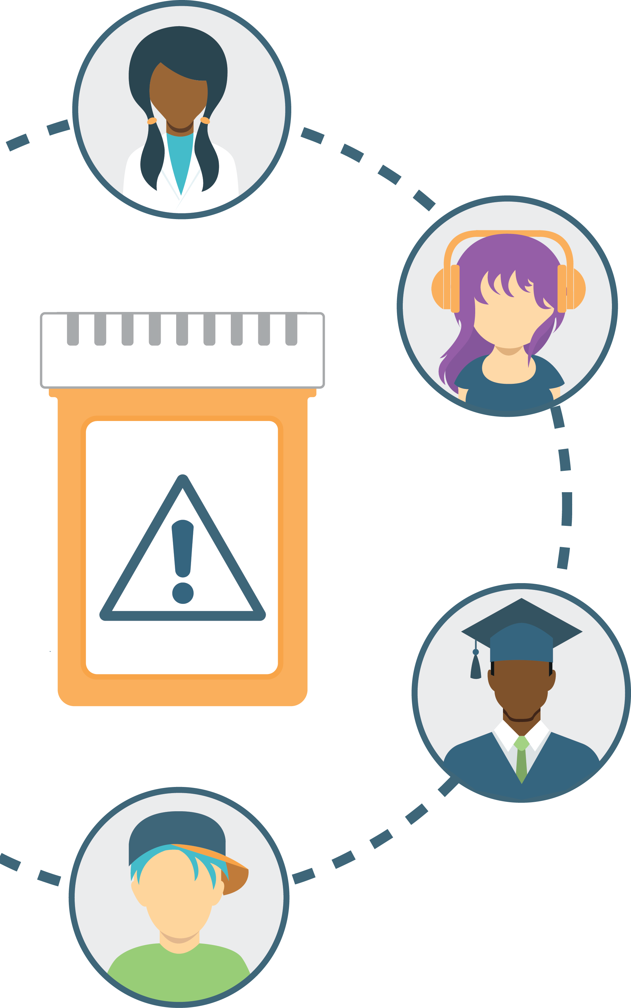

Think About It:
Some people misuse medication by taking them for a different reason than prescribed.
What reasons do teens give?
6
Notes:
Transition: Some people misuse prescription medications by taking them for a reason different than prescribed. What reasons do teens give for misusing prescription medications?
Note to facilitator: encourage participants to suggest reasons. If time allows, you may consider allowing participants to brainstorm reasons in groups. When ready, consider listing these reasons on a whiteboard or a large sheet of paper for all participants to see. Possible reasons include:
To manage stress
To improve academic performance or help in school
To cope with feelings of depression
To deal with a physical injury in order to perform in an athletic event (“play through the pain”)
To have fun
To have something to do (i.e. boredom) or try something new (i.e. curiosity)

Slide 7

Think About It:
What could teens do instead of misusing prescription drugs?
Identify a few positive alternatives.
7
Notes:
Transition: Now that we’ve identified common reasons for misusing, let’s consider some positive alternatives.
Note to facilitator: Encourage participants to brainstorm positive alternatives for the identified reasons. Consider listing these alternatives next to your list of “reasons” on the same whiteboard.
Below are talking points for some alternatives that teens might suggest.
To help with school: it may be tempting to misuse prescription drugs as a “quick fix” to help you cram for an upcoming exam. However, this isn’t a sustainable approach for earning good grades. Try studying with friends, work with a tutor, or meet with your teacher before or after school.
To cope with depression: if your mood feels depressed, confide in a trusted adult. Resorting to misusing prescription medications or using other substances will only prolong your feelings of depression.
To deal with an injury: if you are an athlete experiencing an injury, you may feel pressure to “play through the pain”. However, the possible consequences from misusing a prescription opioid pain medication are far more devastating than not performing in an athletic event. If you are dealing with an injury, work with an athletic trainer or a healthcare professional to safely plan your recovery.
To handle boredom: boredom can affect all of us…try curing your boredom by engaging in something you enjoy (like art, sports, helping others, etc).
To handle stress: stress will always be present in life. Try adopting healthy habits for dealing with stress like exercising, watching TV or a movie, or taking a nap.

Slide 8
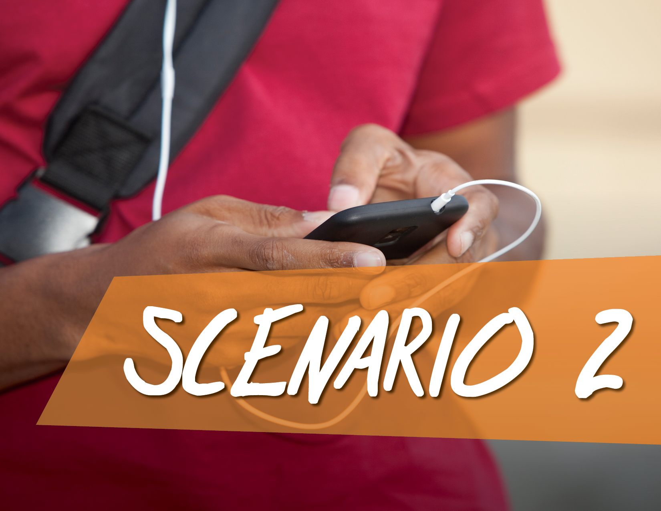
8
Notes:
Transition: Let’s watch our second video clip. Noah and Peter are having a phone conversation. Listen closely, and we’ll discuss the scene when it’s over.
Note to facilitator: When you are ready to play the video, minimize this presentation. Play the video—the video should now begin with scenario 2. Click ‘pause’ following the end of scenario 2. Minimize the video, and then resume this presentation.

Slide 9

Scenario 2
How should Noah handle this situation?
If you were Noah, how would you respond?
What happened in this scenario?
Notes:
Transition: Let’s discuss this scene.
What happened in this scenario?
Noah has a legitimate prescription for Adderall, a prescription stimulant. Peter asked Noah for some of her Adderall to help him study.
How should Noah handle this situation?
Before participants respond, consider posing the question, then advancing the presentation to the next slide. Slide 10 focuses on participants brainstorming techniques for saying “no” to requests for sharing prescription drugs.

Slide 10
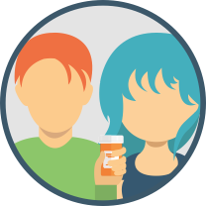
Think About It:
What are ways to say “no” if a friend asks you to share your prescription medication?
Identify a few approaches.
Notes:
Transition: What are ways to say “no” if a friend asks you to share your prescription medication?
Note to facilitator: encourage participants to suggest approaches for saying “no”. If time allows, you may consider allowing participants to brainstorm approaches in groups. When ready, consider listing these approaches on a whiteboard.
Below are suggested approaches for saying “no”:
Use humor, while still saying no
Give a reason or make-up an excuse for saying no
Suggest positive alternatives
Be assertive and consistent, if necessary

Slide 11

11
Notes:
Transition: Let’s watch our last video clip. Noah and Peter are at a college party.
Note to facilitator: When you are ready to play the video, minimize this presentation. Play the video—the video should now begin with scenario 3. Click ‘pause’ following the end of scenario 3. Minimize the video, and then resume this presentation.

Slide 12
Scenario 3
What happened in this scenario?
What potential outcomes could happen for Noah in this situation?
Do you agree with how Peter handled this situation?
Notes:
Transition: Let’s discuss this scene.
What happened in this scenario?
Noah now appears to be misusing prescription drugs, as she was mixing alcohol with them. She also invited Peter to misuse, but he turned down the invitation.
What potential outcomes could happen for Noah in this situation?
Multiple negative outcomes could occur, including legal, social, and health-related consequences:
Legal: It doesn’t appear that Noah is 21; therefore, she is not of legal age to drink. In addition, federal law prohibits the possession of a prescription drug without a written prescription.
Health: Not taking a prescription as directed by a healthcare professional can result in immediate negative effects, including:
For prescription opioid pain medications: drowsiness, confusion, sedation, slowed breathing
For prescription sedatives: decreased heart rate and blood pressure, impaired coordination and judgement, confusion, sedation, slowed breathing
For prescription stimulants: increased heart rate and blood pressure, irregular heart beat, nervousness, insomnia
Mixing alcohol with a prescription medication can be dangerous to a person’s health. For example, alcohol use under the age of 21 can impact brain development, and mixing alcohol with prescription medications can lead to breathing and heart problems.
Lastly, when prescription medications are not taken as instructed by a healthcare professional, it increases the likelihood that negative side effects, including developing dependency and addiction, will occur.
Social: The misuse of medications can affect our family and friends, our job, our education, our finances, and much more.
3. Do you agree with how Peter handled this situation?
Peter did refuse Noah’s invitation to misuse. To help Noah, he could try to remove Noah from the situation in order to prevent her from continuing to drink or misuse prescription drugs. Once she is sober, Peter could share his concerns with Noah and a trusted adult.

Slide 13

Think About It:
What are other ways to turn down the invitation to misuse?
Identify a few approaches.
Notes:
Transition: Let’s consider other approaches for turning down the invitation to misuse.
Note to facilitator: encourage participants to suggest approaches for turning down the invitation to misuse. If time allows, you may consider allowing participants to brainstorm techniques in groups. When ready, consider listing these approaches on a whiteboard.
Below are suggested approaches for turning down the invitation to misuse, they are also included as a graphic on slide 14:
Use humor or make a joke
Give a reason or make-up an excuse
Suggest positive alternatives
Leave the situation
Remember to not be afraid to stand up for yourself and that, by not misusing prescription drugs, you are a part of the majority of teens who use medications safely

Slide 14
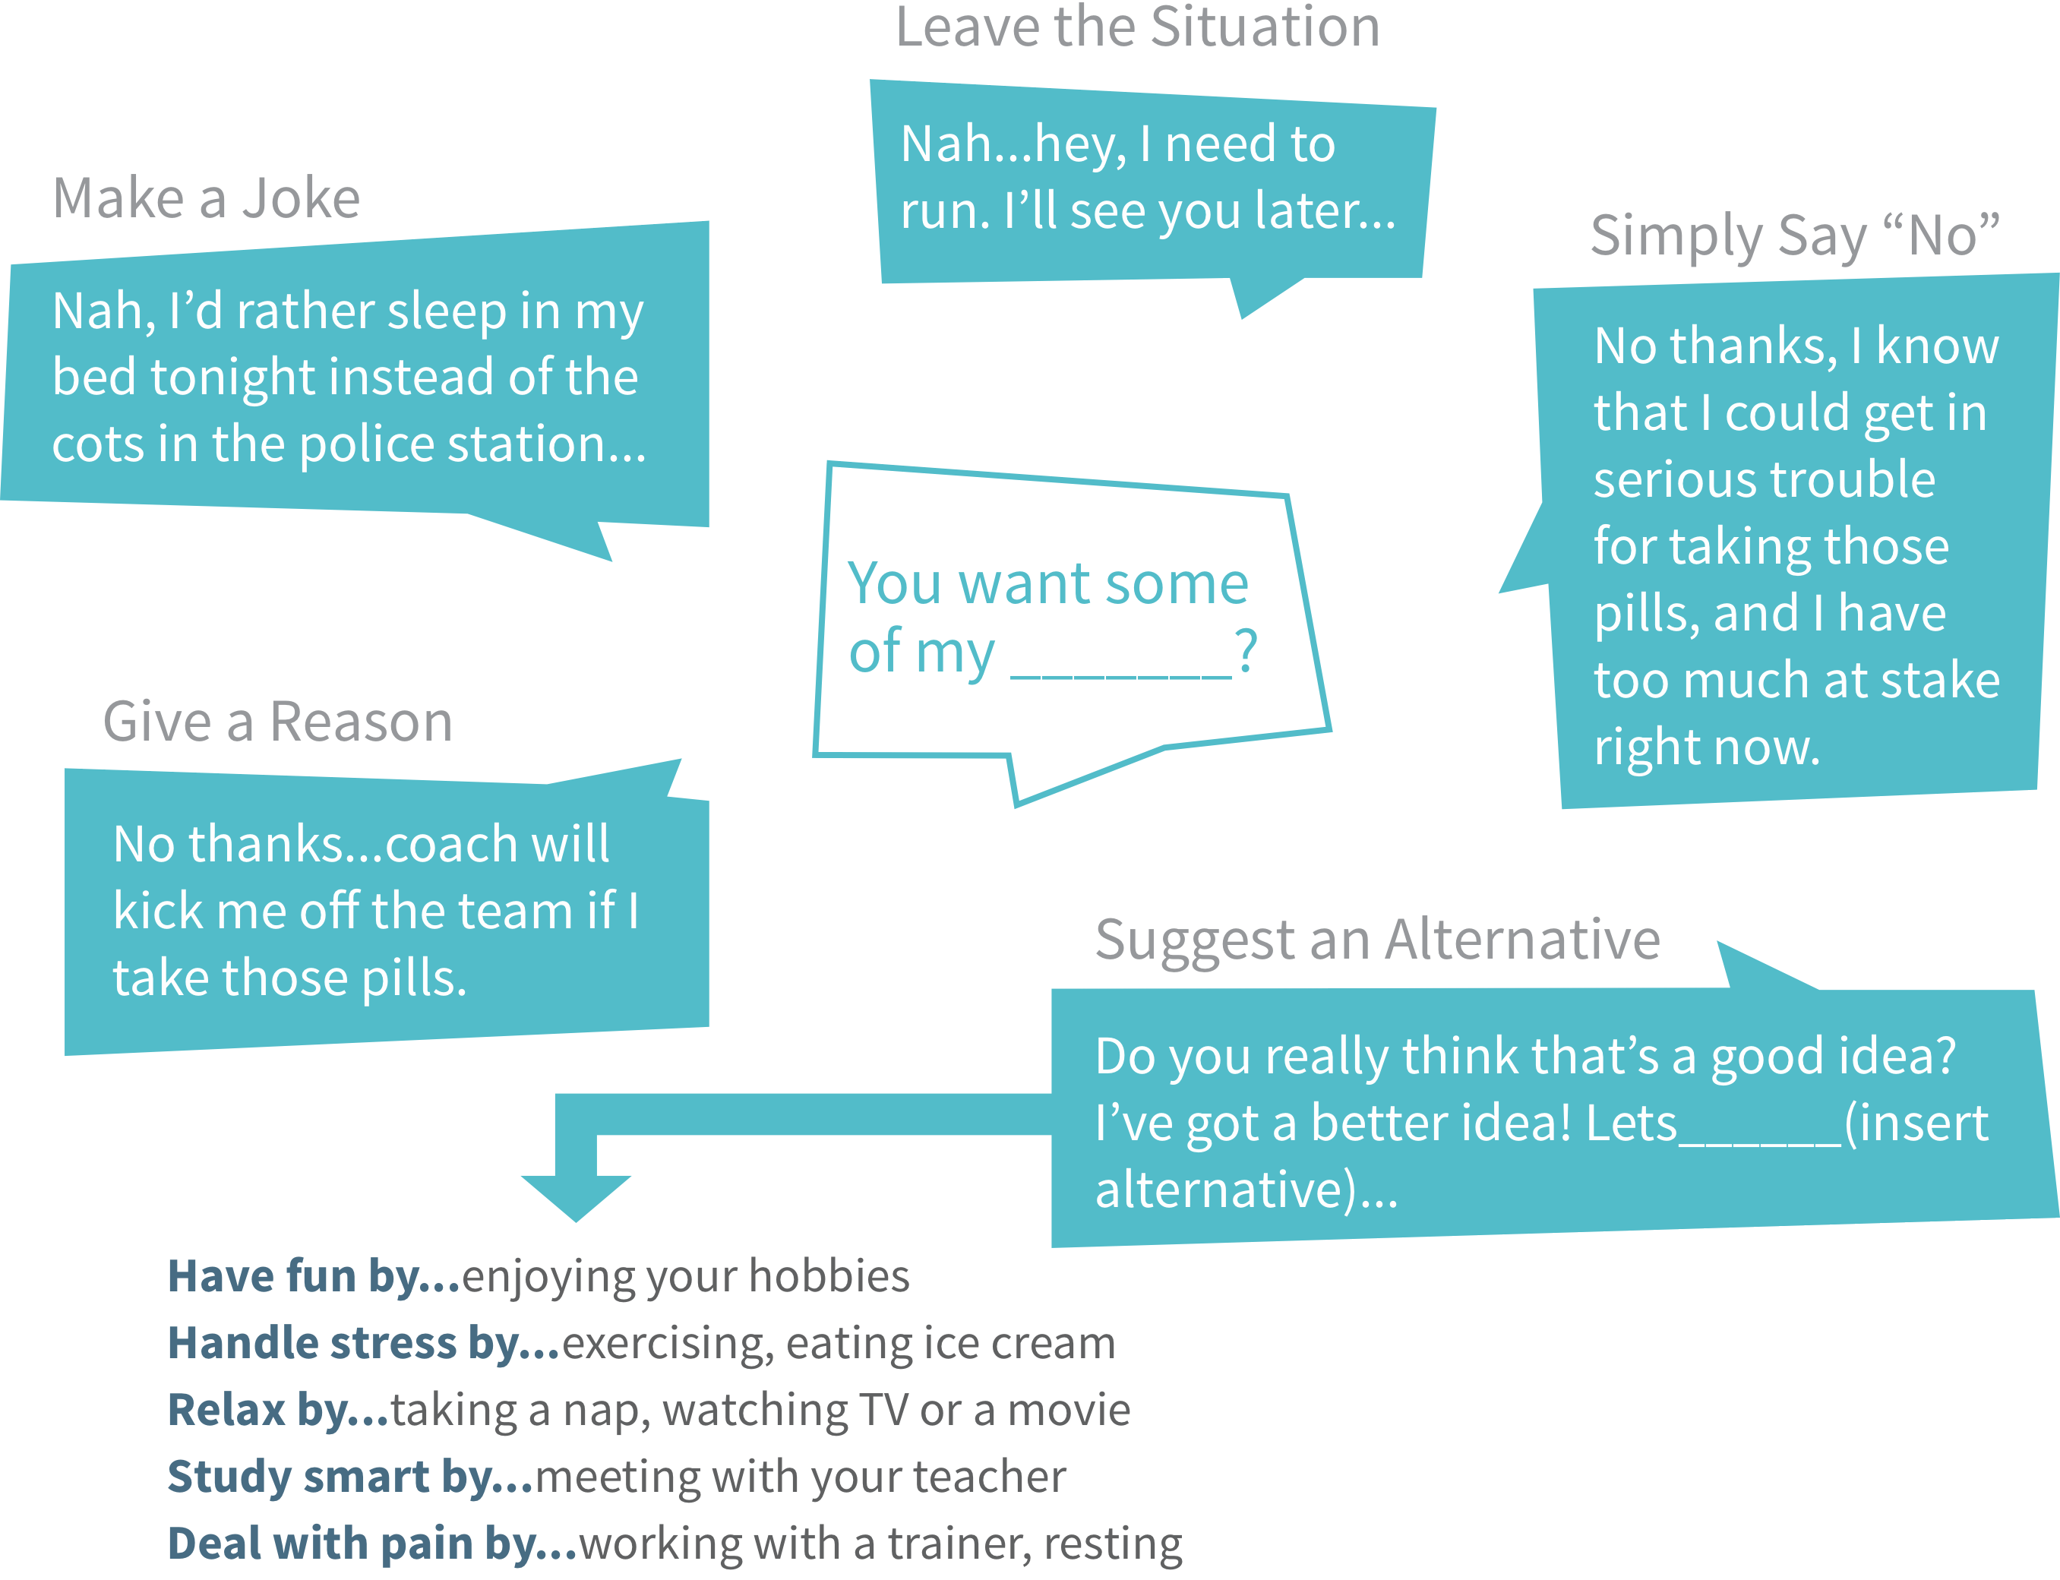
Notes:
Transition: this graphic provides examples of specific approaches, as well as identifies positive alternatives instead of misusing prescription drugs.

Slide 15

If the characters could travel back in time, could different choices have led to more positive outcomes?
Let’s find out!
Think About It:

Slide 16





Activity Instructions
Form small groups. Receive your group’s scenario.
For your scenario, brainstorm different choices the characters could make to ensure a more positive outcome.
Perform this “new” scenario as a theatrical skit—ensure your skit demonstrates these different choices, as well as improved techniques for handling each situation.
Your skit should last 2-3 minutes…be creative!
Notes:
Transition: We’ve observed three different scenarios, and used these scenarios to learn positive alternatives to prescription drug misuse as well as different approaches for saying “no” or turning down the invitation to misuse. It’s time to put these skills to the test!
Note to facilitator: explain the instructions for conducting this activity.
Randomly assign groups Scenario 1-3. If needed, advance the presentation to slide 16 so groups can review the original scenario.
Ensure groups understand that they are traveling back in time and exchanging any negative choices in the scenario for more positive choices. In their skit, they are demonstrating how to implement that more positive choice as well as revealing possibly different outcomes that could occur. Each group has the opportunity to essentially change the scenario to ensure a more positive outcome.

Slide 17
Scenario Recaps
Scenario 2
Scenario 3
Scenario 1
Peter asks Noah for an Adderall® pill.
Noah has to decide how to handle Peter’s request.
James and Peter exchange medication.
Both misuse medication by mixing it with alcohol.
Noah misuses medication by mixing it with alcohol.
Peter declines Noah’s invitation to misuse.
17

Slide 18
Different Choices
Scenario 2
Scenario 3
Scenario 1
Noah informs Peter she is uncomfortable sharing her Rx medication since it is illegal.
Noah offers to help Peter study for future exams.
James and Peter do not misuse medication.
They celebrate James’ birthday by playing laser tag or riding a zip line.
Noah chooses to have fun without misusing Rx drugs.
Noah and Peter host a game night with friends.
Notes:
Note for facilitator: included are suggestions for different choices the characters could make in each scenario to change the outcome. We encourage you to focus on the different choices the participants suggest in their skit, but feel free to suggest these as well.

Slide 19

Summary: Use Medications Safely
Keep for yourself
Follow instructions
Be a good role model
Notes:
Transition: In summary, we can prevent prescription drug misuse by using medications safely. This includes keeping medications for ourselves (not sharing or taking someone else’s medication); following instructions and taking prescription medication as instructed by a healthcare professional (including taking it for only the prescribed reason); and lastly, by being a good role model. This includes modeling these practices at home, and encouraging your family and friends to do the same.

Slide 20

Help Others
Learn more
Share the information
Talk with a trusted adult
Visit: GenerationRx.org
Notes:
Transition: In addition to serving as a good role model, we encourage you to share this information and help others. How can you help others?
First, you (and other adults) can learn more about this issue by visiting the ‘Learn’ section on GenerationRx.org.
Second, you can share these messages with others. This may consist of discussing these messages with family and friends, or sharing these messages through peer-to-peer education. Visit our website, GenerationRx.org, to access free, ready-to-use resources designed to educate teens. You could present this program, or a different activity. You could also present similar educational programs to other audiences, like young children, using our age-appropriate resources.
Lastly, if you are concerned about someone you care about, we encourage you to talk to a trusted adult. In addition, we’ve identified additional resources for helping others on GenerationRx.org.
Note to facilitator: you may consider assisting teens with identifying adults they can discuss concerns with, as well as providing local resources where teens or adults can find help.

Slide 21



Brought to you by:
Notes:
Transition: Does anyone have any questions or comments?
Before we end, we encourage you to stay connected by following us @MyGenerationRx (Twitter) and MyGenerationRx on Instagram.
Also, we encourage you to take a survey evaluating today’s program on GenerationRx.org. You can find a link to this survey at the bottom of the home page. We value your feedback to help us assess the impact of this work and continually improve Generation Rx materials.
Note to facilitator: we encourage you, as the presenter, to also complete this survey. Thank you for advocating safe medication practices in your community!
We also encourage you to share your experience with us. Consider submitting your tips and personal experiences about how you advocate safe medication practices at home or in your community. To do this, visit the ‘Contact’ section of GenerationRx.org. In this same section, you can also submit any questions you may have regarding how to use these educational resources.

