Slide 1
Ending the Silence on Mental Illness
Video Project
Notes:
https://www.nami.org/Learn-More/Know-the-Warning-Signs

Slide 2
1.
Create a 60 Second Video

Slide 3
2.
Include:
Signs and Symptoms of the Mental Illness

Slide 4
3.
Video Reduces Stigma of Mental Illness
Keep language positive
Talk openly about Mental Illness
Stand up for others
Be supportive
Don’t wait to get help

Slide 5
4.
Provides at least one school/local hotline, website, phone # and one national hotline, website, phone #

Slide 6
5.
Message has an overall positive health enhancing message

Slide 7
Project Example:
https://www.youtube.com/watch?time_continue=10&v=IQ1X868672Q

Slide 8
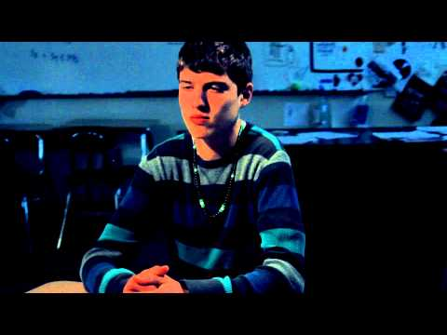
Another Project Example:
https://www.youtube.com/watch?time_continue=2&v=ofnBBuWg7Pk

Slide 9
Video Should
Include:
Videos will be disqualified and not shown if:
Know the signs
Finding the words
Reaching out for help:
National Suicide Hotline
NAMI warmline
Local resources for mental health
Video portrays death
Portrayal of suicide death
Includes weapons/drugs
Inappropriate language
Language that stigmatizes a person living with mental illness
The point of the video is to educate, reduce stigma so people reach out for help. The 60 second film should stay positive and show friends helping each other and recognizing the signs of mental illness.

Slide 10
Resources:
Directing Change. “Circling Stigma.” YouTube. (March 8, 2013). Retrieved June 15, 2018, from
https://www.youtube.com/watch?time_continue=10&v=IQ1X868672Q
Directing Change. “Dear Best Friend”. YouTube. (April 30, 2018). Retrieved June 15, 2018, from
https://www.youtube.com/watch?time_continue=2&v=ofnBBuWg7Pk

