Slide 1
Decision Making

Slide 2
Teen Brain
Notes:
https://www.youtube.com/watch?time_continue=2&v=-KQb3Mx2WMw

Slide 3
No Decision - letting others decide what you will do
Notes:
3

Slide 4
Snap Decision - A quick choice you Make with no consideration of the result
Notes:
4

Slide 5
Responsible Decision - considering others (not only me) and your future (not only now) when you make a decision.
Notes:
5

Slide 6
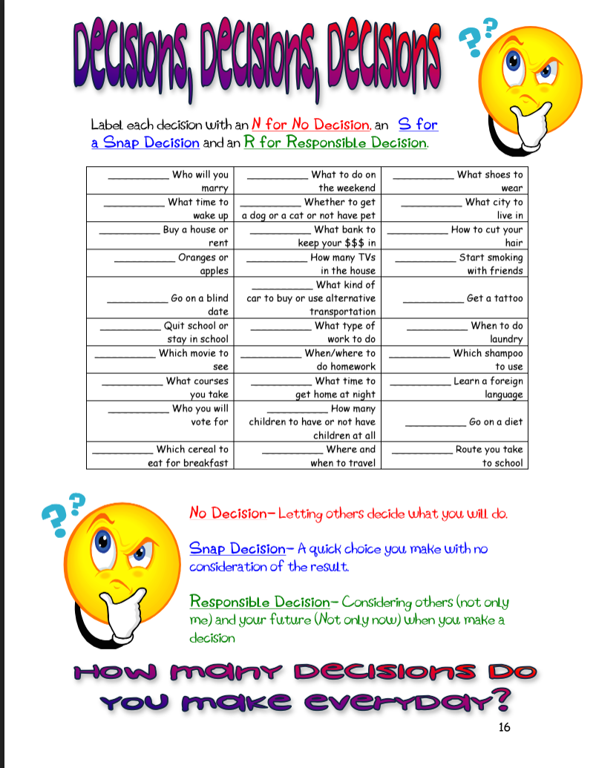
Notes:
6

Slide 7
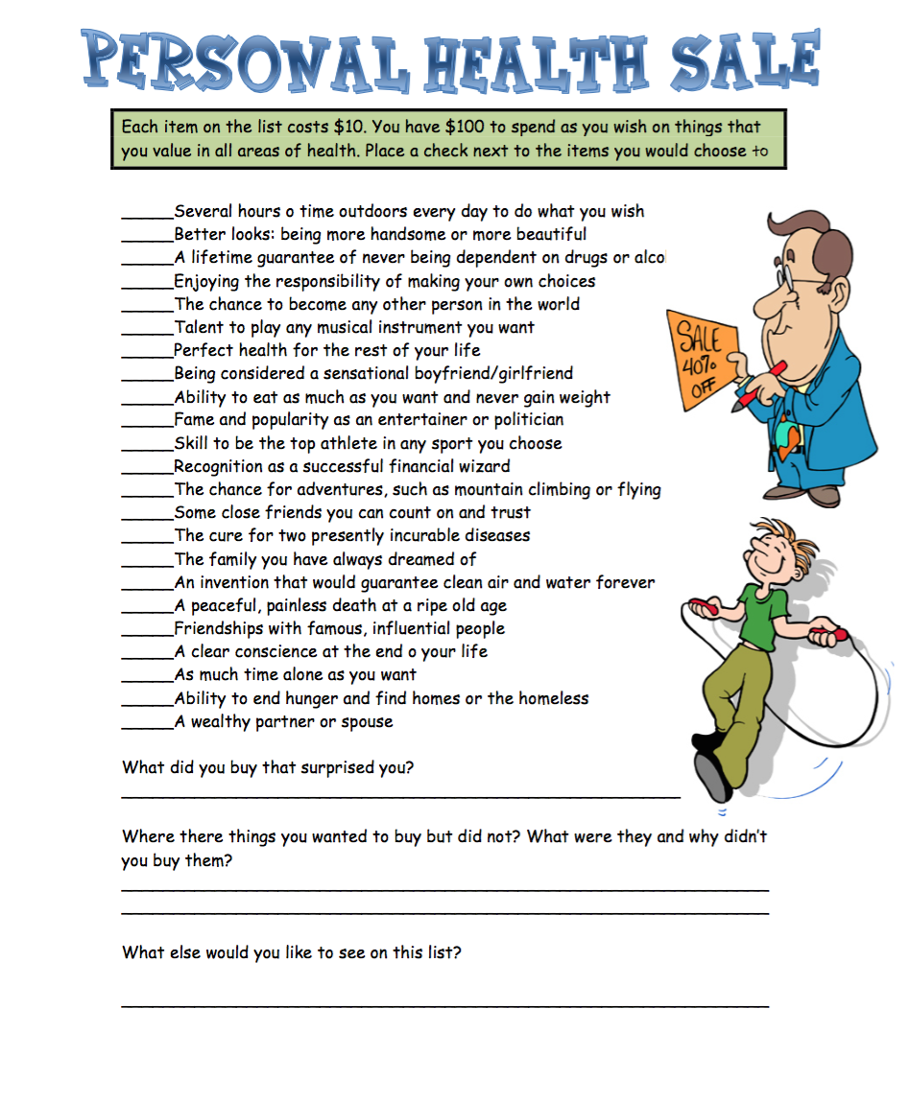
Notes:
7

Slide 8
DECIDE
D Define the problem
E Explore the alternatives
C Consider the consequences
I Identify your values
D Decide and act
E Evaluate the results
Notes:
8

Slide 9
4 Steps to take when you have made a wrong decision
Take responsibility and admit you have made a wrong decision
Do not continue actions based on wrong decision
Discuss the wrong decision with parent, guardian, or other trusted adult
Make restitution for harm done to others
Notes:
9

Slide 10
Core Values
Core- basic or universal
Values- Something of special worth or importance
Notes:
10

Slide 11
Core Values
When one bases his life on principle, 99 percent of his decisions are already made. ~Author Unknown

Slide 12
Equality
Understanding that all people have the same rights
Notes:
12

Slide 13
Social Justice
Treating all people fairly
Notes:
13

Slide 14
Self-Control
Able to control your own actions
Notes:
14

Slide 15
Honesty
Telling the truth and meaning what you say.

Slide 16
Responsibility
Carrying out your obligations or duties and answering for your own actions
Notes:
16

Slide 17
Promise Keeping
Keeping your word
Notes:
17

Slide 18
Respect
Treating everyone, including yourself, with dignity
Notes:
18

Slide 19
Refer to Slide 8 - DECIDEi
Assignment
Illustrate your steps in making an important decision that you are going to have to make in the next 12-18 months. Consider the options and the consequences

