Slide 1
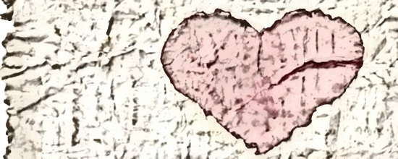
Wrinkled
PERSPECTIVE
Heart

Slide 2
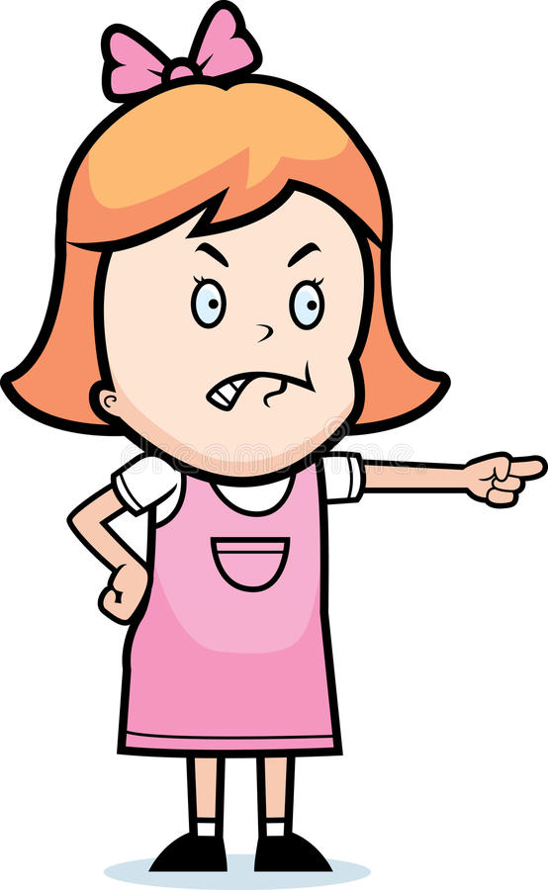
I’m really fed up with my friend Greg. In fact I wouldn’t really call him a friend anymore.
He borrowed my new book. He promised a gazillion times he would bring it to my house after school today.
He only lives down the street.
After school I waited for him to come, but he obviously couldn’t be bothered. I called him and told him what I was really thinking.
Instead of saying sorry he came up with some stupid excuse…I couldn’t take it. I hung up.
I’m over it and HIM!
Name an unkind action, word or feeling that happened in this story. It can be about either character, Marcie or Greg.
For example: Marcie is “fed up”
PERSPECTIVE
Marcie

Slide 3
For every unkind word, action, or feeling ~ make 1 fold in your heart.
It doesn’t matter where your fold is & keep adding 1 fold every time something negative is stated.
PERSPECTIVE

Slide 4
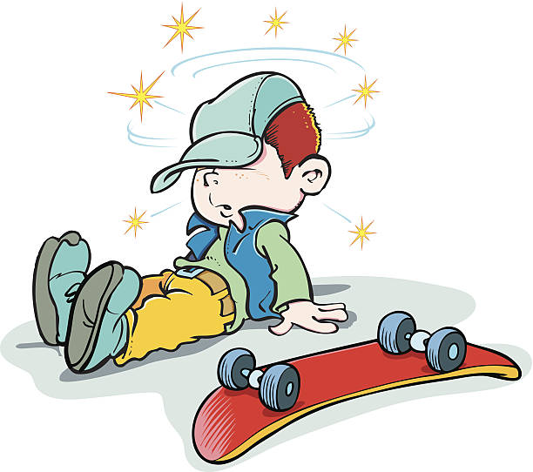
I’m having a really sad moment after a really painful accident yesterday.
Last night I fell off my skateboard and really hurt my head – I had to go to the hospital and they kept me there till midnight!
I was lonely and in pain. I wanted to call Marcie, but they wouldn’t let me. My mom and doctor kept saying “rest” over and over again.
What makes it worse, Marcie called today. I couldn’t wait to tell her about the whole thing, but before I could even tell her anything…she started shouting at me about something I was suppose to give her.
I don’t think she wants to be my friend anymore. She just hung up.
She didn’t ask how I was…or anything.
Greg’s story adds a different perspective or point of view.
PERSPECTIVE
Greg

Slide 5
Unfold your heart.
Can you take the wrinkles away?
What happens when you say or do certain things?
How does it affect others?
PERSPECTIVE

Slide 6
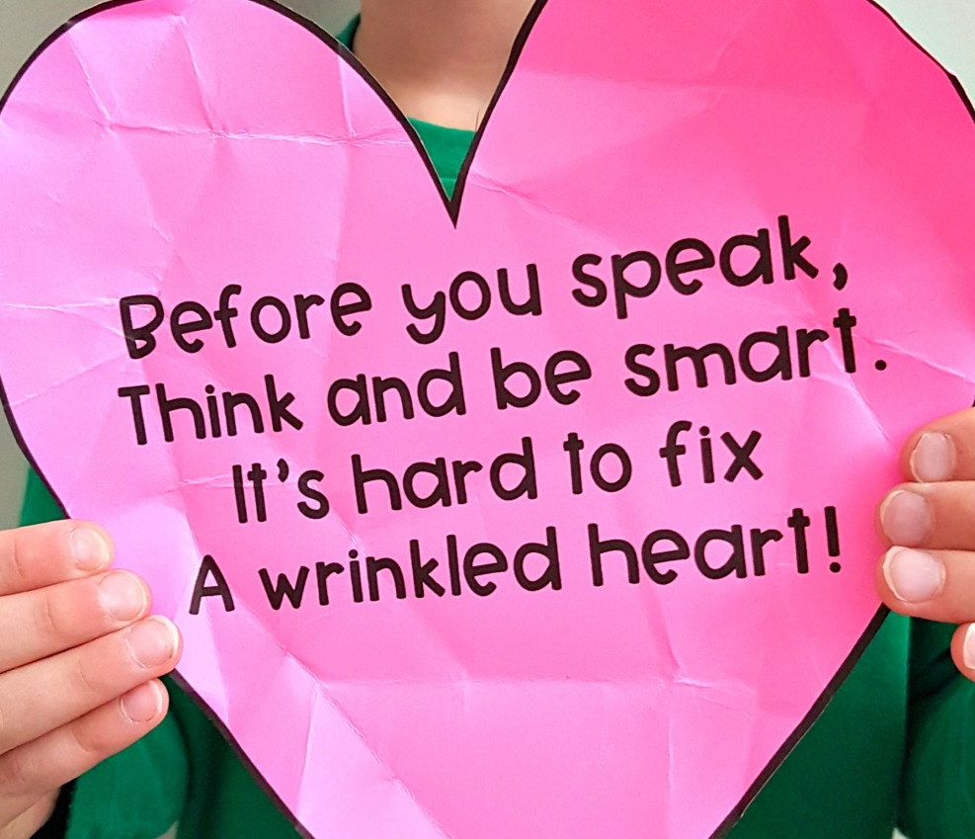
PERSPECTIVE

Slide 7
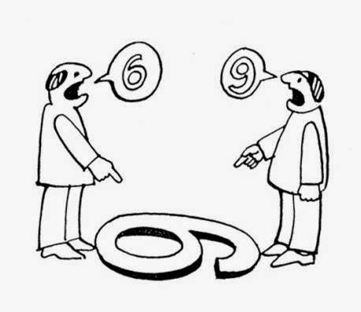
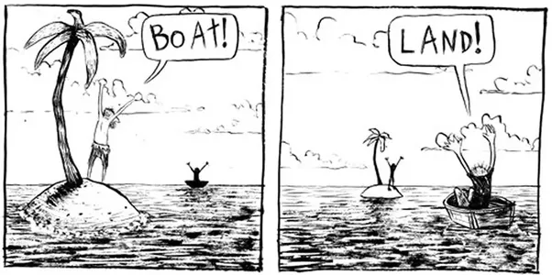
What is going on here?
7
PERSPECTIVE
2 people, 2 sides

Slide 8
Define PERSPECTIVE
8
The way you see something; a point of view
Your outlook on something
Both Marcie and Greg are actually telling the same story but from their own points of view. Neither of them knew the WHOLE story.
Usually when there is a conflict or argument about something, it’s important to find out what the situation is like from the other person’s point of view…this is a game changer.
PERSPECTIVE

Slide 9
How do you think Greg felt when Marcie hung up on her?
How do you think Marcie felt when Greg didn’t return the book?
Why do you think they felt upset with each other?
PERSPECTIVE
Does this situation change the way they really think about each other?
What could Marcie have done differently?
What could Greg have done differently?

