Slide 1
VIDEO
THE BIGGEST ORGAN
FEELS

Slide 2
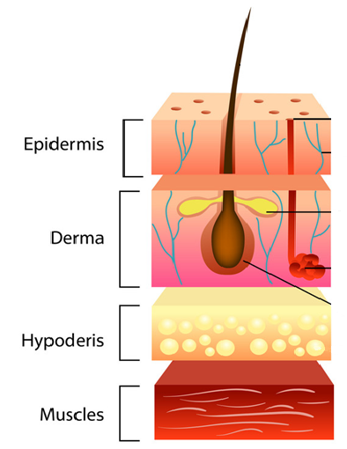
SKIN: Layers
EPIDERMIS
Outer most layer
Barrier/protection
Skin tone/color
DERMIS
Hair follicle
Sweat gland
HYPODERMIS
Fat
Connective tissue
MUSCLE
Movement

Slide 3
SKIN: Care
3. What makes skin different colors?
4. Which layer could get sunburn?
5. What are some helpful hints to protect your skin from the sun?
a. Stay indoors between the hours of
_______ AM and _______ PM
b. Use sunscreen that has UV protection and
reapply about every _______ hours.
MELANIN
EPIDERMIS
10 2
2

Slide 4
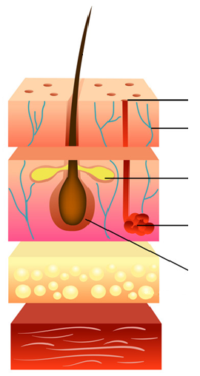
SKIN: Structure
SWEAT PORE- pathway sweat exits body
NERVE- touch/feeling
SEBACEOUS (OIL) GLAND- lubricates skin, when blocked = pimple
SWEAT GLAND- controls body temperature
HAIR FOLLICLE- warmth

Slide 5
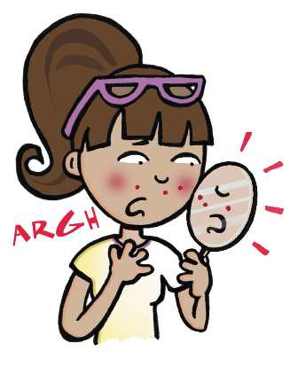
SKIN: Care
What are some ways to care for your skin? Good hygiene practices include:
Wash with soap daily
Don’t touch your face
Don’t pick/pop pimples
Change your pillow case

