Slide 1
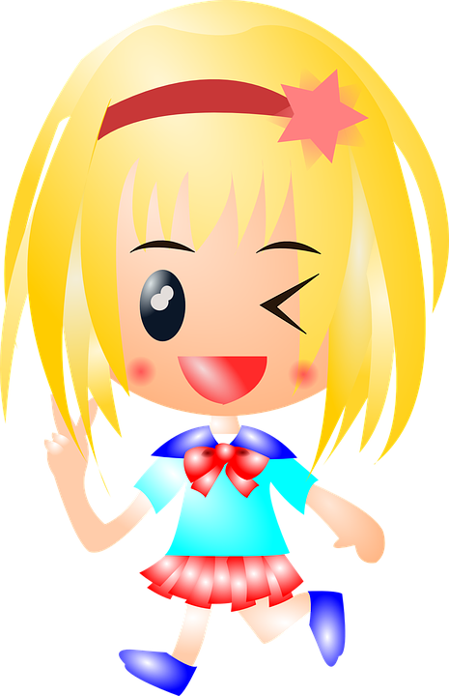
All About Me
Healthy Relationships
Let’s Learn about Health
3rd Grade

Slide 2
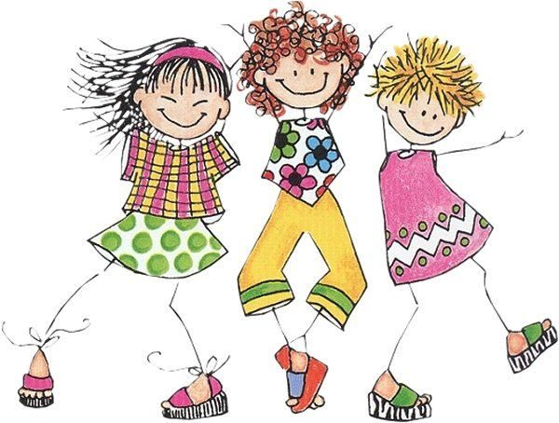
Positive Peer Relationships

Slide 3
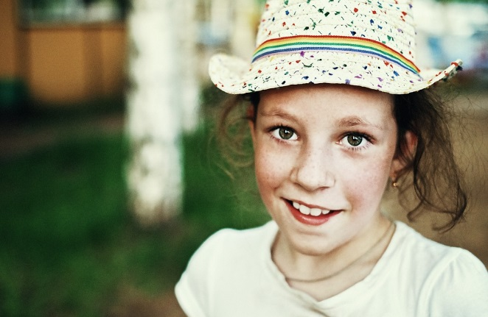
What Should I do?
It’s the beginning of second semester, and I love 3rd grade. It was tough at first, but I’ve made a lot of friends and my teacher is great. Today, we have a new student. Her name is Victoria, and Ms. McCarley put her seat next to mine. I can tell from her face she is nervous and her body is slumped in her seat. I’ve changed school mid-year before, so I know the feeling. I’m going to say hi to her and invite her to play with me on the playground.
I say “Hi.” Her eyes shutter back and forth. She says, “Hello” but is not looking at me. Something is not right with her eyes. Can she play on the playground? Should I even ask her to play?
What should I do?

Slide 4
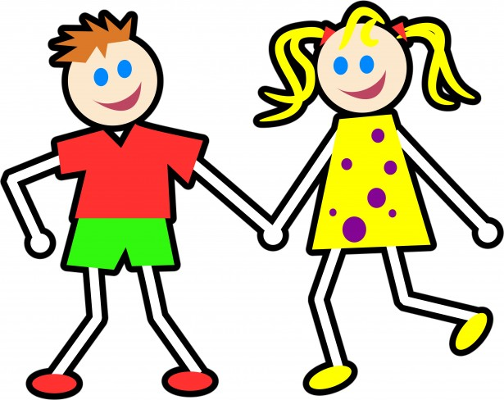
Positive Relationships
Respect, Kindness, & Empathy
Listen to the story and think about how you show respect, kindness, and empathy for other. What can you do to be a “bucket filler?”
https://www.youtube.com/watch?v=A5R6-2m_qHk
Questions:
1. How can you communicate respect to peers?
2. What does kindness look like, sound like, and feel like?
3. How can you show empathy for others?

Slide 5
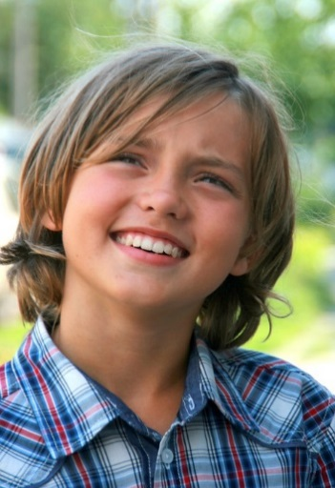
What Should I Do?
Today my mom announced that new neighbors would be moving in next door. I watched as a boy my age helped his family carry boxes. My mom encouraged me to go over and say hello, so I did. Jose seemed really nice and funny. I helped him carry boxes and we unpacked his legos and video games. I also found out Jose liked football. I love football! Having a friend like Jose next door was going to be so much fun…
As the day went on, I noticed a group of my neighborhood friends in Jack’s front yard throwing a football. Since Jose liked football, I invited him, which turned out to be a mistake. While Jose likes football, he is not good at it. All my friends laughed at him and no one wanted him on their team. I was really excited about our friendship, but I’m not sure anymore. Is Jose what I want in a friend. What should I do?

Slide 6
Characteristics of a Friend
Discussions Questions:
What qualities do you want in a friend?
Think of a situation that you were in that was similar to the story about Jose. How did you respond? Did your response have a positive or negative impact on your relationship with your friend?
Read the following statements and decide if it is a quality of a healthy relationship and positive interaction between friends. Your friend says to you…
“If you don’t want to hang out with me at recess, I’m not coming over to your house today.”
“I can’t believe you still like to cook with your mom. I did that when I was in kindergarten.”
“I’m sorry I hurt your feelings. I didn’t mean to.”
“If you were my friend, then you would want to be on the same team as me.”

Slide 7
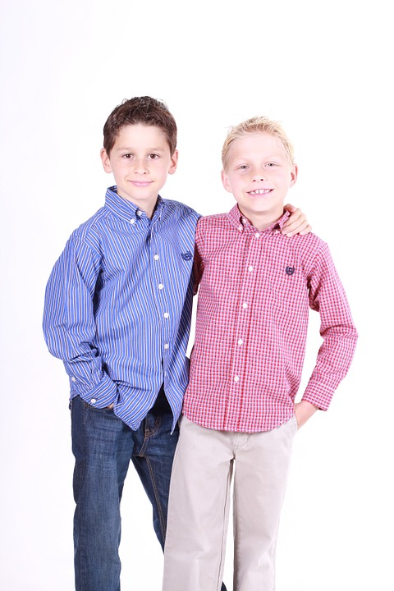
Qualities and Benefits of a Healthy Relationship
Qualities of a Healthy Relationship:
Accept you for who you are
Honest
Good communication
Fun to be around
Positive influence in your life
Others?
Benefits of a Healthy Relationship
Increase happiness
Increase self-confidence and self-esteem
Help you cope with struggles
Create fun and happy memories
Others?

Slide 8
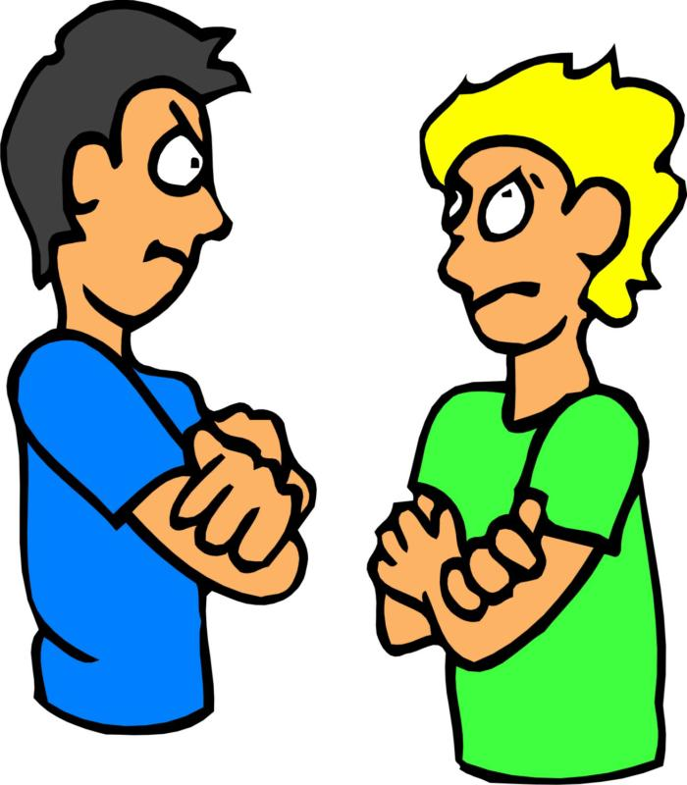
Conflict among Friends

Slide 9
What Should I Do?
Imagine you are in one of the following three scenarios:
I’m so lucky that my best friend lives in my neighborhood. We have been friends since kindergarten. However, I am sporty, and she is not. I like to play outside, and she likes to play inside. Today is a beautiful day and I want to be outside, but she would rather do art inside. I believe that I am right because it is such a beautiful day, and she believes that she is right because the wind will blow away her art papers. We begin to argue on what to do. What should I do? What should I say?
I love to play two hand touch football during recess. The game is tied and there is only 5 minutes left of recess. The other team has the ball. Johnny runs for a touchdown, but I touch him (I think) before he crosses the line. Johnny yells “Touchdown. We won!” I yell “I touched you. Don’t lie.” I’m so mad... What should I do? What should I say?
I love sports and my favorite color is blue. My best friend loves art, music, and her favorite color is pink. This year, we are in the same class, and it’s a lot of fun most of the time. Lately, my best friend has put pressure on me to sit and talk with her at recess rather than play sports with my other group of friends. What should I do? What should I say?

Slide 10
Effectively and Respectfully Expressing a Different Opinion
Think of a time when you had a different opinion than someone else.
Did the other person respect your opinion? If not, how did that make you feel?
Did you respect their opinion? If not, how did you try to change their mind?
How can you respectfully disagree with someone?
Watch the video, A Bad Case of Stripes, and think about the following questions: https://www.youtube.com/watch?v=pTJJjabqzns
Have you ever decided not to do something that you like because you were afraid someone would make fun of you?
Is it okay for you to like something that your friends do not?

Slide 11
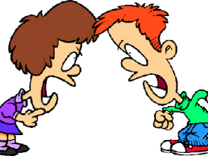
Loss of a Friend
Think about your friendships over the years. What negative behaviors could cause a friendship to fail?

Slide 12
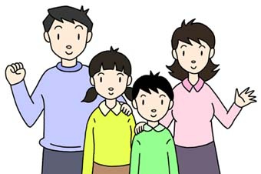
Positive Family Relationships

Slide 13
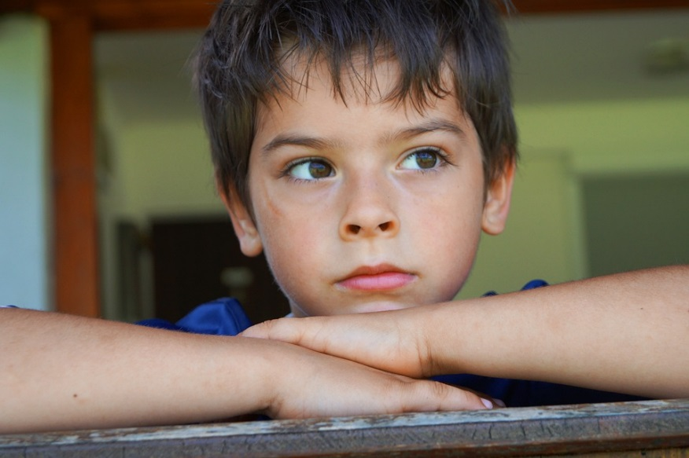
Can You Help Me?
As a 3rd grader, I get homework every night. It takes me longer to do my homework than my friends in the neighborhood. Today, I’m watching my friends play through the window, and I’m stuck inside. I can feel the anger boiling inside. I ask my mom if I can go play and she states, “Finish your homework first.” I’m so mad that I yell, “You are so unfair and so mean to me...”
I wish I can take back my word but I can’t. Mom mom is not unfair or mean. Can you help me change my words to positively communicate to my mom that I need a break from my homework?

Slide 14
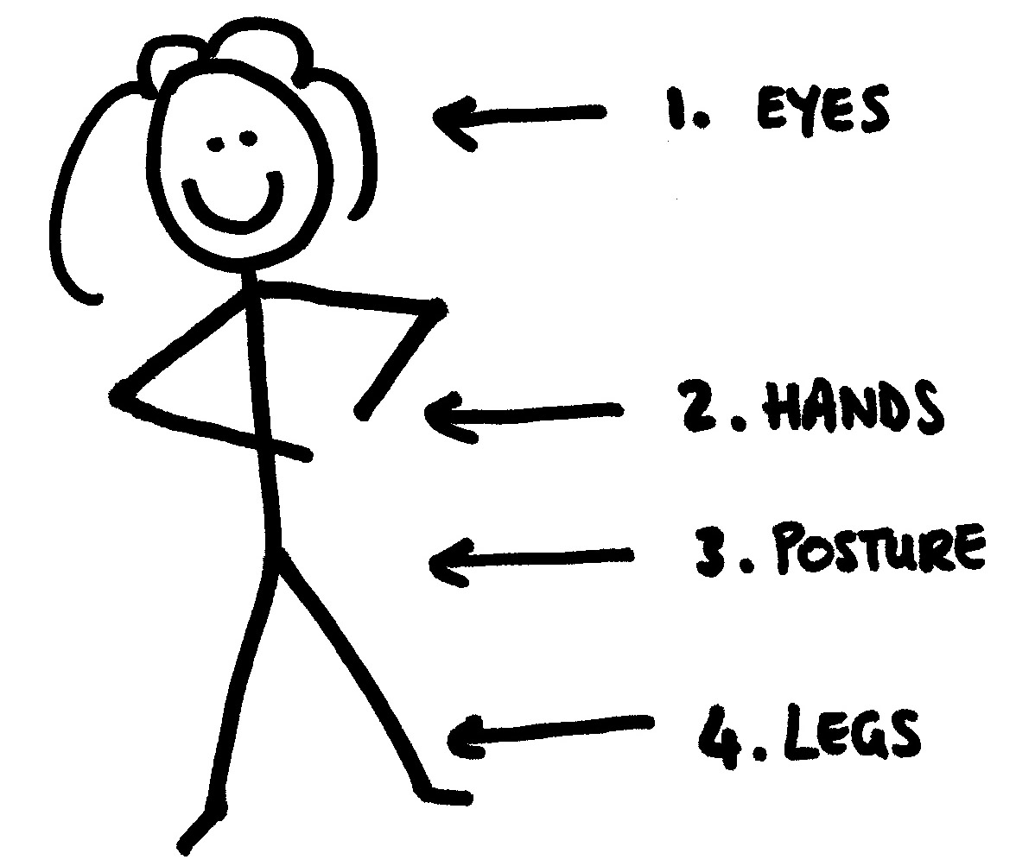
Positive Interactions with Family
Think about how you communicate with your family. Is it positive or negative?
What are examples of positive communication?
What are examples of negative communication?
How can your body language show respect for family members?

Slide 15
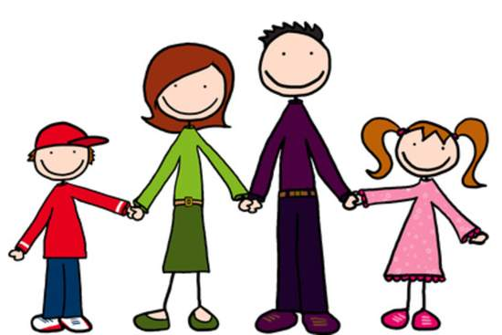
Benefits of a Positive Relationship with Family
Why is it important to have a positive relationship with your family members?

Slide 16
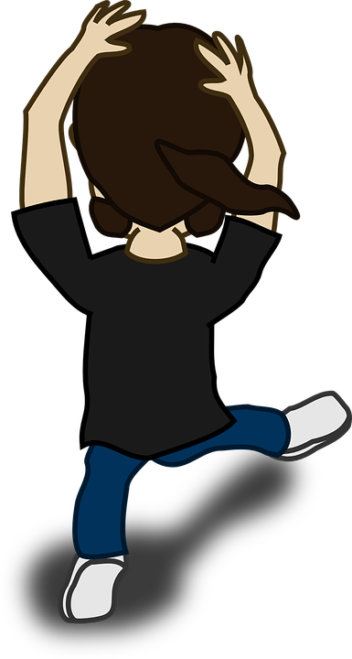
Let’s Move!
https://www.youtube.com/watch?v=neGpgxcJdY8

Slide 17
The End
Take Care of Your Health

